Slide 1
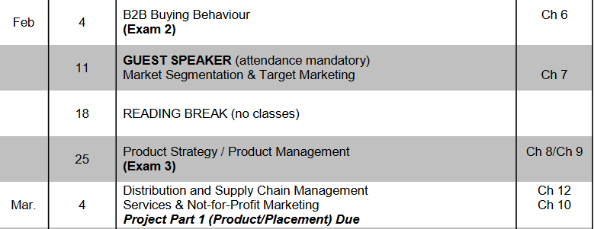
TODAY
READING BREAK
WRITING QUIZZES
NEXT EXAM (3): Thursday after Reading Break
Chapters 7, 8/9 (Tuesday)

Slide 2
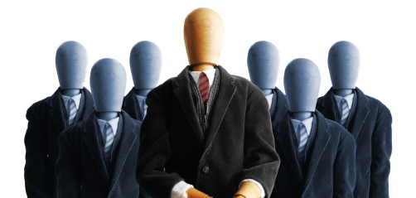
Market Segmentation and Target Marketing
CH 07
Notes:
Review some of the chapter highlights

Slide 3
What does it mean to ‘segment’ a market?
To divide a large market into smaller segments (or targets) based on common need and/or similar characteristics.
Notes:
With marketing segmentation the goal is to reach customers effectively.
The marketer concentrates on segments of the population by marketing different products to segments with different characteristics.
A market was defined as a group of people having a similar need for a product or service, the resources to purchase the product or service, and the willingness and ability to buy it.

Slide 4
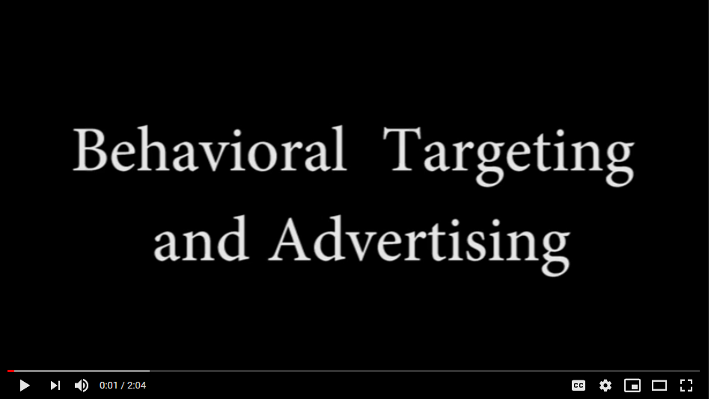
Notes:
https://www.youtube.com/watch?v=phDTLJTLSqo
BEHAVIOURAL TARGETING USED FOR DIRECT SEGMENTATION (1:1)

Slide 5
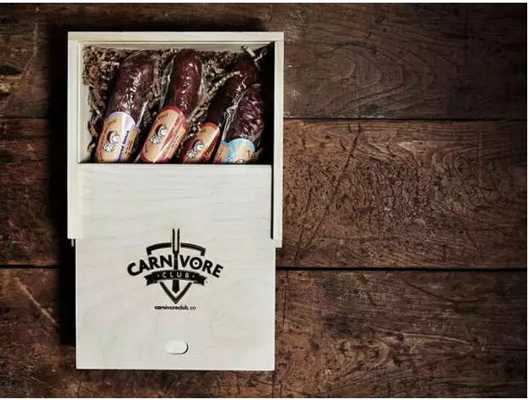
Notes:
SEASON 9, EPISODE 9 – THE CARNIVORE CLUB
Watch DD video; Market segments and Marketing Activity (Things you need to understand…)
https://business.financialpost.com/entrepreneur/founder-of-foodscrooge-hits-second-home-run-in-the-den-with-carnivore-club

Slide 6
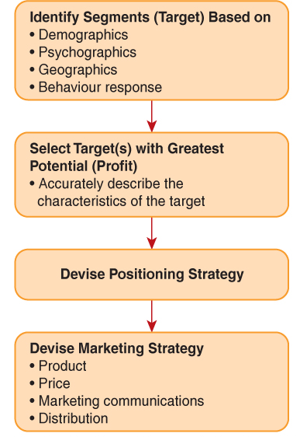
Segmentation and Targeting Process
Notes:
Fig. 7.22

Slide 7
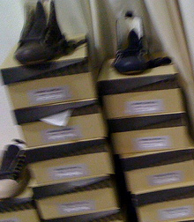


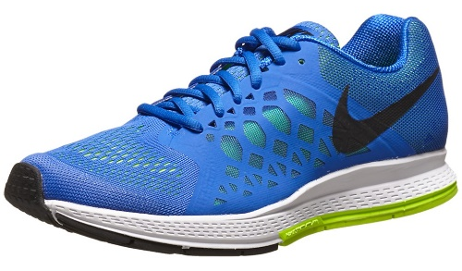
The 4 Basic Segmentation Alternatives
1. Mass Marketing One marketing strategy appeals to a broad range of consumers. Distinct characteristics of consumers are not considered when devising strategies. | 2. Market Segmentation Unique marketing strategies are devised based on the unique characteristics of specified customer groups. | 3. Niche Marketing Unique strategies are devised for a particular segment of a bigger market. All marketing strategies are dedicated to this one particular segment. | 4. Direct or One-to-One Segmentation Unique marketing strategies are devised for the unique needs and preferences of individual customers.
Figure 7.3
Notes:
Walmart and Amazon are two powerful examples of mass marketing
Just ‘shoes’ to cover my feet
Segment: hiking boots
Niche ballet or tap or army boots…
Individual customers – custom Nike runners

Slide 8
Direct Segmentation
Geo-targeting - customizing an ad based on the geographic location of potential buyers (country, province, city, or postal code).
Location-based Targeting - an effort to integrate consumers’ location information into their marketing strategy
Mass Customization - produce products and personalize messages to a target audience of one.
Brand Democratization - customer can interact with a brand, giving customer control over the marketing of a brand.

Slide 9
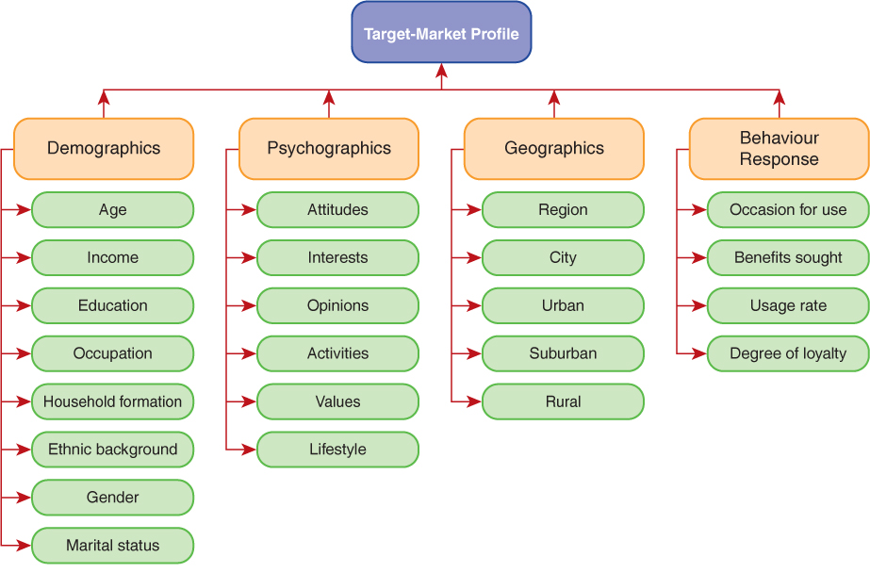
Identifying Target Markets: Variables
What are some key trends?
Notes:
Marketers evaluate social and demographic trends to identify new marketing opportunities.
FIG 7.7 Key trends include:
Aging Population
Social Responsibility
New Household Formations
Ethnic Diversity

Slide 10
Gender Segmentation
Within the context of the average Canadian family:
Women drive an estimated 70-80% of consumer spending
About 75% of women identify themselves as the primary shopper in the household
Women influence about 85% of consumer spending
91% of women felt advertisers didn’t understand them
Gabe Rosenberg, “Study: 91 percent of women feel misunderstood by advertisers,” https://contently.com

Slide 11
Ethnic Segmentation
Visible minorities represent 20% of Canadian population; by 2031 this figure will reach 30%
In Toronto, visible minorities make up 49.1% of the population; in some surrounding cities such as Markham and Brampton, this number exceeds 65%
This is an emerging trend in urban areas across Canada making ethnic marketing a smart strategy for many companies

Slide 12
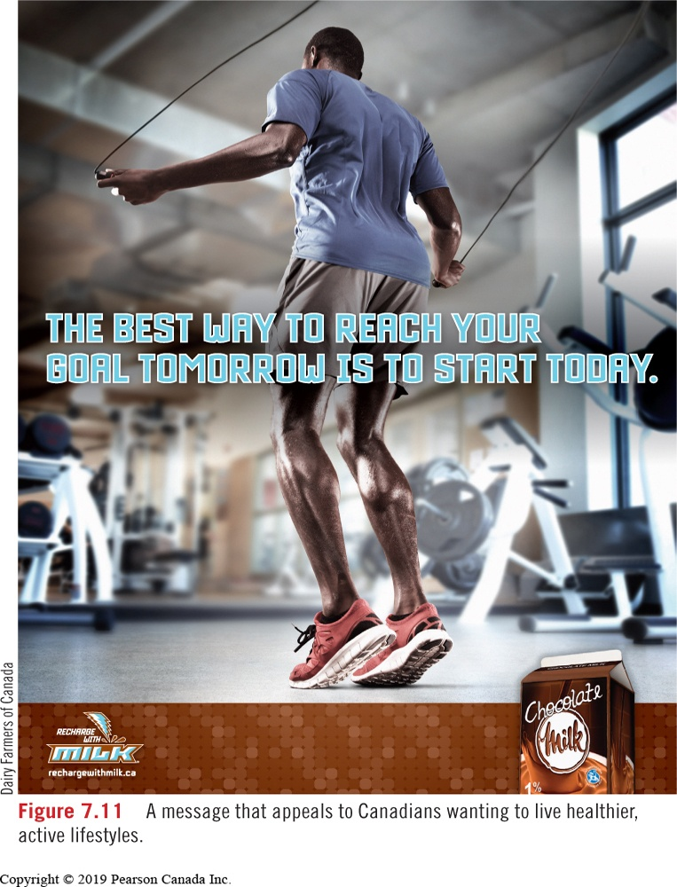
Psychographic Segmentation
Market segmentation based on the activities, interests, and opinions of consumers.
Lifestyle Marketing

Slide 13
Geographic Segmentation
The division of a large geographic market into smaller geographic or regional units
Geodemographic segmentation – a combination of geographic and demographic information
Micro-marketing – based on a regional or local basis, giving consideration to the unique needs of a small group of highly targeted customers

Slide 14
Positioning
“The place a brand occupies in the customer’s mind in relation to competing products.”
In a marketing plan, how a brand is positioned is described in a positioning strategy statement.
Brand Leadership
Focus on consumer acceptance
Focus on continuous technical leadership
Technical Innovation
Product Differentiation
Focus on unique attributes / benefits
Lifestyle
Focus used in crowded markets with similar brands.
Notes:
- Leaders in market share often advertise in a manner that shows why the brand is highly acceptable to consumers.
- A strategy that focuses on the unique attributes or benefits of the product.
- A strategy that demonstrates continued technical leadership in a product category.
- In crowded markets where brands are similar, marketers develop communications based on the lifestyle of the target market.

Slide 15
Have a great break!

Slide 16
How Internet Advertisers Read Your Mind
The Economist
Notes:
https://www.youtube.com/watch?v=8KYugpMDXAE
(7:25)

