Slide 1
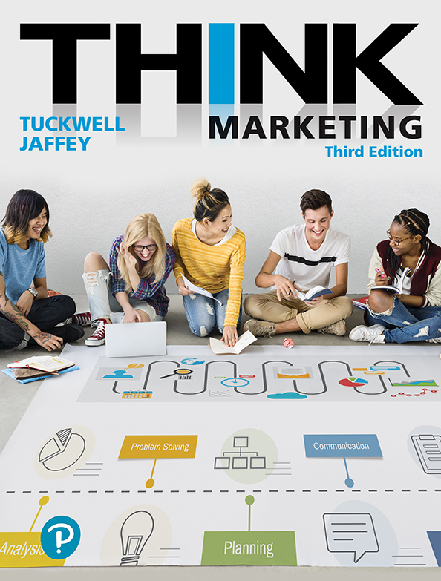
Think Marketing
Third Edition
Chapter 7
Market Segmentation and Target Marketing
Copyright © 2019 Pearson Canada Inc.
Notes:
If this PowerPoint presentation contains mathematical equations, you may need to check that your computer has the following installed:
1) MathType Plugin
2) Math Player (free versions available)
3) NVDA Reader (free versions available)

Slide 2
Learning Objectives
Explain market segmentation and differentiate among the different forms of market segmentation.
Describe the process used and information needed to identify and select target markets.
Explain the concept of market positioning and its role in contemporary marketing practice.

Slide 3
Levels of Market Segmentation
Marketers choose among four basic segmentation alternatives:
Figure 7.3 The Levels of Market Segmentation
1. Mass Marketing One marketing strategy appeals to a broad range of consumers. Distinct characteristics of consumers are not considered when devising strategies. | 2. Market Segmentation Unique marketing strategies are devised based on the unique characteristics of specified customer groups. The customer groups are identified based on similarities in demographics, psychographics, geographics, and behaviour responses. | 3. Niche Marketing Unique strategies are devised for a particular segment of a bigger market. All marketing strategies are dedicated to this one particular segment. | 4. Direct or One-to-One Segmentation Unique marketing strategies are devised for the unique needs and preferences of individual customers.

Slide 4
Mass Marketing
The use of one basic marketing strategy to appeal to a broad range of consumers, not addressing any distinct characteristics among the consumers.
Walmart and Amazon are two powerful examples of mass marketing

Slide 5
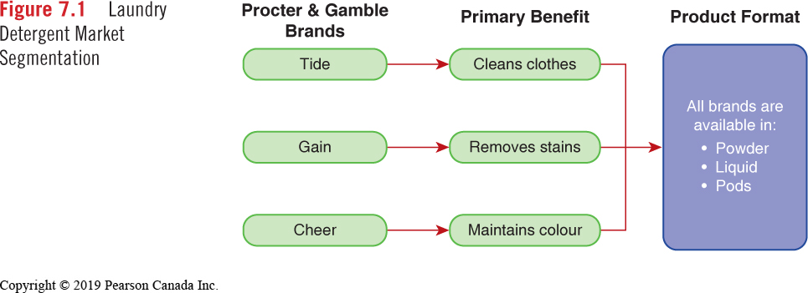
Market Segmentation
“The division of a market into smaller markets based on similar needs, characteristics or lifestyles.”

Slide 6
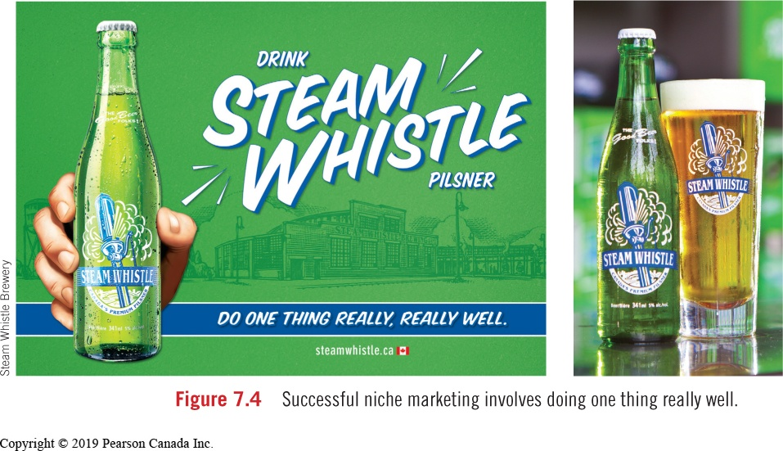
Niche Marketing
Targeting a product line at one particular segment of the market

Slide 7
Direct (1:1) Segmentation
A situation in which unique marketing programs are designed specifically to meet the needs and preferences of individual customers.
Behavioural Targeting
Reaches mass audiences via Internet, direct mail text and video messaging and is now used more often than traditional media

Slide 8
Direct Segmentation (1 of 2)
Marketers can target customers individually based on where they live:
Geo-targeting
customizing an advertisement for a product or service to a specific market based on the geographic location of potential buyers (country, province, city, or postal code).
Location-based Targeting
an effort to integrate consumers’ location information into their marketing strategy

Slide 9
Direct Segmentation (2 of 2)
Mass Customization
The creation of systems that can produce products and personalize messages to a target audience of one.
Brand Democratization
A situation in which the customer can interact with a brand, giving the customer some control over the marketing of a brand

Slide 10
Identifying Targets
Marketers evaluate social and demographic trends to identify new marketing opportunities.
Key trends include:
Aging Population
Social Responsibility
New Household Formations
Ethnic Diversity

Slide 11
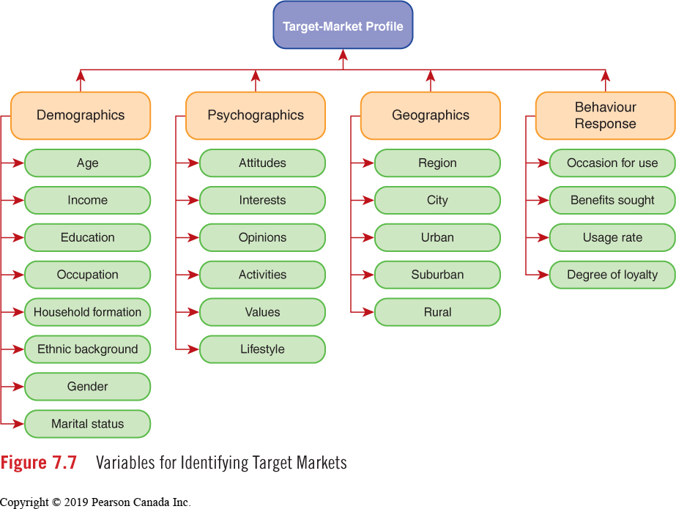
Variables for Identifying Target Markets

Slide 12
Demographic Segmentation (1 of 2)
Characteristics
Age
Income
Education
Occupation
Household Formation
Ethnic Background
Gender
Marital Status
Marketers monitor demographic trends and adjust marketing strategies appropriately.

Slide 13

Demographic Segmentation (2 of 2)
The Acura RLX appeals to a target customer described as managerial or professional, with higher education and a healthy income.

Slide 14
Gender Segmentation
Within the context of the average Canadian family:
Women drive an estimated 70-80% of consumer spending
About 75% of women identify themselves as the primary shopper in the household
Women influence about 85% of consumer spending
91% of women felt advertisers didn’t understand them
Gabe Rosenberg, “Study: 91 percent of women feel misunderstood by advertisers,” https://contently.com

Slide 15
Ethnic Segmentation
Visible minorities represent 20% of Canadian population; by 2031 this figure will reach 30%
In Toronto, visible minorities make up 49.1% of the population; in some surrounding cities such as Markham and Brampton, this number exceeds 65%
This is an emerging trend in urban areas across Canada making ethnic marketing a smart strategy for many companies

Slide 16
Psychographic Segmentation
Market segmentation based on the activities, interests, and opinions of consumers.

Slide 17
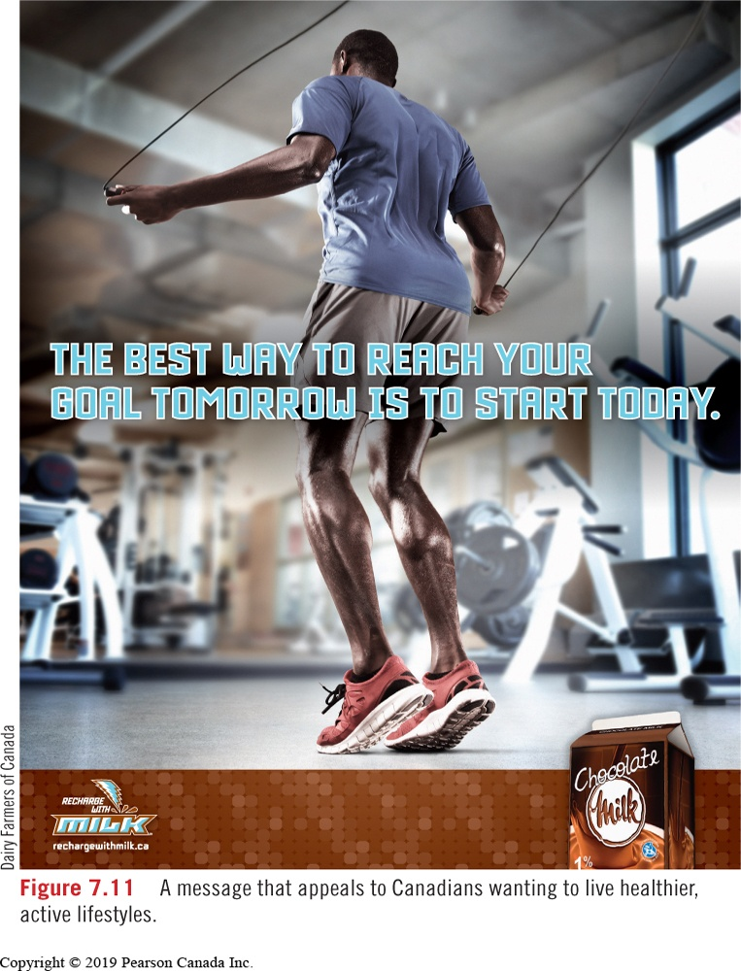
Lifestyle Marketing

Slide 18
Geographic Segmentation
The division of a large geographic market into smaller geographic or regional units
Geodemographic segmentation The isolation of dwelling areas through a combination of geographic and demographic information
Micro-marketing The development of marketing strategies on a regional or local basis, giving consideration to the unique needs of a small group of highly targeted customers

Slide 19
Behaviour Response Segmentation (1 of 2)
The division of buyers into groups based on certain behaviour patterns.
Occasion for Use
Associating products with special occasions.
Example: Valentine’s Day, Mother’s Day
Benefits Sought
Different consumers gratify different needs when purchasing a product.
Example: Post Shredded Wheat satisfies one’s health needs while Post Alpha-Bits or Sugar Crisp appeals to those with a sweet tooth.

Slide 20
Behaviour Response Segmentation (2 of 2)
Usage Rate
The characteristics of “heavy” users may be different from “medium” or “light” users.
Example: Young males are heavy beer drinkers; that’s why brands like Coors Light, Budweiser, and Molson Canadian devote so much attention to them.
Loyalty Response
The characteristics of brand loyal customers are identified; marketers devise strategies to attract people with similar profiles.

Slide 21
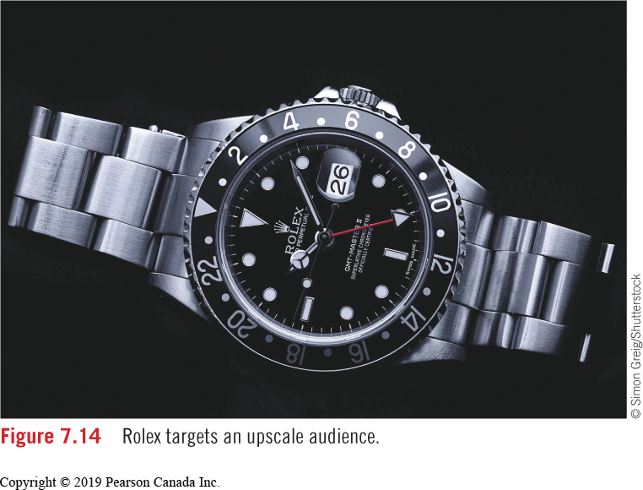
Targeting: Applied
Target Profile:
Demographic
35 – 49 years old
Male or female
$100,000+ annually
Executives, owners, professionals
Cities over 500,000 population
Psychographic
Progressive thinkers and risk takers; interested in the arts and adventure travel
Behaviour Response
Attracted to brands based on heritage, image and reputation

Slide 22
Positioning (1 of 2)
“The place a brand occupies in the customer’s mind in relation to competing products.”
In a marketing plan, how a brand is positioned is described in a positioning strategy statement.
Example: The core of Apple’s brand is innovation, beautiful design, and an ability to bring warmth and passion to those customers who may be averse to technical gadgetry, but need it nonetheless to survive in today’s world.
All marketing strategies must fit with the positioning strategy.

Slide 23
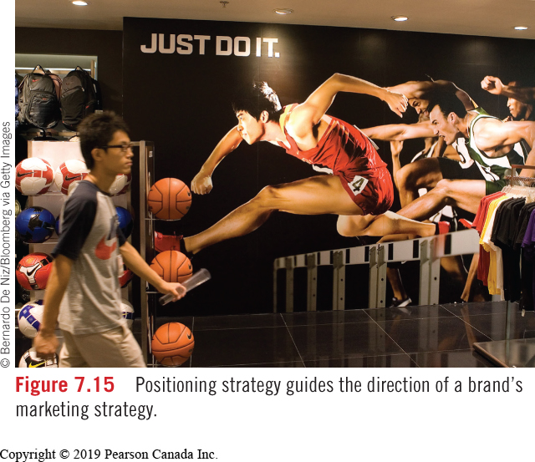
Positioning (2 of 2)

Slide 24
Head-On Positioning
The Pepsi challenge is the classic example of head-on positioning. Pepsi finds ways to show consumers preferring their beverage over Coca-Cola.
Apple established Macintosh computers by comparing them to PCs: “Hi I’m a Mac…and I’m a PC.”

Slide 25
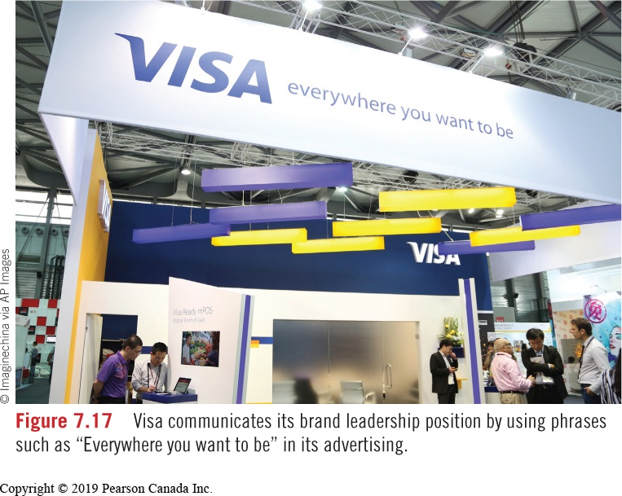
Brand Leadership Positioning
Leaders in market share often advertise in a manner that shows why the brand is highly acceptable to consumers.

Slide 26

Product Differentiation Positioning
A strategy that focuses on the unique attributes or benefits of the product.

Slide 27

Technical Innovation Positioning
A strategy that demonstrates continued technical leadership in a product category.

Slide 28
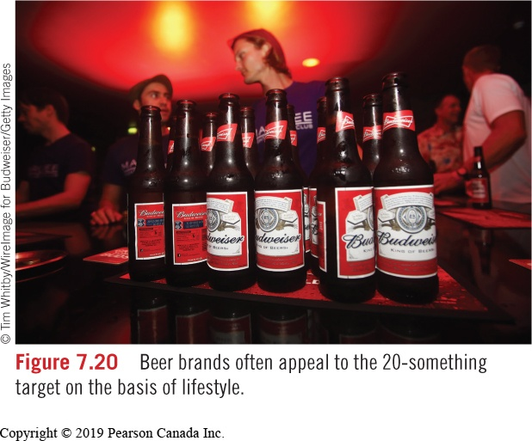
Lifestyle Positioning
In crowded markets where brands are similar, marketers develop communications based on the lifestyle of the target market.

Slide 29
Repositioning
Changing the place a brand occupies in the consumer’s mind, relative to competing products.
Repositioning may occur when:
The actions of a direct competitor change
The preferences of the target market change

Slide 30
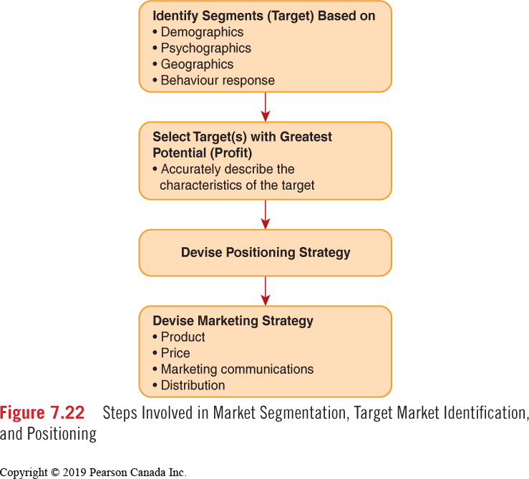
Segmentation and Targeting Process

