Slide 1

Think Marketing
Third Edition
Chapter 6
Business-to-Business Marketing and Organizational Buying Behaviour

Slide 2
The B2B Market
“Individuals and organizations that acquire goods and services that enter into the production of other goods and services that are sold or supplied to others.”
Notes:
5 Customer Types that make up B2B
WHO CAN NAME ALL 5

Slide 3
B2B Market Characteristics
Fewer buyers in B2B compared to consumer markets.
Business markets tend to concentrate by area.
Decisions are influenced by derived demand and joint demand.
Buying criteria are practical.
Notes:
Derived demand: driven by consumer demand
Joint demand: product production & marketing dependent on another.

Slide 4
Consumer or Business Characteristic?
Products are purchased less frequently.
Distributors are offered a list price and a series of discounts.
Extensive price negotiation.
Personal Selling centric.
Increasing Mass advertising focus.
Individuals influence buying decision.
Formalized purchase decision process.
Distribution mainly manufacturer to wholesaler to retailer to purchaser.
Notes:
1-B, 2-C & B, 3-B, 4-B, 5-B, 6-C, 7-B, 8-C
Page 131 table

Slide 5
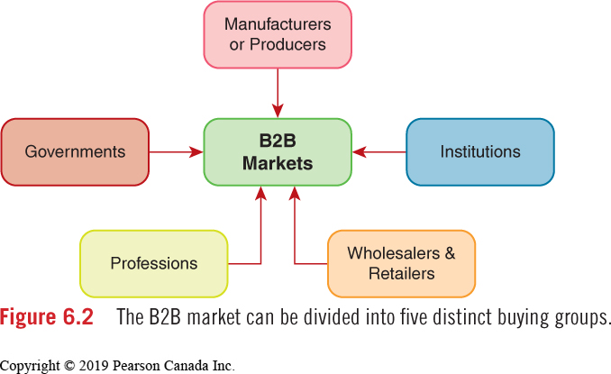
B2M Market Composition

Slide 6

Partnership Marketing
“A process that involves cooperation and collaboration among members of a channel of distribution that do business with one another.”
Notes:
The partners are part of a supply chain management system.
The goal of the partnership (supply chain) is to make all participating members more efficient in their operations.
https://youtu.be/a92_mZemYqs
INTERFACE VIDEO
http://www.interface.com/EU/en-GB/about/index/Mission-Zero-en_GB

Slide 7
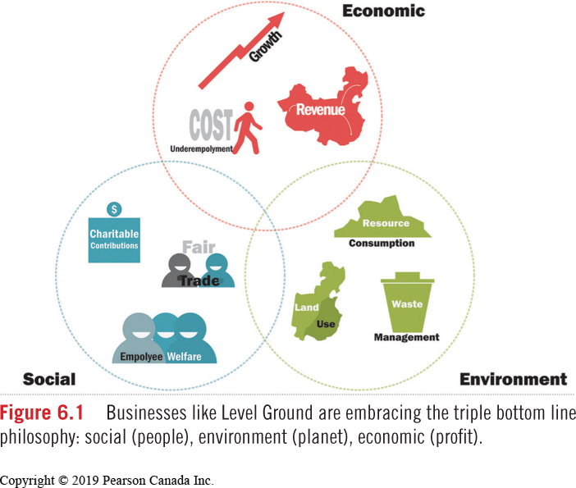
B2B 3BL
Notes:
Why is the triple bottom line important to business?

Slide 8
Buying Criteria
Vendor Analysis: Evaluate potential suppliers based on
  Technological ability
  Consistency in meeting product specifications
  Delivery
  Ability to provide needed quantity, and price.
B2B buying decisions are practical in nature. Buyers evaluate competitor offerings based on:
  Price
  Quality
  Service and Services Offered
  Continuity of Supply

Slide 9
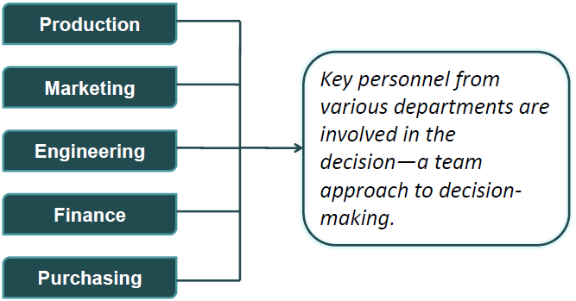
Formal Buying Process
Buying Committee
Notes:
A formal process involving members from across an organization who share responsibility for the purchase decision
Known as BUYING COMMITTEE

Slide 10
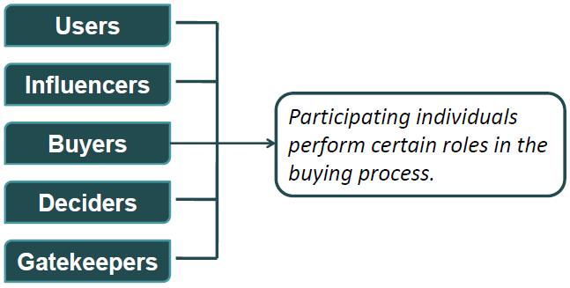
Informal Buying Process
Buying Centre
Notes:
An informal process where individuals perform particular roles but may not have direct responsibility for the purchase decision.
Known as BUYING CENTRE

Slide 11
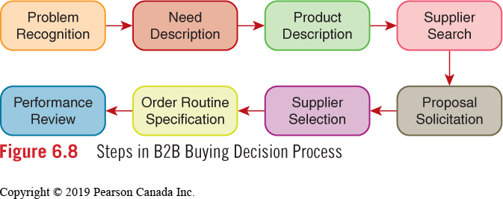
B2B Buying Decision Process

Slide 12
Centralized Purchasing
Buying in larger quantities from a central location results in better price negotiation.
Inventory requirements are based on electronically tracked daily sales.
Personal Characteristics
Personal relationships can play a role in B2B buying decisions.
New suppliers often find it difficult to crack the bond in an existing buyer-seller relationship.
Notes:
Walmart
Costco

Slide 13
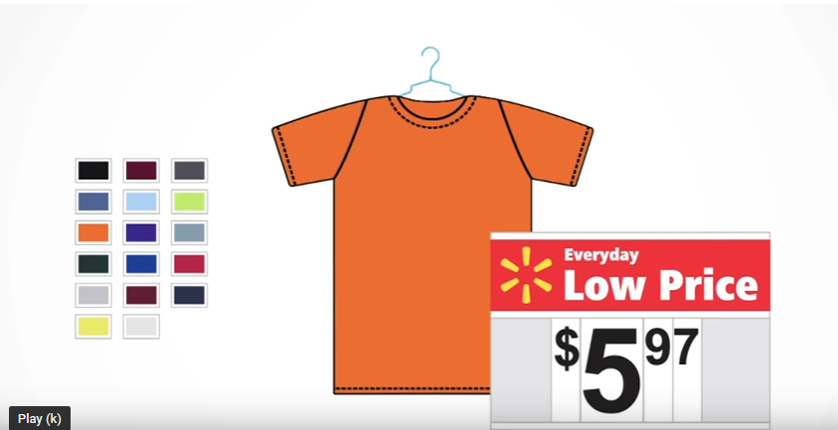
Amazon and Walmart
Disrupt the Grocery Industry
Notes:
WALMART: https://youtu.be/yZC4neLax5o
PAGE 132 – Amazon & Walmart disrupt the Grocery Industry
Code of Conduct for Grocery Industry in Canada? Agree or Disagree?
Why can Walmart (types) get away with their business practices? DERIVED DEMAND.
At what point will there be an upset to the equilibrium – consumers demanding (and willing to pay for) 3BL

