Slide 1


Marketing Intelligence
Chapter 4

Slide 2
Learning Objective
Define marketing research and identify the ways in which marketing research findings are used.
Outline the basic stages in the marketing research process.
Describe secondary data sources available to marketing organizations.
Explain the steps and methodologies used for collecting primary data.
Describe the role and impact of information collection on customer relationship marketing strategies.
Identify key issues associated with the collection and use of information about consumers.

Slide 3
Chapter Flashcard Challenge
Notes:
PRELOAD: Chapter Resources / Flashcards / definition first

Slide 4
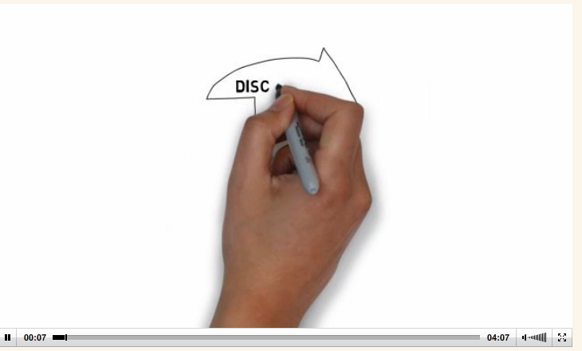
Many experts believe online research will replace the need for focus groups as well as methods for collecting quantitative information.
Pairs: discussion / research. Agree or Disagree?
Notes:
SKETCH VIDEO: (4 mins)
Many experts believe online research will replace the need for focus groups as well as methods for collecting quantitative information.
IN Pairs - think about whether experts are right. CAN conduct some quick secondary research on the issue in order to formulate a position on this trend.
Students then pair up with another student in the class and share their thoughts and positions on this issue. Debrief.
DEBRIEF: experts are probably right.
The Internet is a useful tool for conducting research panels along with extensive surveys of a quantitative nature.
Many organizations are doing online surveys to keep tabs on customer satisfaction and other marketing metrics.
Hotels like Holiday Inn, for example, now conduct their own email surveys (some take 15 minutes to complete) to evaluate recent guest experiences. Feedback helps keep individual hotel owners (franchisees) and managers on their toes!

Slide 5
Scope of Marketing Research
Market Analysis
Information about the marketplace.
Product Research
Information about how people perceive products.
Consumer Analysis
Information about the needs and motivations of consumers.
Notes:
Organizations tend to focus on three primary areas when conducting marketing research.

Slide 6
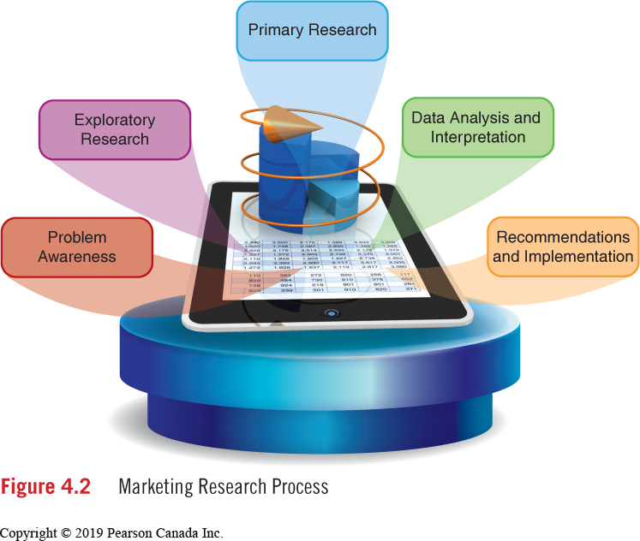
Marketing Research Process
Notes:
The problem must be precisely defined.
A typical research study will address a specific decision that must be made.
Exploratory research helps to define the problem.

Slide 7
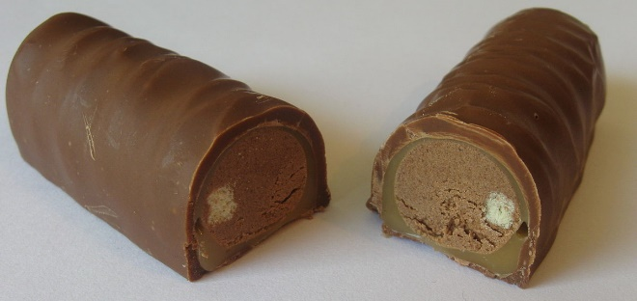
Cadbury Adams Canada
Evaluate the opportunity to launch a new chocolate bar in Canada: Boost
Competes in the “eat now” segment of chocolate marget; segment consists of regular size, thick and thin chocolate bars. Popular brands are Reese Peanut Butter Cups, Kit Kat, Caramilk, Oh Henry. High competition.
Boost offers a slightly higher level of glucose than most other brans; brand name and sugar content is distinguishing means.
Your Role: Develop a fundamental marketing research proposal that will uncover information to shed light on decision to proceed or not proceed with product.
Is there room in the market for another bar,
and who will the primary buyer be for this product?
Pg 100
Notes:
Cadbury Adams Canada – 3 Q’s on white board. GROUPS OF 3 OR 4
1. Both qualitative and quantitative research is required. Students should explain why, using the advantages of each type of research in their rationale.
2. A student's recommended sample design should follow these basic steps:
a) Define the population
b) Identify the sampling frame
c) Determine the type of sample
d) Determine the sample size
3. The main data collection method should be survey research. Students can debate the type of survey research to be conducted.

Slide 8
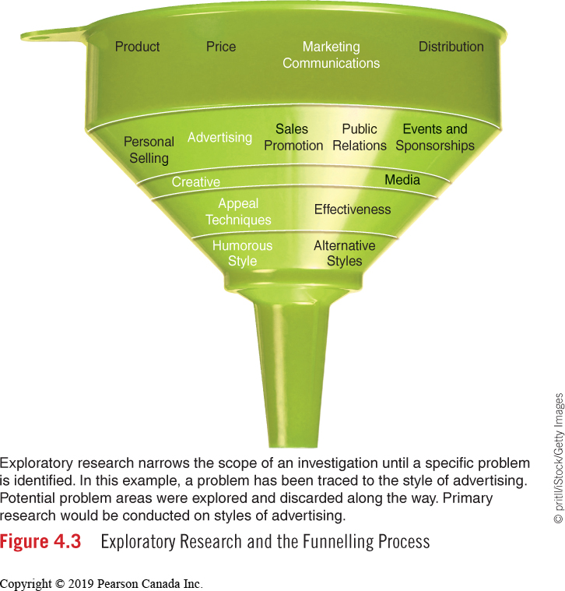
Exploratory Research and the Funneling Process
divide subject into manageable variables
Notes:
Exploratory Research clarifies the nature of a problem.
Funneling is the dividing of a subject into manageable variables so that specifically directed research can be conducted.
Situation analysis is the collecting of information from knowledgeable people inside and outside the organization and from secondary sources.

Slide 9
Secondary Data: Pros and Cons
Advantages
Information is inexpensive or obtainable at no cost.
Information is readily available.
Possibly the only source of information (e.g., census data).
Useful in exploratory research stage where information is assessed to identify a problem.
Disadvantages
The data do not resolve the specific problem under investigation (e.g., data were compiled for another problem or purpose).
Reliability and accuracy of data are questionable.
Information can be outdated, even obsolete, for the intended situation.
Information from an Online Database
Advantages
Data are available very quickly (on the spot).
Identification of relevant data occurs quickly.
Disadvantages
Amount of data available is overwhelming (discourages use of data).
Hidden costs associated with retrieval and distribution of data (e.g., cost per hour for computer time).
Figure 4.5 Secondary Data and Online Database Information
Notes:
Secondary data is data compiled and published for purposes unrelated to the specific problem under investigation, yet may have some impact on resolving the problem.
Internal Data Sources
External Data Sources

Slide 10
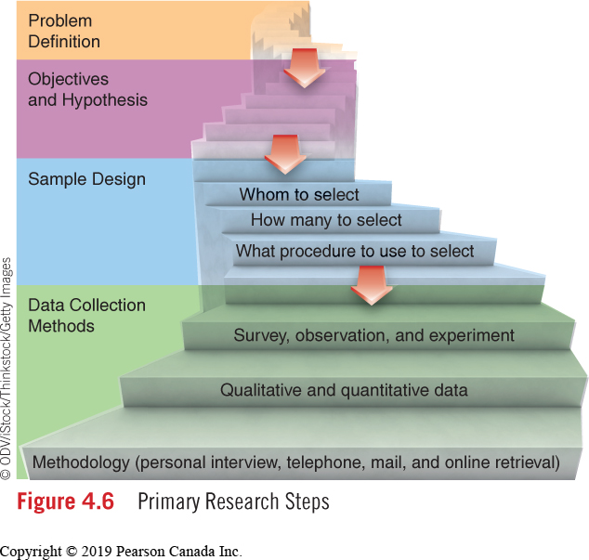
Primary Research Steps
Marketer Must:
Identify the precise nature of the problem.
Establish the objectives of the study
The hypotheses is confirmed or refuted by the collected data.
Notes:
Data collected and recorded for the first time to resolve a specific marketing problem.
In directing the marketing research, the marketer must:
Identify the precise nature of the problem.
Establish the objectives of the study
The hypotheses is confirmed or refuted by the collected data.

Slide 11
Sample Design
Define Population (Universe)
Identify Sampling Frame
Determine Type of Sample
Determine Sample Size
Population – a group of people having certain age, gender or other demographic characteristics.
Sampling Frame – A listing that can be used for reaching a population.
Type of Sample – Either a probability sample in which respondents have a known and equal chance of being selected or non-probability sample in which respondents have an unknown chance of selection.
Sample Size – determining how many respondents are required to produce accurate results.
Notes:
A representative sample is essential in order to produce valid and reliable data.
The key terms involved with sample design include:

Slide 12
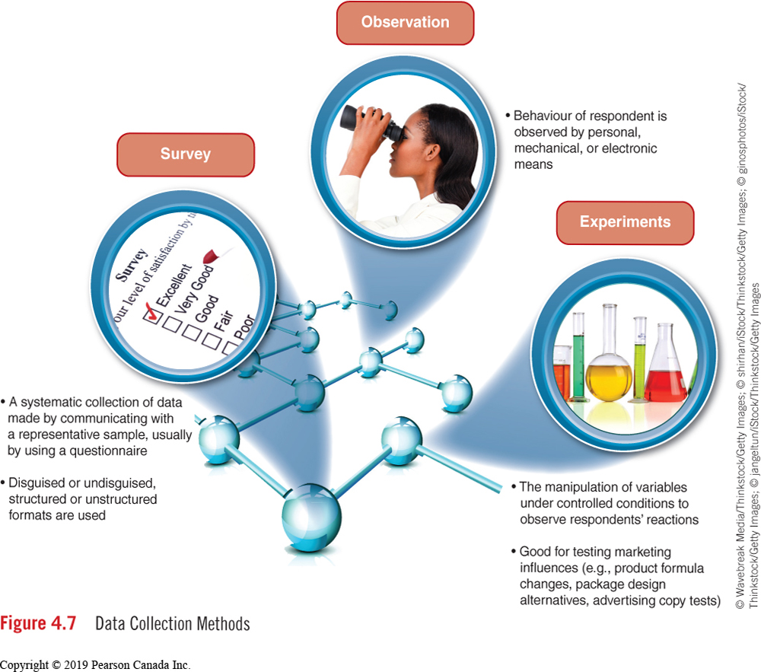
Data Collection Methods
Notes:
3 primary methods to collect data: surveys, observation, experiements
Ethnography?

Slide 13
Qualitative vs. Quantitative?
Qualitative Research
Collected from a small sample group
Question format is unstructured
Questions deal with why people act, do, purchase, etc.
Small sample poses reliability (of data) problems
Quantitative Research
Collected data from a truly
representative sample (e.g., 200–300 people who represent a specified target market)
Structured format (e.g., questionnaire with predetermined responses) is common
Questions deal with “what,” “when,” “who,” “how many,” and “how often”
Data are statistically reliable; degree of error can be calculated
? Data collected from small samples in a controlled environment (e.g., a focus group).
? Data collected from large samples. Analysis and interpretation rely on numbers and percentages obtained from data collected from a structured questionnaire.
attitudes vs. who, what, when,
how many, how often
Figure 4.9 Comparing Qualitative and Quantitative Research
Notes:
“Focus” implies the discussion concentrates on one topic or concept. Interviews reveal “attitudes” held by consumers.
Focus groups are now held online; an environment where control is in the hands of the participant.
The feelings, attitudes, and opinions obtained from focus groups are quantified.
Quantitative data provide answers to questions concerned with “what,” “when,” “who,” “how many,” and “how often.”

Slide 14
Survey Methodology
Personal Interview
Which option to use depends on:
Nature of information sought
Cost and time constraints
Location of respondent
Telephone
Mail
Online
Notes:
Pros’ and Con’s to each type of survey methodology
Q: Low Response rates? Mail surveys
Q: Higher rates of participation? Personal Interview
Q: Respondent authenticity concerns? Online
Q: Costs less? Telephone

Slide 15
Data Transfer and Processing
Editing
Questionnaires are reviewed for consistency and completeness.
Responses to questions are transferred to a computer (if from a paper-based interview).
Data Transfer
Responses are counted for each question producing a frequency distribution. Numerous cross-tabulations are also made (analysis by demographic characteristic.
Tabulation
Notes:
Once data have been collected, editing, data transfer, and tabulation take place:

Slide 16
Data Analysis & Interpretation
Data Analysis
An evaluation of each question to record observations.
An assessment of accumulated data in relation to the problem, objectives, and hypotheses of the study.
Interpretation
Notes:
Based on the analysis and interpretation of data, certain courses of action are recommended.
Independent research companies typically present a summary of their research findings to a client in a presentation format and provide a detailed written report which covers the entire research process.

Slide 17
Information Collection and Consumer Privacy
In the age of technology, retailers can develop an individual customer profile and deliver offers of interest to that individual. It is an efficient way to market.
CRM - to devise efficient marketing strategies that will attract customers, retain customers, and extend the value of customers over the lifetime of the relationship
Personal Information Protection and Electronic Documents Act (PIPEDA) offers a list of guiding principles for businesses to follow.

Slide 18

Thursday: Chapter 5 – Consumer Buying Behaviour

Slide 19
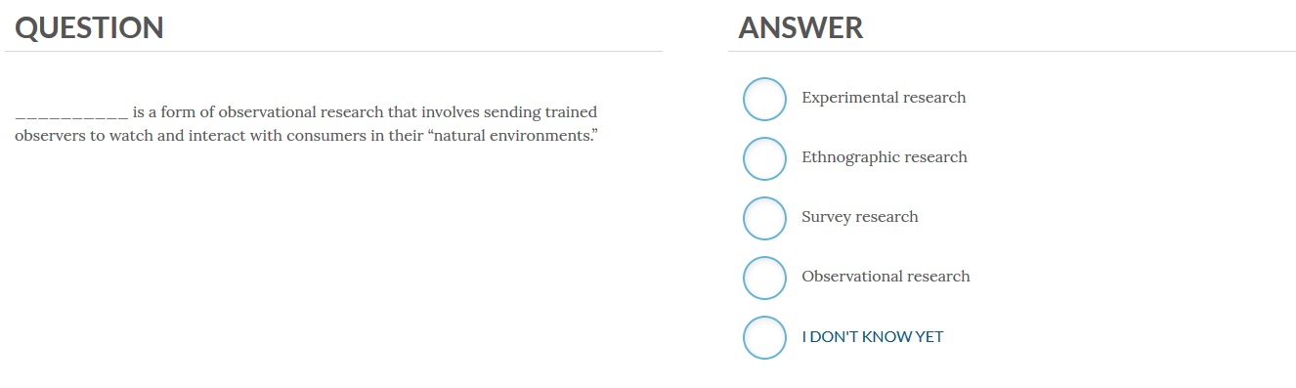
Pairs: go online to Dynamic Study Module
Notes:
ONLINE: DY NAMIC STUDY MODULE (handout)

