Slide 1
THURSDAY JAN 24
AGENDA
Exam 1 Review
Term Project
  Assignments and Evaluation
  Individuals and Pairings
Part 1 working time
Next Class

Slide 2
Exam 1: External Marketing Environment & Strategic Planning
Average grade = 68%
Highest grade = 94%

Slide 3
Chapter 4 questions (2)
+ 2 to everyone’s grade (if you answered correctly you received a bonus!)
Multiple answer questions (4)
.5 if you got ½ of proper answer
I will not be keeping that format for future.

Slide 4
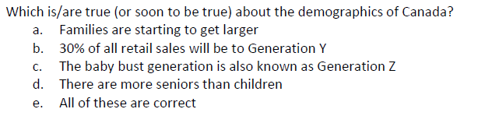
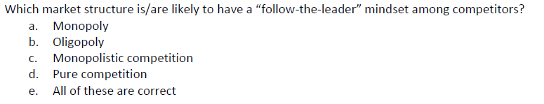
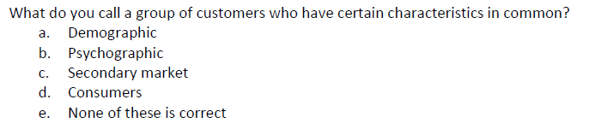
Social / Cultural
nicname
Market segment
Notes:
- 7 of you (41%) got both B and D correct; 8 B only and 14 D only
11 (25%) got B correct;
10 (23%) get E correct. What is the correct answer?

Slide 5
Next Exam #2
Thursday, February 7
Chapter 4 – Marketing Intelligence
Chapter 5 – Consumer Buying Behaviour
Chapter 6 – B2B Buying Behaviour
Exams worth 50% of Final Grade
Exam #5 – Pricing – 10%
Exams #1, 2, 3, 4, 6 – lowest grade dropped; remaining averaged – 40%
Must achieve minimum 50% on final (averaged) Exam grade to pass course
Communication with Pamela
Notes:
Electronic communication – STATE COURSE & SECTION – BUAD 116 is enough this term, but GOOD HABIT is to include section for ALL PROFS.

Slide 6
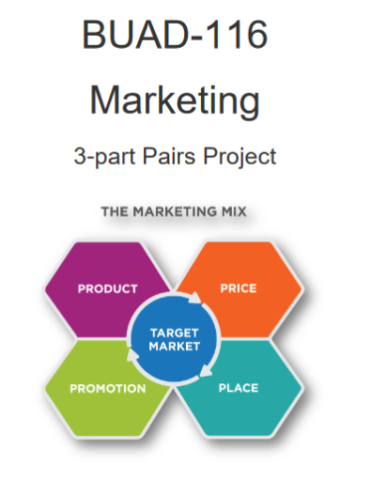
Term Project

Slide 7
Project Pairings
Individual grade
Pairs Project – workshare notations
Preliminary Pairings as noted:
  Find your partner
  If not here, may re-assign
Due Dates (changed) *revised schedule on Moodle
  Part 1: March 7th
  Part 2: March 21st
  Part 3: Sunday April 7th
Ample working time (scheduled class times) after Exams
Notes:
Workshare: if shared equally, mark 50/50 on cover page. MUST EQUAL 100%.

Slide 8
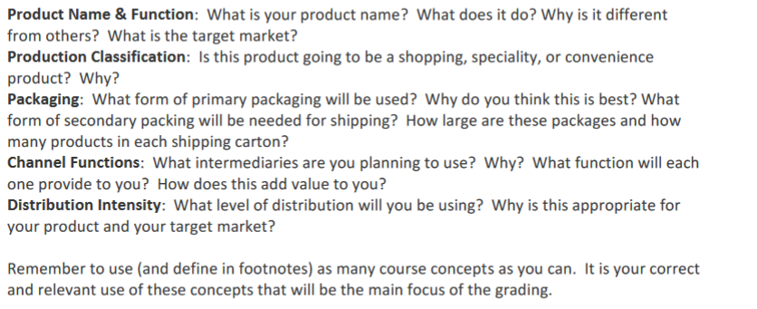
Part 1: Product/Placement
Notes:
Additional information and DETAIL in the project outline. Read Thoroughly.

Slide 9
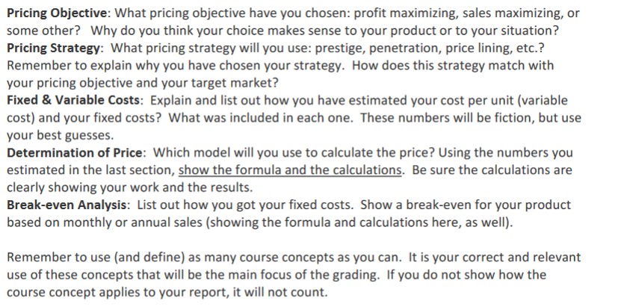
Part 2: Pricing
Notes:
Additional information and DETAIL in the project outline. Read Thoroughly.

Slide 10
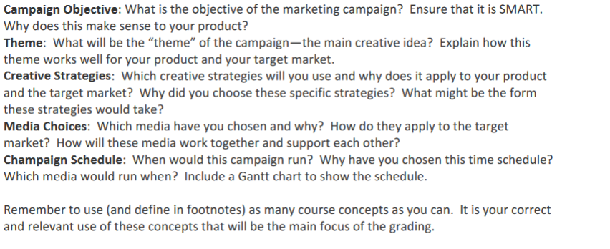
Part 3: Promotion
Notes:
Additional information and DETAIL in the project outline. Read Thoroughly.

Slide 11
Part 4: Presentation
Professional presentation
between 4 and 5 minutes (min/max)
Highlighting main points from Parts 1 through 3
Pairings Introductions!

Slide 12
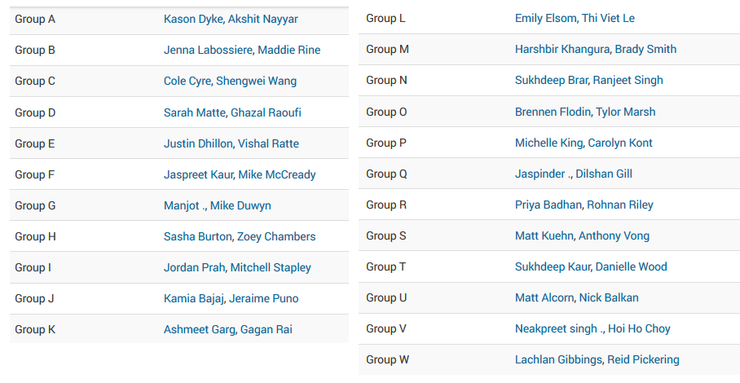
Notes:
When I call your name please put up your hand… wait until I am done before moving to your partner.

Slide 13
Next Class:
Objectives:
Product ideas (next slide)
How you will work together
  Contact information
  Task assignments (strengths?)
  Next steps
Chapter 4 Marketing Intelligence
Chapter 4 Moodle Quiz

Slide 14
Where do business ideas come from?
Brainstorming
  Trends – Reflect change and change creates opportunities
  Problems or pain points – Discovered through first hand work or customer experiences
  Others?
Use the remainder of this class time to brainstorm ideas and get to know each other.

