Slide 1
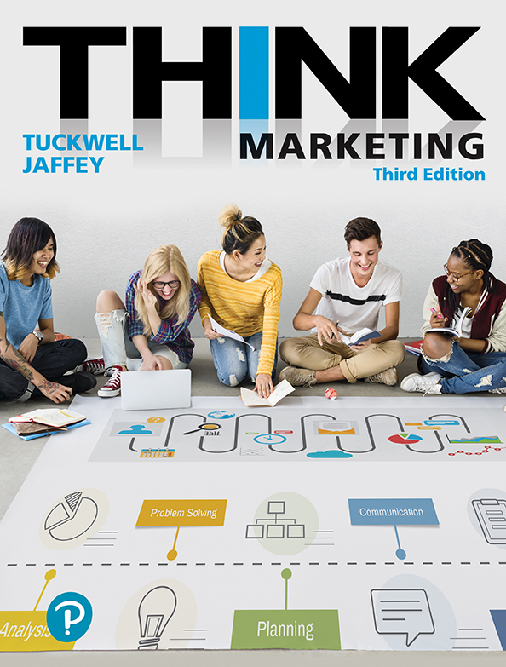
Strategic Marketing Planning
Chapter 3

Slide 2
Learning Objectives
Identify the key elements of strategic business planning.
Identify the nature of corporate planning and its impact on marketing planning.
Outline the process of creating a marketing plan.
Describe the content of a typical marketing plan
Describe fundamental marketing strategies employed by organizations
Explain the control and evaluation procedures used in marketing planning.

Slide 3
Strategic Business Planning Variables
Objectives
What is to be accomplished
Strategies
How objectives will be achieved (a plan with appropriate resources)
Execution
Detailed action plan; the tactics.
Notes:
LO1
Strategic business planning involves making decisions about three variables: objectives, strategies, and execution or tactics. All corporate plans and functional plans in an organization (e.g., marketing, human resources, operations, information technology, and so on) formulate plans by clearly identifying objectives, strategies, and execution details.
Variables
Objectives are statements that outline what is to be accomplished in the corporate plan or marketing plan. For example, they outline how much sales revenue, profit, or market share is to be achieved over a one-year period. Objectives are specific, measurable, and time based.
2. Strategies are statements that outline how the objectives will be achieved. Strategies usually identify the resources necessary to achieve objectives, such as money, time, people, and type of activity.
3. Execution, or tactics, refers to the plan of action that outlines in specific detail how the strategies are to be implemented. Tactical plans usually provide details of an activity’s cost and timing.

Slide 4
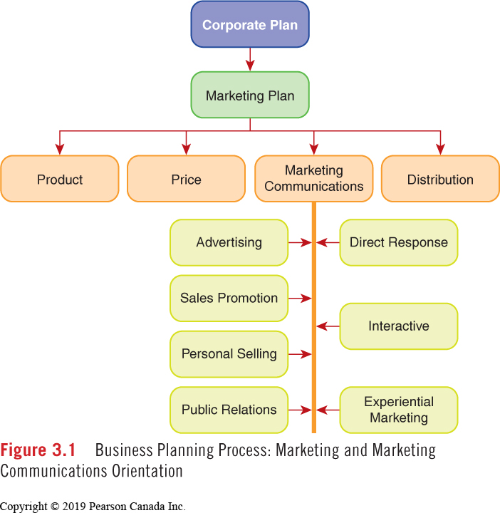
Business Planning Process
Notes:
The corporate plan sets the direction for an organization. The plan is developed by senior executives and usually includes three variables: a vision statement and/or mission statement, a statement of corporate objectives, and a statement of corporate strategies. A corporate plan provides direction for all the functional areas of the company, including marketing; therefore, it is long-term in nature and broad in scope, and considers the overall well-being of the organization.

Slide 5
Mission and Vision of MEC (1 of 2)
Figure 3.2 An Illustration of Mission and Vision Statements from MEC
Mission
We inspire and enable everyone to lead active outdoor lifestyles. We do that by selling outdoor gear, clothing and services. We match our members with gear that suits their needs. But we offer more than products, we offer passion. We love to share our expertise, experience, and enthusiasm.
What guides us as we go
Quality
We offer high-quality, high-performance products at very competitive prices.
Integrity
We listen carefully to one another. We deal in good faith. We are honest, fair, and ethical.
Co-operation
We understand the power of community and co-operative principles. We draw on the strength of people working together.
Creativity
We embrace original ideas and fresh ways of looking at the world. We draw on these to build and evolve our heritage.
Notes:
LO2
Corporate Planning
BEGINS WITH MISSION / VISION / VALUES
Mission: a statement of purpose and operating philosophy and the direction an organization will take
Vision: A statement of what and where an organization would like to be in the future.
Values: Statements reflecting an organization’s culture and priorities that guide an organization’s progression

Slide 6
Mission and Vision of MEC (2 of 2)
Figure 3.2 Continued
Leadership
We lead by example. We seek to motivate other individuals and organizations to act for people and the planet.
Sustainability
We work to make and market our products sustainably. We strive to build and operate our facilities with minimum ecological impact.
Stewardship
We act to preserve and restore wild places. We do so actively, consistently, and generously.
Humanity
We work actively to ensure those who make our products are treated with respect.
Adventure
We believe in living life to the fullest, with a spirit of adventure, a thirst for challenge, and a desire to learn.
© Mountain Equipment Co-op (MEC)
Notes:
LO2
Corporate Planning

Slide 7
Corporate Objectives
Statements of a company’s overall goals that take their direction from the mission statement.
Corporate Strategies
Plans outlining how the objectives are to be achieved.
Considers: marketing strength, degree of competition, financial resources, R&D capabilities, and commitment.
S.M.A.R.T. Goals
Notes:
LO2
Corporate Planning
Corporate objectives are statements of a company’s overall goals; they take their direction from the mission statement.. Good objective statements are written in quantifiable terms so that they can be measured for attainment.

Slide 8
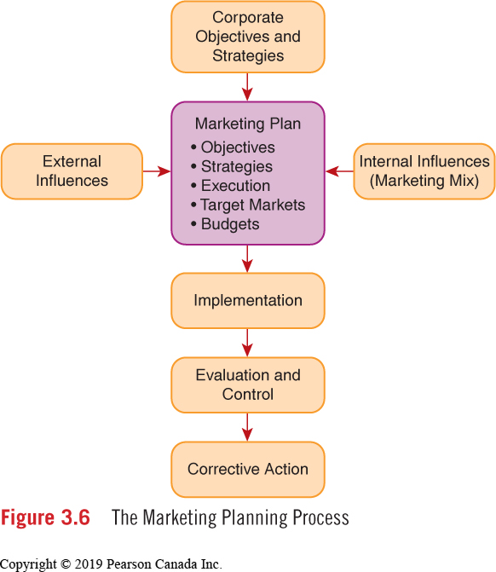
Marketing Planning Process
Marketing plans guide the activities of a brand or company.
Notes:
Marketing planning is the analysis, planning, implementation, evaluation, and control of marketing initiatives in order to satisfy target-market needs and achieve organizational objectives.
Process of Creating a Marketing Plan
Marketing plans are short term in nature (one year), specific in scope (they deal with one product and outline precise actions), and combine both strategy and tactics (they are action oriented). They are also subject to change on short notice, as a result of economic shifts or competitive activity. Figure 7.6 summarizes the stages of marketing planning.

Slide 9
Marketing Plan
Sales Volume
Market Share
Profit
Product Launch
Marketing Objectives
What?
Positioning Strategy
Target Market Profile
Marketing Mix
Budget
Marketing Strategies
How?
S.M.A.R.T. Goals/Objectives?
Notes:
Marketing Objectives: Statement outlining what a product or service will accomplish in one year, usually expressed in terms of sales volume, market share, or profit.
all of which are quantitative and measurabl.
sample statements:
1. Sales Volume: To achieve a unit volume of 200 000 units by the end of the year, an increase of 10 percent over the current-year sales
2. Market Share: To achieve a market share of 30 percent in 12 months, an increase of four share points over the current position
3. Profit: To generate an after-budget profit of $600 000 in the next 12 months
4. Product: To launch a new package design in the fourth quarter of this year
Marketing Strategies: Strategies that identify target markets and satisfy the needs of those targets with a combination of marketing mix elements within budget constraints.
Marketing strategies are the master plans for achieving marketing objectives. Marketing strategies usually include three main elements: a description of the target market, discussion about how the various elements of the marketing mix will be used, and a budget. All marketing strategies must fit with the positioning strategy described in the previous section.

Slide 10
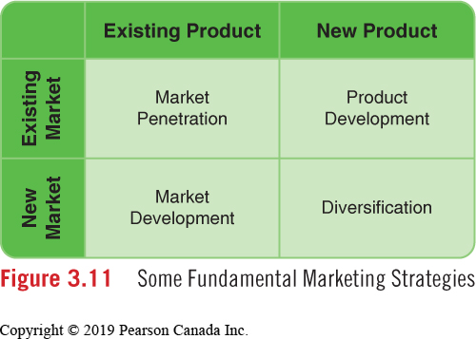
Fundamental Marketing Strategies
Notes:
Market Penetration: improve the market position of existing products in existing markets.
Market Development: market existing products to new target markets.
Product Development: new products or modifies existing products to current customers.
Diversification: invests its resources in a totally new direction (e.g., a new industry or market).

Slide 11
Marketing Plan - Background Situation Analysis
The collecting of information from knowledgeable people inside and outside the organization and from secondary sources
External Influences
Market Analysis
Product Analysis
Competitive Analysis
SWOT Analysis
Notes:
LO3
Marketing Plan Content
Marketing Plan Background—Situation Analysis: As a preliminary step to marketing planning, a variety of information is compiled and analyzed and summarized in the front section of the marketing plan. These trends and this information were discussed in detail in previous chapters.

Slide 12
EXERCISE: S.W.O.T.

Slide 13
EXERCISE: STRATEGY MATCH
Acquisition Strategy
Vertical Integration
Penetration
Horizontal Integration
New Products
Strategic Alliance
Divestment
Notes:
WHICH STRATEGY FITS FOR:
A FIRM decides to sell off or close up some product lines or divisions.
A FIRM decides to work with another FIRM to achieve common goal
A FIRM buys another profitable firm
A FIRM introduces new offerings
A FIRM focuses on growing market share with existing offerings
A FIRM owns many businesses at many levels in the distribution channel
A FIRM owns many businesses at one level of distribution channel
Divestment: Removing an entire division of a company through sale or liquidation.)
Strategic Alliance: A relationship between two or more companies who decide to work together to achieve common goals.
Acquisition: A company acquires other companies that represent profitable opportunities.
New products in new markets produce new revenue streams for a company.
Penetration: A strategy that calls for aggressive and progressive action to achieve growth among existing products.
Vertical Integration: The company owns and operates businesses at different levels of the channel of distribution.
Horizontal: A corporation operates many companies at the same level of the channel.

Slide 14
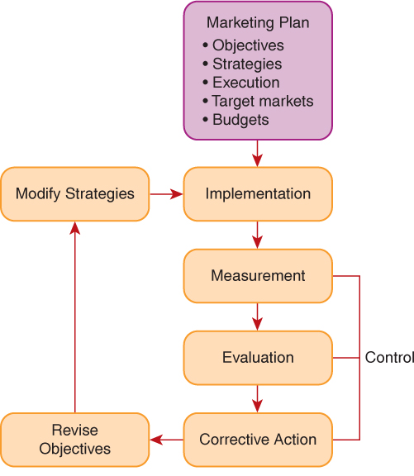
Marketing Control Process
Notes:
LO6
Control and Evaluation Procedures
Fig 3.4
Marketing Activity Reviews The effectiveness of a marketing plan is measured against a few key indicators: sales volume, market share, and profit. Activity reviews typically occur on a quarterly basis and often involve a gathering of brand managers, sales managers, and some senior marketing executives. Planning cycles that have activity reviews built in give an organization the opportunity to make strategic adjustments during the course of a year.

Slide 15
Learning Objectives
Identify the key elements of strategic business planning.
Identify the nature of corporate planning and its impact on marketing planning.
Outline the process of creating a marketing plan.
Describe the content of a typical marketing plan
Describe fundamental marketing strategies employed by organizations
Explain the control and evaluation procedures used in marketing planning.

Slide 16
Penetration Strategy
A strategy that calls for aggressive and progressive action to achieve growth among existing products.
PepsiCo aggressively markets its key brands to ensure financial growth.
PepsiCo’s key brands include Pepsi-Cola, Diet Pepsi, Tropicana and Gatorade.
Strategies
Notes:
LO2
Corporate Planning
Penetration Strategy: calls for aggressive and progressive action on the part of an organization. Growth is achieved by building existing businesses (either company divisions or product lines). PepsiCo implements a penetration strategy across its various product lines in its two operating divisions in Canada.
PepsiCo Beverages Canada includes brands such as Pepsi and Diet Pepsi, Gatorade, and Tropicana. PepsiCo Foods Canada includes all Quaker brands and salty snack foods such as Doritos, Tostitos, Sun Chips, and Frito Lay.
Marketing managers devise annual marketing plans that are designed to improve the business performance of all of these brands and to penetrate the market further by increasing market share. PepsiCo wants to stay ahead of its competitors and maintain a strong presence among consumers.

Slide 17
Acquisition Strategy
A company acquires other companies that represent profitable opportunities.
Loblaws acquires Shoppers Drug Mart @ $12.4B
Canada Bread acquires bakery division of Saputo In.,@ $120M
Strategies
Notes:
LO2
Corporate Planning
Acquisition Strategy: involves the purchase of another company or parts of another company. A strategy based on acquisition allows a company to enter an attractive market quickly, and it may be less costly in the long term. It may also be a strategy to gain more market share in the industry an organization presently competes in. In contrast, the time required to develop new products can be extensive and the financial commitment considerable.
A company will acquire another company because they see it as a good corporate “fit.” Both examples cited above appear to be good fits for the acquiring organization. The acquisitions were in industries where the acquiring organizations were firmly established and highly experienced.

Slide 18
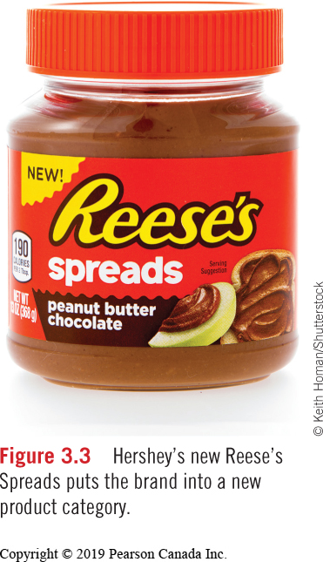
New Products Strategy
New products in new markets produce new revenue streams for a company.
Strategies
Notes:
LO2
Corporate Planning
New-Products Strategy A new-products strategy requires considerable investment in research and development. Such a strategy also requires financial commitment over an extended period, as it takes considerable time to develop a new product. And the odds of successfully marketing a new product remain low.
To demonstrate, Kraft developed and successfully launched a completely new “liquid water enhancer” called Mio. Mio is packaged in a squeezable container small enough to carry in a purse or pocket. Users squeeze as little or as much as they like into a glass of water. With some good advertising Mio skyrocketed out of the gate. North American sales were expected to reach $200 million in 2013.
Mio was specifically targeted at millennials, a generation of consumers who like to personalize things. Mio was a good fit for their lifestyle—it embraced their sense of individuality. Kraft CEO Tony Vernon called Mio “One of our most successful new products ever.”(3) Eyeing the success of Mio, Coca-Cola launched a similar beverage called Dasani Drops, a zero-calorie liquid beverage enhancer.

Slide 19
Vertical Integration Strategy
The company owns and operates businesses at different levels of the channel of distribution.
Apple manufacturers computers and phones and markets them through its own retail stores in addition to independent dealer networks
Strategies
Notes:
LO2
Corporate Planning
In a vertical integration strategy, one organization in the channel of distribution owns and operates organizations in other levels of the channel.
For example, Apple Computer traditionally marketed its range of computer products and accessories through an independent dealer network and various catalogue merchants, but in an attempt to get closer to its customers, the company decided to open its own retail network. Owning and operating retail stores was not Apple’s area of expertise.
The venture would be costly and the company risked alienating existing retailers who had been loyal to the brand. Nonetheless, Apple saw the benefit of getting closer to its customers.
Apple opened its first store in 2001. By 2010 Apple retail stores had reached $9.1 billion in sales revenue and $2.3 billion in profit. The retail division contributes significant value to the overall success of the company. The stores are well designed (much like their products) and offer daily exposure to Apple’s products in an inviting environment, an environment that is more socially oriented than sales oriented.6

Slide 20
Horizontal Integration Strategy
A corporation operates many companies at the same level of the channel.
Harvey’s
Swiss Chalet
Kelsey’s
Montana’s
Milestones
Cara Operations
Cara offers different menus at different price points to reach different targets.
Strategies
Notes:
LO2
Corporate Planning
In a horizontal integration strategy, one organization owns and operates several companies at the same level in the channel of distribution. The objective of horizontal integration is to control greater market share within a certain segment of a market.
For example, Cara Operations, a Canadian restaurant chain, owns and operates many different restaurant chains in Canada that embrace fast food and casual dining experiences. Its original stable of restaurants included Harvey’s, Swiss Chalet, Kelsey’s, Montana’s, and Milestones.
Just recently Cara merged with Prime Restaurants, a division of Fairfax Financial Holdings. Prime operates East Side Mario’s, Casey’s, Fionn MacCools, and BierMarkt.
As a result of the merger, one company now operates at many different price points, offering different customer experiences to diverse target markets. It’s an enviable position to be in. One way or another they will get your restaurant dollar! On speaking about the merger John Rothschild, CEO of Prime says, “This broadens our offering to Canadian families and moves us further towards our vision of becoming the undisputed leader of the restaurant industry in Canada.”(7)

Slide 21
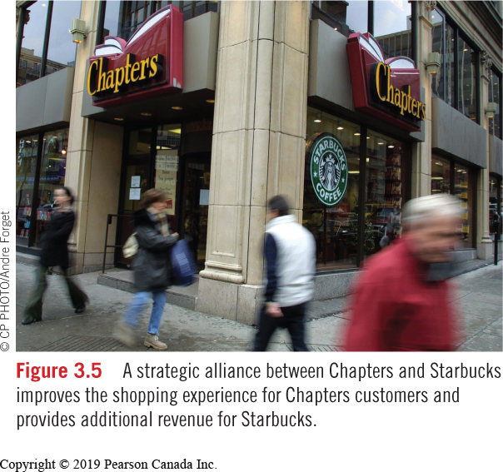
Strategic Alliance
A relationship between two or more companies who decide to work together to achieve common goals.
Strategies
Notes:
LO2
Corporate Planning
Strategic Alliance Strategy: Strategic alliances are now very popular among companies wanting to find ways of reducing costs or improving operating efficiencies. A strategic alliance is a relationship between two or more companies that decide to work cooperatively to achieve common goals.
Alliances are a means of reducing costs and improving operating efficiency. A successful alliance between Target and Starbucks in the United States was introduced to Canada when Target opened its stores in 2013. The in-store Starbucks-licensed stores serve the usual customized beverages along with breakfast items and lunch sandwiches. Target says the relationship brings the true Target experience to Canadian shoppers.8 Starbucks also has a successful strategic alliance with Chapters in Canada.

Slide 22
Divestment Strategy
Removing an entire division of a company through sale or liquidation.
A company retreats to its core business by selling unprofitable divisions or brands that no longer fit strategically.
Sony closes all retail stores in Canada.
Strategies
Notes:
LO2
Corporate Planning
Divestment Strategy: Bigger is not always better! Rather than expanding, some companies are consolidating their operations by divesting themselves of unprofitable operations or operations that no longer fit strategically with the direction a company is heading in. Divestment alternatives include downsizing, closing, or selling parts of a company.
Procter & Gamble decided food was no longer a strategic fit and over the past five years has been divesting itself of a variety of product lines, all of which were attractive acquisitions for smaller companies in the food business. The latest product to go was Pringles chips, which sold to Kellogg’s for $2.3 billion. Kellogg’s looked at the situation differently. Its core business is cereal, a market that is facing limited growth due to changes in consumer behavior around the breakfast table. Kellogg’s operates in a small way in the snack business but sees Pringles as a path to revenue and profit growth in the future.(10)

Slide 23
Chapter Flashcard Challenge
Notes:
PRELOAD: Chapter Resources / Flashcards / definition first

