Slide 1
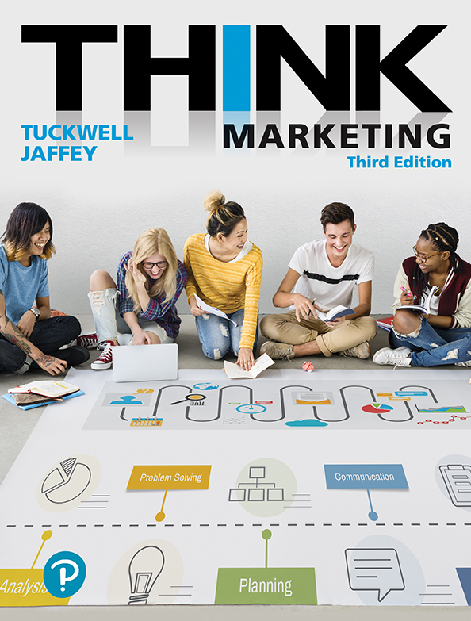
Contemporary Marketing
Notes:
Last class we considered what Marketing is. Today we will take a deeper look into the components and depth of Marketing as a functional area of business.

Slide 2
What is a Market?
A group of people (or an organization or both) who have a similar need for a product or service, the resources to purchase the product or service, and the ability to buy it.
What is the Goal of Marketing?
To attract, retain, and maximize the value of a customer, so that organizational objectives are achieved.
Typical objectives: an increase in sales, profit, market share, image and reputation improvement
Notes:
“ING” IS A VERB ‘TENSE’ (‘ed’, ‘ing’)
Market – Ing – adding “ing” becomes a verb, an action - within a Market…
How many MARKETS do we have in this classroom?

Slide 3
The Importance of Marketing
Marketing is the means by which an organization connects with customers.
Two key areas of Implementation:
Attract customers and encourage them to buy a good or service for the first time.
Encourage customer satisfaction and loyalty to maximize the lifetime value of customers.
Notes:
a vital business function

Slide 4
Effective Marketing helps companies grow and prosper
Figure 1.3 Best Brand Reputations in Canada
Rank | Company | % Good Opinion | % Bad Opinion | Net Score
1 | Google | 91.0 | 2.0 | 89.0
2 | Heinz | 84.0 | 5.0 | 79.0
3 | Shoppers Drug Mart | 83.0 | 5.0 | 78.0
4 | Canadian Tire | 85.0 | 7.0 | 77.0
5 | Kellogg | 83.0 | 7.0 | 76.0
6 | Dollarama | 81.0 | 6.0 | 75.0
7 | Samsung | 80.0 | 5.0 | 75.0
8 | Kraft | 83.0 | 9.0 | 74.0
9 | Campbell | 80.0 | 7.0 | 73.0
10 | Tim Hortons | 83.0 | 11.0 | 72.0
Data from “The 10 Most Reputable Brands in Canada Best Reputations in Canada,” Marketing, May 10, 2016, http://www.marketingmag.ca/brands/the-10-most-reputable-brands-in-canada-174142
Notes:
What is the connection between Marketing and Brand Reputation?
Discuss what they know of these companies, and how these companies share information about their ethical practices and social responsibility.
Select one: identify/discuss the marketing mix activities that have helped this firm achieve its positive image. This is a good way to introduce the 4Ps.

Slide 5
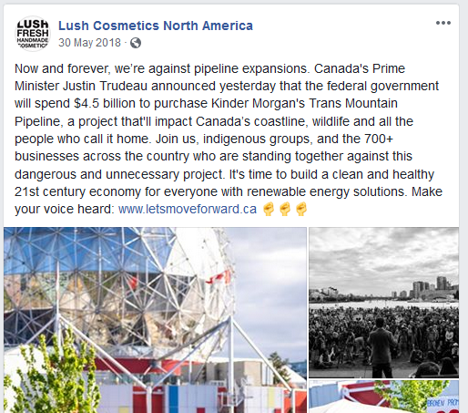
What global social responsibility issues do businesses currently face?
Notes:
Students work in small groups to identify a few companies in each.
Animal Rights; humane treatment (dairy, eggs, meat producers – SPCA approved)
Child labour: clothing factories
Sustainable environmental causes (Palm oil, deforestation, water conservation, )
Human rights: LGBT, race, religions
Guns
Pipeline – Lush! – how is that working out?

Slide 6
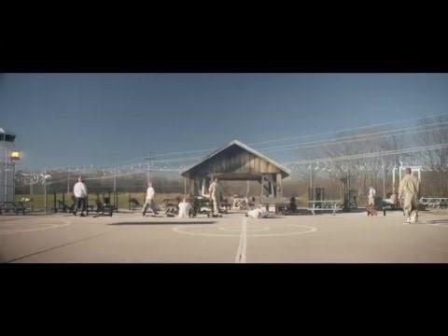
Notes:
DIRT IS GOOD – (2:37) https://youtu.be/8Q2WnCkBTw0

Slide 7
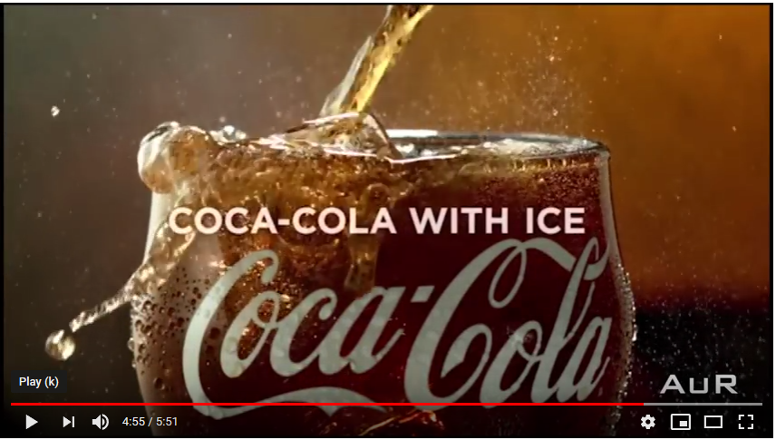
The Nature of Marketing Has Evolved
Marketing is based on a simple idea: identify a need and then satisfy it.
Notes:
https://youtu.be/fx2E5yM9kvw
(5:51) Coke commercials

Slide 8
4 P’s of Marketing: The Marketing Mix
In groups of no more than 3 complete the 4Ps exercise for Coca-Cola.
In each of the 4 squares, make note of what you know/think about the Coca-Cola brand.
Put all team members names on the document before handing in.
Notes:
When complete: REVIEW ON WHITEBOARD

Slide 9
Distribution Channel Activity
In groups of no more than 3 complete the Distribution Channel Activity.
Put all team members names on the document before handing in.
Notes:
When complete: REVIEW ON WHITEBOARD

Slide 10
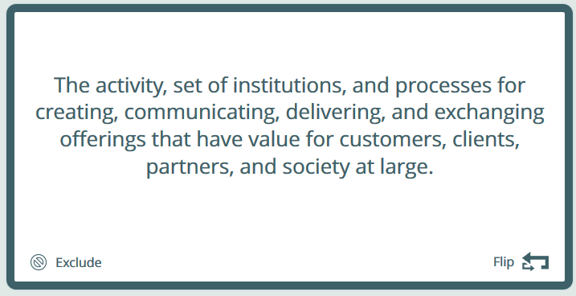
Flashcards!
Notes:
HANDOUT FLASHCARD SHEETS
Open MyLab (online)
Chapter Resources (scroll down to) Glossary Flashcards / continue / Select Chapter
Build Deck / select DEFINITION
BEGIN

Slide 11
Concepts Review
Marketing Definition
Marketing Process
Target Market
Marketing Mix
Product Strategy
Price Strategy
Distribution (Place) Strategy
Communications (Promotion) Strategy
Maximizing Customer Value
Customer Relationship Management
Evaluating Marketing Activity
Ethical Considerations
Notes:
Review any concepts… then Ethical

Slide 12
Marketing Defined
“The activity, set of institutions, and processes for creating, communicating, delivering, and exchanging offerings that have value for customers, clients, partners, and society at large.”
American Marketing Association

Slide 13
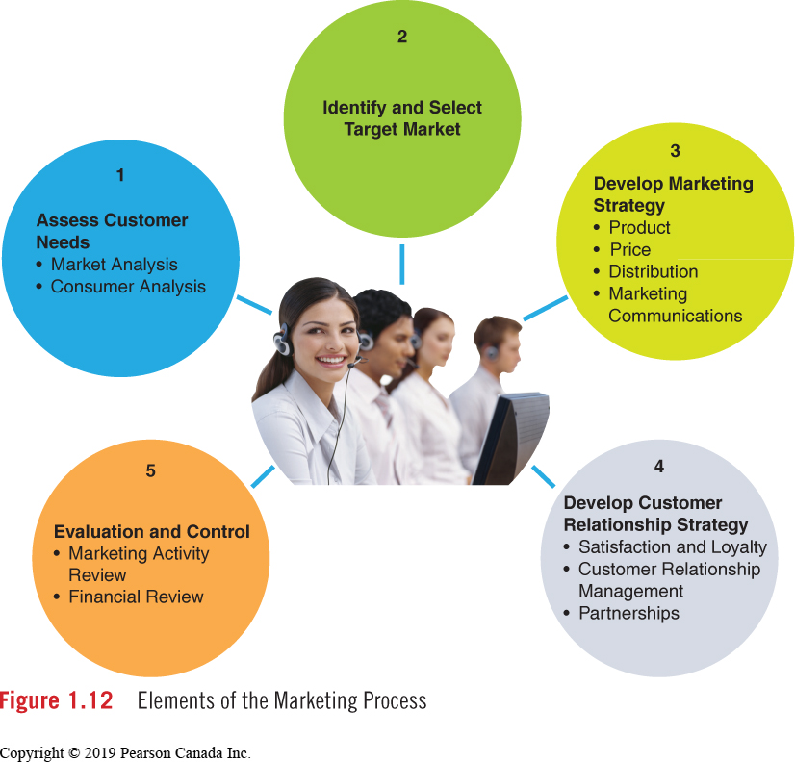
Marketing Process
Notes:
Assess Customer Needs
Identify & select Target market
Develop Marketing Strategy (4 P’s)
Develop Customer Relationship Strategy
Evaluation and Control

Slide 14
Target Market Identification and Selection
A target market is a group of people to which a company markets its products.
The target has something in common:
age
education
lifestyle
activity

Slide 15
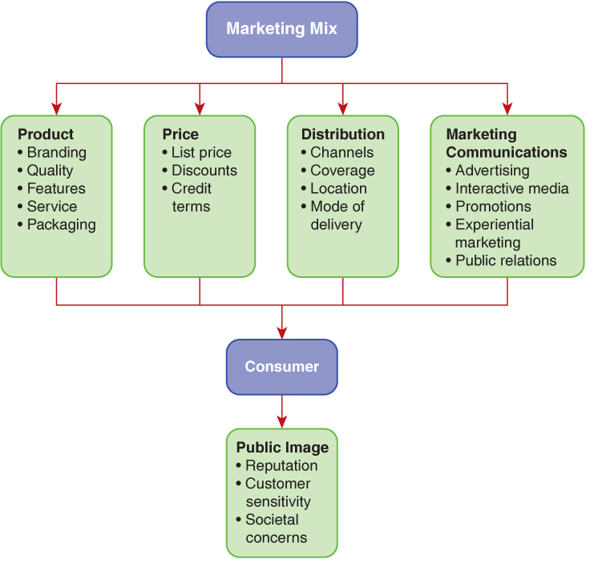
The Marketing Mix

Slide 16
Product Strategy
A product may possess tangible and intangible characteristics.
Product decisions are numerous and embrace:
Quality
Features
Brand Name
Image
Size
Format
Service
Package Design

Slide 17
Price Strategy
Establishing a fair and equitable price for customers while being profitable for the organization.
Price decisions consider the following:
Cost of manufacturing a good
Location of customers
Desired profit level
Degree of competition

Slide 18
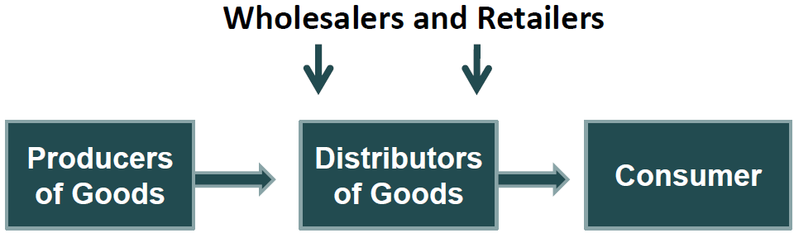
Distribution Strategy
The selection and management of marketing channels and the physical distribution of products.
Marketing channel: firms that participate in the flow of goods and services from producers to final users.
A change in consumer behaviour is fuelling direct distribution strategies to consumers.
Notes:
Among Canadian Internet users:
77 % research goods and services online
56 % order goods and services for direct delivery
Total value of goods and services ordered online by consumers
$20.6 billion in 2014 and is expected to reach $34 billion in 2018.
Hollie Shaw, “Online retail sales to hit $34 billion by 2018,” http://business.financialpost

Slide 19
Marketing Communications Strategy
“The blending of advertising, sales promotion, event marketing and sponsorship, personal selling, and public relations to present a consistent and persuasive message about a product or service.”
Integrated Marketing Communications (IMC) strategy defined as:
“The coordination of relevant forms of marketing communications in a unified program that maximizes the impact on consumers”.

Slide 20
Maximizing Customer Value: Building Customer Relationships
Marketing today is about building relationships with channel members and consumers.
Customer Relationship Management: strategies that optimize profitability, revenue, customer retention, and customer satisfaction.
Notes:
What loyalty program cards do you have on you right now? In your wallet, as an app…
Whiteboard?

Slide 21
CRM Programs
Successful CRM programs rely on a strong internal data management system.
Three distinct organizational functions:
To collect and analyze information.
Develop new marketing offers that should be of interest to its customers based on its analysis of the information.
A communications plan that delivers the details of the new offer to the market.

Slide 22
Evaluating Marketing Activity
Marketing strategies must be periodically reviewed for effectiveness. A typical review may include an assessment of:
Market conditions (external influences)
Competitor activity (their success or failure)
Brand performance to date (are objectives being achieved?)
Potential changes in marketing strategy are addressed in the review process.

Slide 23
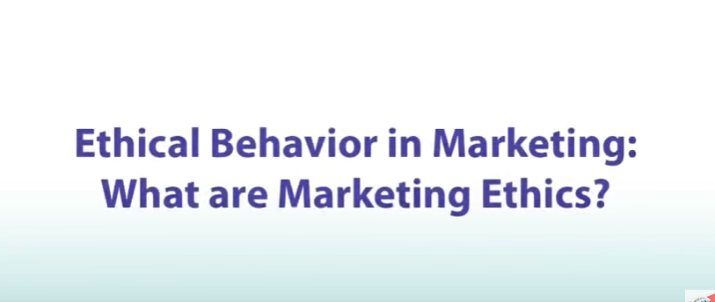
Ethical Considerations for Marketing
Business ethics is defined as the study and examination of moral and social responsibility in relation to business practices and decision-making in business.
In Canada, the CMA’s Code of Ethics and Standards of Practice guides marketing organizations
Businesses today strive for sustainability… the ability to sustain or the capacity to endure.
Notes:
What is ethical marketing?
https://www.youtube.com/watch?v=cX5Wz9fElJk

Slide 24
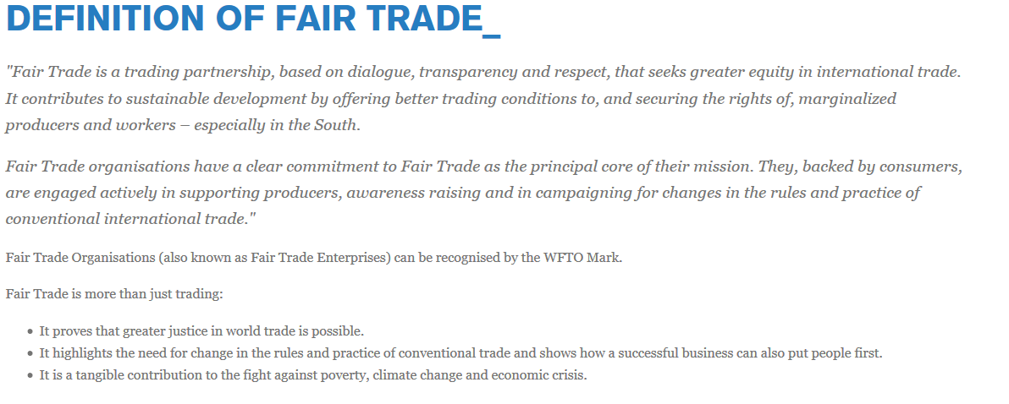
Notes:
https://wfto.com/fair-trade/definition-fair-trade
Why is FAIR TRADE important?
"Fair Trade is a trading partnership, based on dialogue, transparency and respect, that seeks greater equity in international trade. It contributes to sustainable development by offering better trading conditions to, and securing the rights of, marginalized producers and workers – especially in the South.

Slide 25
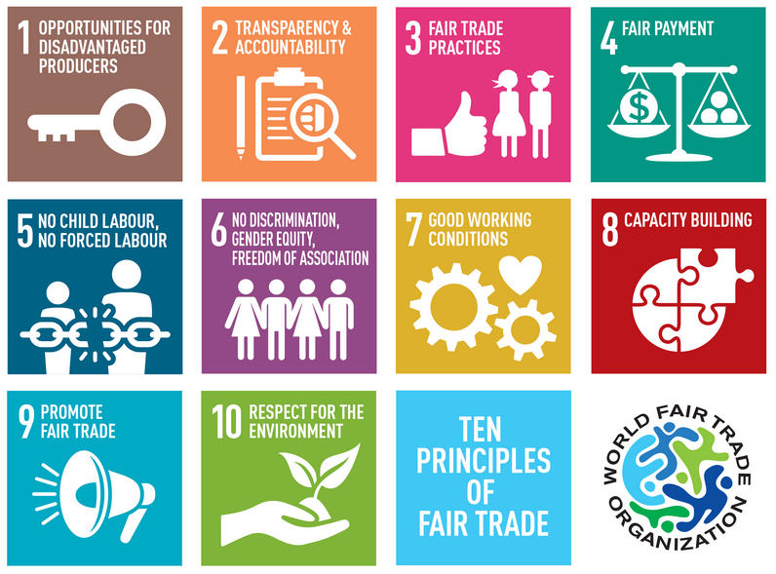
World Fair Trade Organization
Notes:
10 Principles of Fair Trade

Slide 26
Chapter Review. Can you…
Define the term marketing?
Describe the importance of marketing in organizations?
Describe how marketing has evolved to become the driving force of business growth?
Explain the fundamental process of marketing practiced by organizations today?
Explain the concept of the marketing mix?
Explain how an organization maximizes the value of its customers?
Identify fundamental methods for measuring the effectiveness of marketing activities?
Explain how ethical considerations impact marketing strategies?
Notes:
After studying this chapter you should be able to …
L01 – org function; set of processes for creating, communicating & delivering value; managing cust. Relationships – benefit org & stakeholders
L02 – allows firms to grow and prosper
L03 – from product orientation – selling orientation – marketing orientation – socially responsible marketing orientation – social media marketing orientation
L04 – assess customer needs/ id target market / develop strategy (4P’s) / develop Cust. Relationship strategy / evaluate & control
L05 – 4 P’s + Public Image 9repuration / society concerns/ customer sensitivity
L06 – form relationships: loyalty programs, CRM programs
L07 – review progress against objectives; adjust
L08 – Cdn Mrktg Assoc. and American Mrktg Assoc. – standards; heightened expectation for ethics

Slide 27
Next Class:
Chapter 2 The External marketing Environment
Chapter 2 Moodle Quiz

