Slide 1

Services Available to You
Opportunities & Events
Important Dates & Reminders
Chat With Us

Slide 2
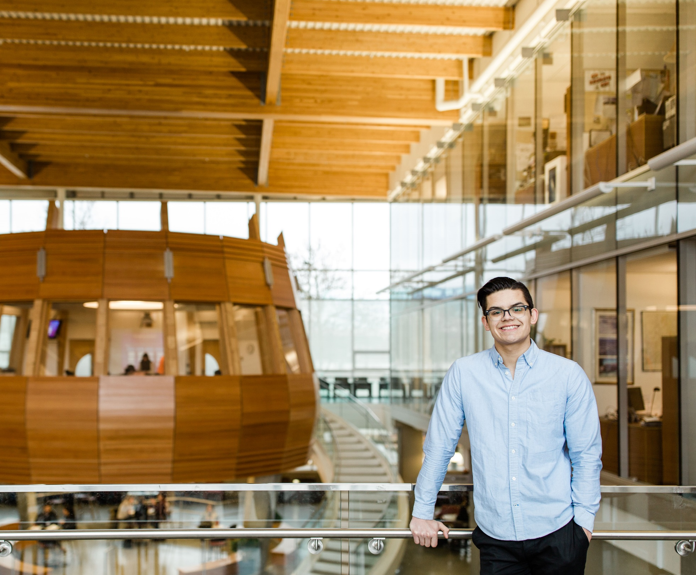
Services
Academic Advising
Learning Centre
Counselling
Financial Aid

Slide 3
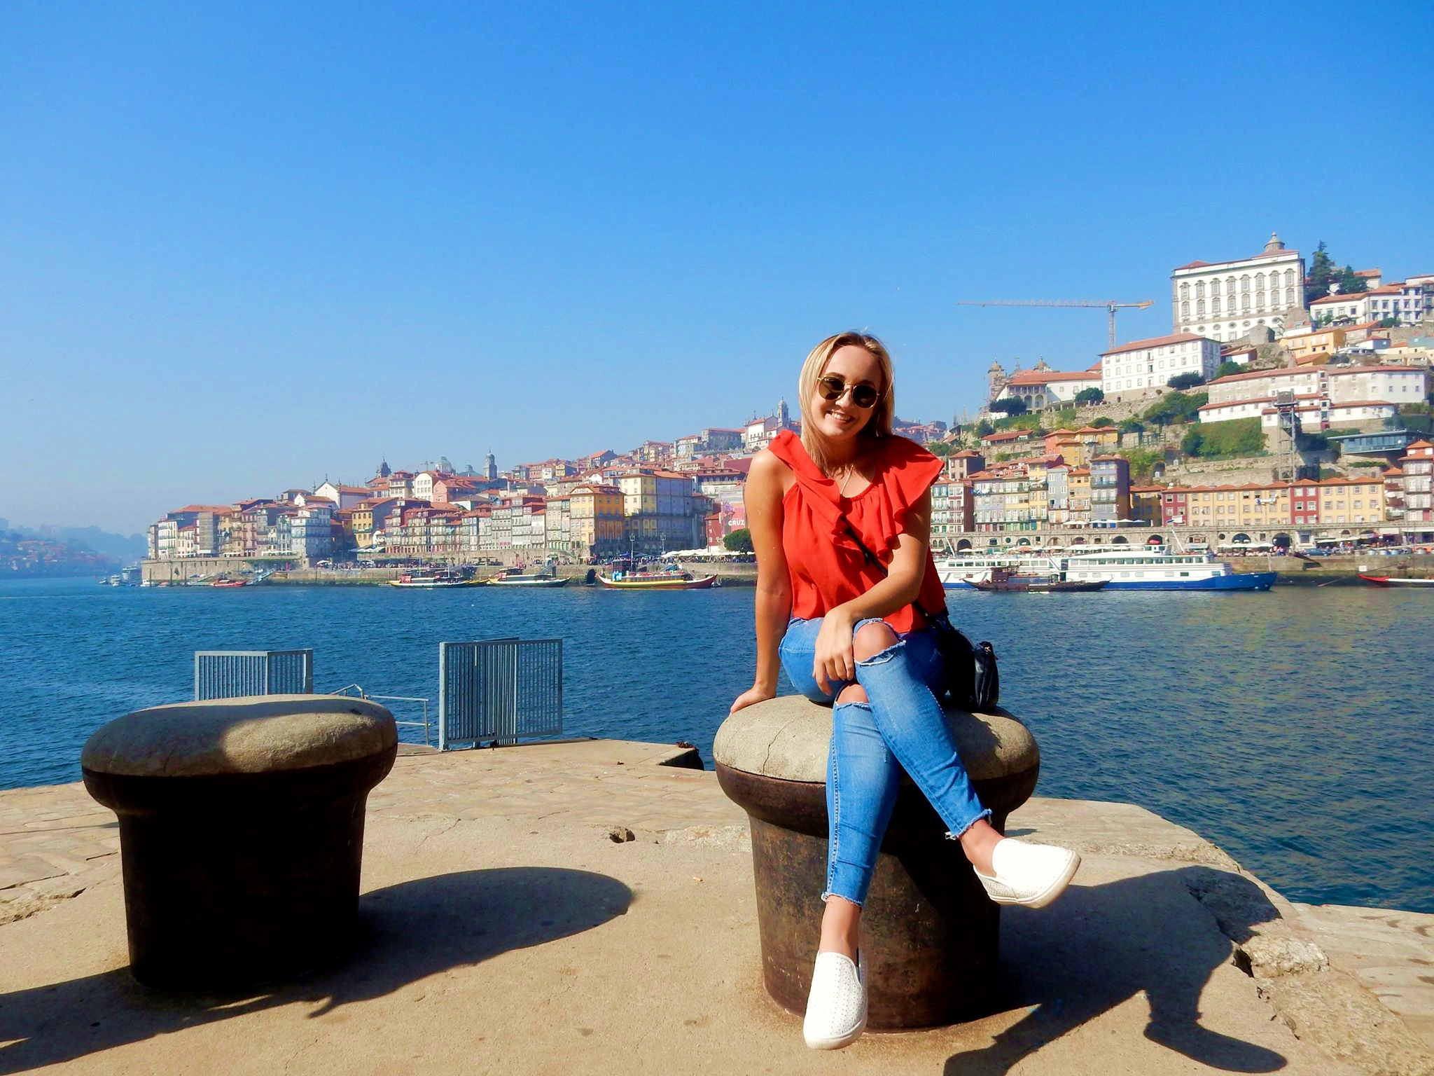
Opportunities & Events
Exchange Programs & Study Abroad
Co-Op Employment Programs
Competitions & Clubs
Volunteer Opportunities

Slide 4

Important Dates & Reminders
Classfinder Schedule
Declare specialty at Registration Office
Apply to graduate
Personal Diploma/Degree Planners
Like and follow us on social media

Slide 5

Chat With Us
Fran Kelly
250-762-5445 local 4725
fkelly@okanagan.bc.ca
Room E229
Kim Felice
250-762-5445 local 4639
kfelice@okanagan.bc.ca
Room E227
Jamie Morrow
250-762-5445 local 4726
jmorrow@okanagan.bc.ca
Room E217A
Shanna Stephenson
250-762-5445 local 4961
sstephenson@okanagan.bc.ca
Room E214
Sara-Jane Schofield
250-762-5445 local 4112
sschofield@okanagan.bc.ca
Room E214

