Slide 1
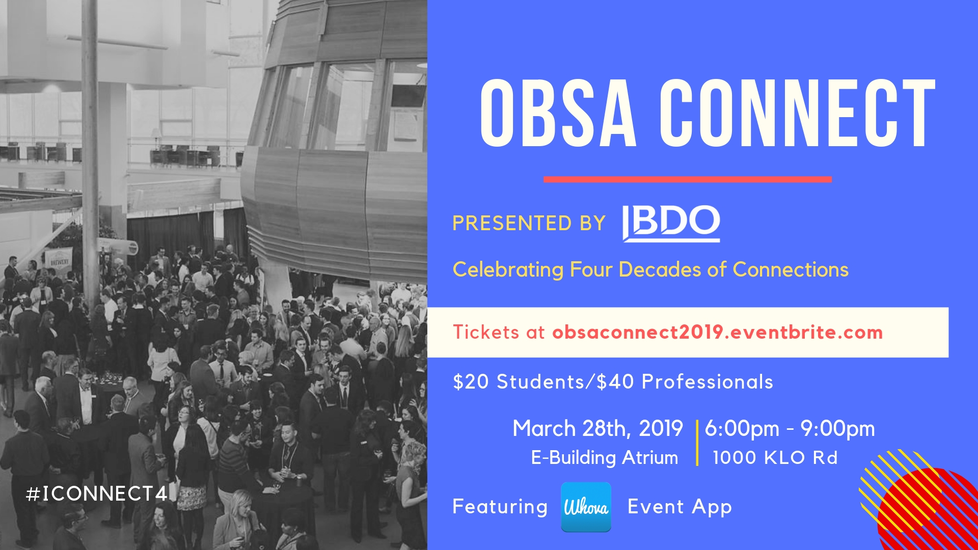

Slide 2
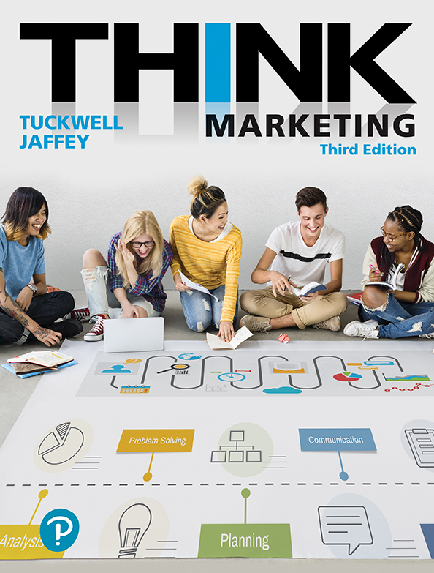
Think Marketing
Third Edition
Chapter 14
IMC: Media Advertising, Social and Mobile Communications
Copyright © 2019 Pearson Canada Inc.
Notes:
20 / 20 / 20

Slide 3
Learning Objectives
Define integrated marketing communications and describe the components of the integrated marketing communications mix.
Describe the basic elements that comprise marketing communications planning.
Explain the nature of creative (message) decisions that are part of an advertising campaign.
Explain the nature of media decisions that are part of an advertising campaign.
Assess various media alternatives for delivering messages.
Describe the role of social media in marketing communications campaigns.
Describe the role of mobile communications in marketing communications campaigns.

Slide 4
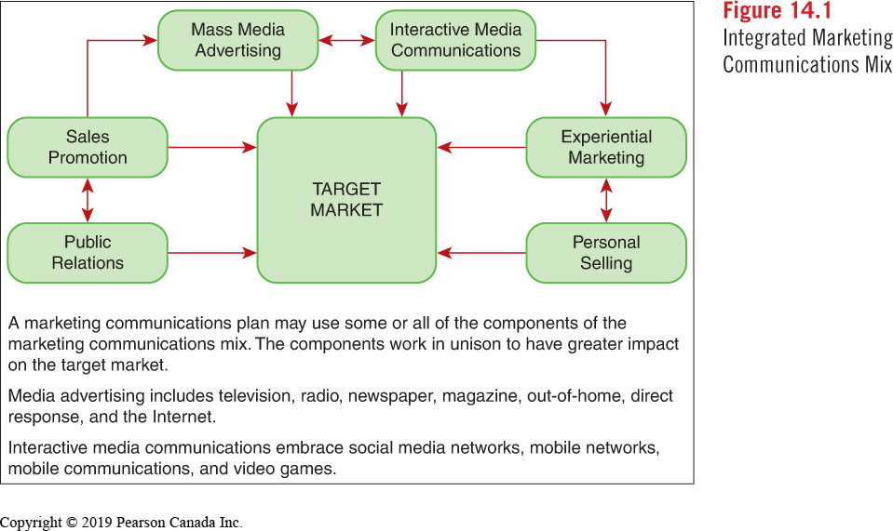
IMC: The coordination of various forms of marketing communications into a uniform program that maximizes the impact on the intended target audience.
Notes:
Marketing Communications Plan may use some or all of the components of the marketing communications mix.
The components work in unison to have greater impact on the target market
Media advertising includes: tv, radio, newspaper, magazines, out-of-home, direct response and the Internet
Interactive media communications enhance social media networks, mobile networks, mobile communications and video games.

Slide 5
Marketing Communications Planning
Set Objectives
Determine Strategy
aimed at consumers
aimed at distributors
Budget Determination
pull
push
Percent of sales
Industry average
Arbitrary allocation
Task/Objective
Notes:
“The process of making systematic decisions regarding which elements of the communications mix to use in marketing communications.”
-sample objectives: brand awareness; position/reposition perception of product/ trial purchase, defuse situation, etc.
PULL – aimed @ consumers (pull through channel w/requests); PUSH – aimed at distributors (push through channel)
Budget factors:
Percentage of Sales: predetermined percentage of forecasted sales
Industry Average: average amount (current or forecasted) spent by all brands in the market.
Arbitrary Allocation: judgment and experience.
Task (Objective): determines the activities (strategies required) to achieve the objective

Slide 6
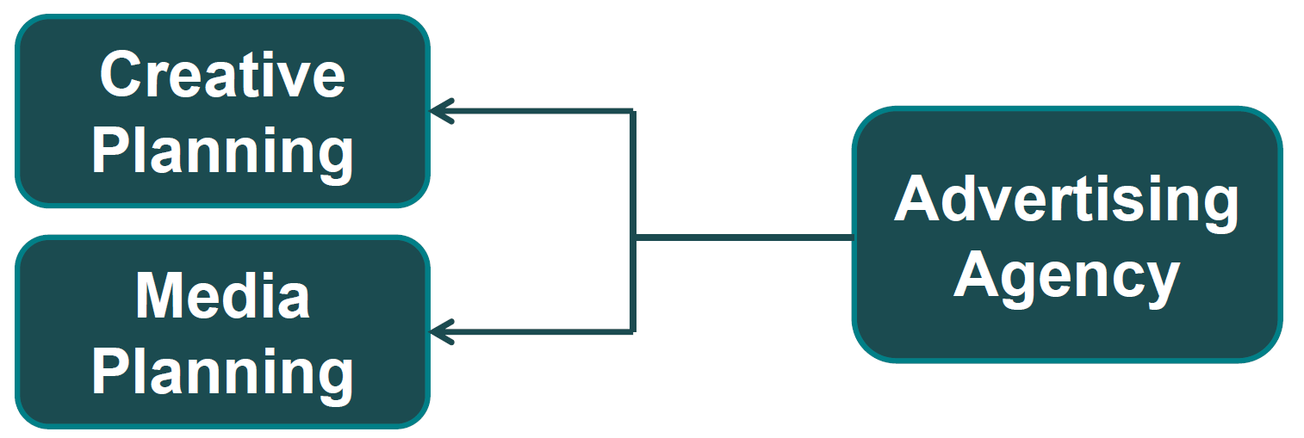
Advertising: placement of persuasive messages in any medium by an identified sponsor.
Basic objective of advertising:
Influence thought patterns of target audience in a favourable manner
Motivate purchase of a specific brand of good or service
Advertising agencies usually create the ad campaigns for marketing organizations.

Slide 7
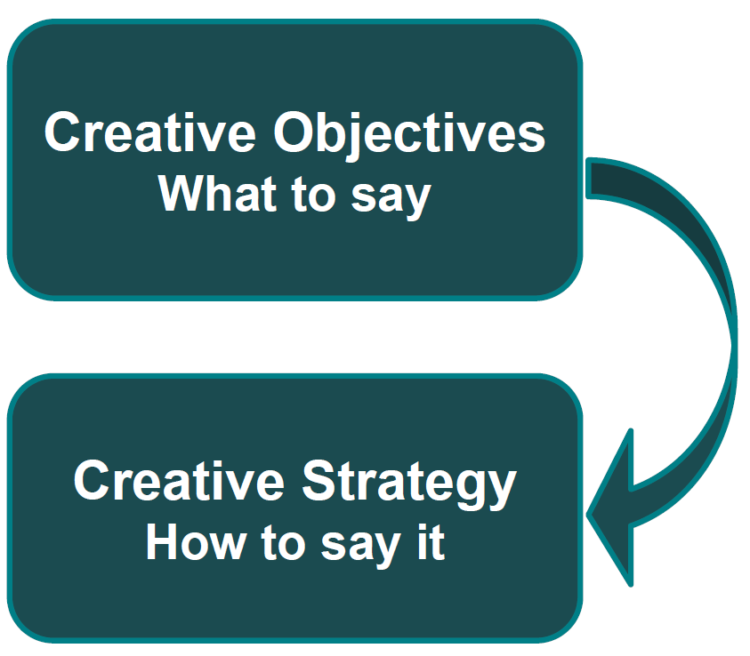
Creating the Message
The message includes the key benefit the brand offers.
Potential themes and appeal techniques:
Humour
Comparison
Emotion
Lifestyle
what
Creative Strategies:
Celebrity Endorsement
Testimonial
Sex
Product Demonstrations
how

Slide 8
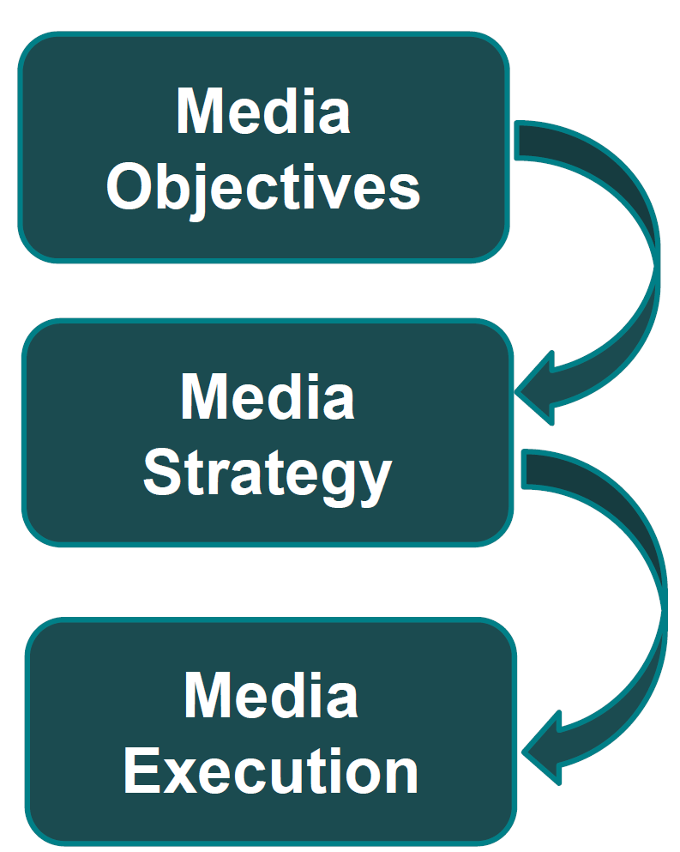
Media Planning
The media plan has three essential components:
Who?
What?
When?
Where?
4 KEY AREAS:
Reach
Frequency
Continuity
Engagement
Market Coverage
Timing
HOW to reach
shotgun
rifle
profile
Evaluate media cost comparisons (CPM)
Calendar all media activities
Budget summary shows allocations across selected media.
Specific Choices Made:
Notes:
A good media plan employs the right media to reach the target audience effectively and efficiently.
Strategy: Match Target with Medium

Slide 9
Matching Target with Medium
Figure 14.9 Target Market Media Matching Strategies
Shotgun Strategy | Rifle Strategy | Profile Matching Strategy
The description of the target is very broad. Therefore, mass media with broad reach are appropriate. Example: To reach adults 18+ years old, newspaper, television, and outdoor ads are good options. | The key element of the target description is often an interest or activity. Demographics are less important. Example: The target is people interested in snowboarding. A special interest magazine titled Snowboarding is a good choice. | The target description includes several demographic and psychographic variables that require more selective media choices. Example: The target is married women, 25–49 years old, who balance household and career responsibilities. A magazine such as Chatelaine or Canadian Living is a good match.

Slide 10
Media Alternatives
Net advertising revenue by media in Canada 2015
Medium
Internet
Television
Newspaper
Radio
Out-of-Home
Magazines
Total
 | Reported Actual $ | % Total Revenue
 | 4604 | 35.5
 | 3511 | 27.1
 | 2305 | 17.8
 | 1576 | 12.0
 | 586 | 4.5
 | 412 | 3.1
 | 12 543 | 100.0
Notes:
What proportion of advertising expenditures is on the Internet?
Were you surprised by the distribution of advertising expenditures by medium??

Slide 11

Product Placement | Branded Content
Notes:
Jurrasic World? Parody… HOW MANY PRODUCTS/BRANDS DO YOU SEE?
https://youtu.be/KZcFS8IO2N4

Slide 12
Media Advertising Selection Considerations (1 of 2)
Figure 14.15 Media Advertising Selection Considerations
Advantages | Disadvantages
Television Impact—sight, sound and motion; demonstration Reach—very high among all age groups | Television Cost—high cost for time and commercial production Clutter—too many commercials reduces impact of message
Radio Targeting—reaches a selective audience based on station format Reach and Frequency—reaches same audience frequently | Radio Retention—short, single-sense message Fragmentation—many stations in large markets reduces impact
Newspaper Coverage—good reach among adults in local markets Flexibility—message can be inserted quickly | Newspaper Lifespan—short; a one-day medium Targeting—not appropriate for advertiser with carefully defined targets
Magazine Targeting—specialized magazines reach defined demographic targets Environment—quality of editorial enhances advertising message | Magazines Clutter—too many ads in each issue Frequency—low message frequency (monthly)

Slide 13
Media Advertising Selection Considerations (2 of 2)
Figure 14.15 Continued
Advantages | Disadvantages
Out-of-Home Reach and Frequency—message reaches same target frequently (daily travel patterns) Coverage—available on a market-by-market basis | Out-of-Home Message—only suitable for short messages Targeting—reaches broad cross-section; can’t target specific demographics
Direct Response Targeting—reaches a pre-selected and defined audience Measurement—expenditure directly attributed to advertising effort | Direct Response Image—junk image of mail used; hard-sell approach No Editorial Support—message stands alone in medium
Internet Targeting—ads reach individuals based on behaviour (destinations) Timing—ads delivered anytime, anywhere | Internet Low Click Rates—only a small audience visits a website for more information Clutter—barrage of banner ads on websites reduces impact

Slide 14
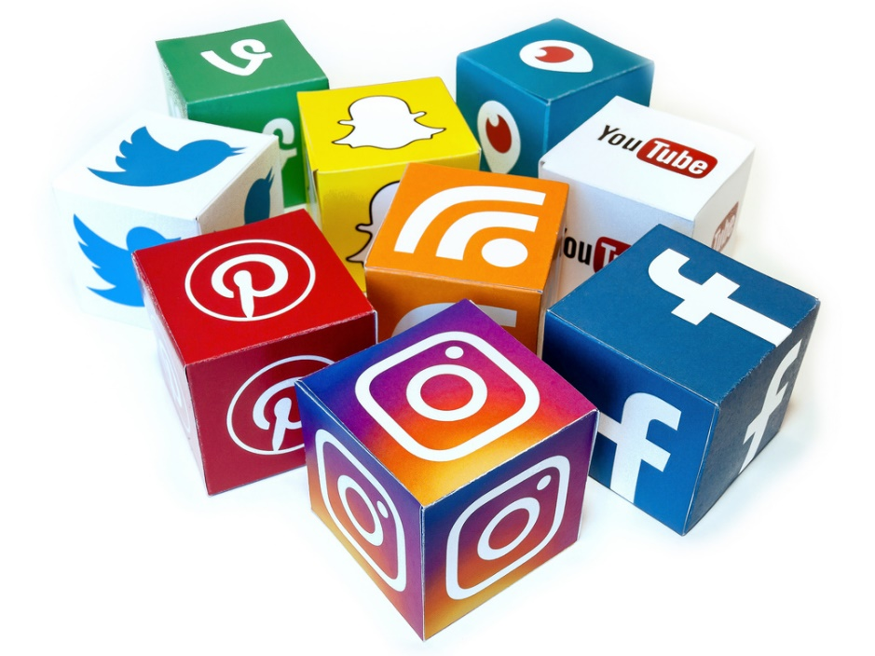
Social Media Communications
Changing how we view brands, customers, and media.
Integrating social media into the mix should be a priority.
Consumer control:
Brand democratization
Consumer-generated content
Crowdsourcing
Advertising on SM networks
Display ads
Sponsored posts
Video ads
Brand page (fan page)
Blogs
YouTube
Viral marketing and communications
Word of mouth
Reach potential
Engagement
Notes:
Democratization: customer gaining control
Crowdsourcing (Dorito’s – Crash the Superbowl) – collective talents of consumers to create content
BENEFITS OF SM communictions:

Slide 15

Mobile Media Communications
30 m wireless subscribers (Canada); 76% smartphones
Mobile devices have surpassed desktop computers for connecting to Internet.
Canadians spend as much as 75 hours per month on their mobile devices
Text Messaging
Video Messaging
Mobile Applications
QR Codes
Video Game Advertising
Notes:
Some facts about the mobile communications market:

Slide 16
Figure 14.21 Media Selection Considerations—Interactive Media Communications
Advantages | Disadvantages
Social Media Word of Mouth—brand endorsements by friends have positive influence Targeting—can reach precisely defined targets Engagement—consumers interact with brand | Social Media Word of Mouth—bad news about a brand travels fast Currency—considerable time required to “refresh” posted information Relevance—too many unsolicited “promotional” ads
Mobile Targeting—effectively reaches younger target Timing—can reach target at point of sale | Mobile Cost to Consumers—consumers may balk at data charges for downloads Image—intrusiveness borders on telemarketing image
Video Games Recall—heightened interest while playing game improves brand recall | Video Games Message—message can’t be changed in commercially sold games

Slide 17
ACTIVITY:

