Slide 1
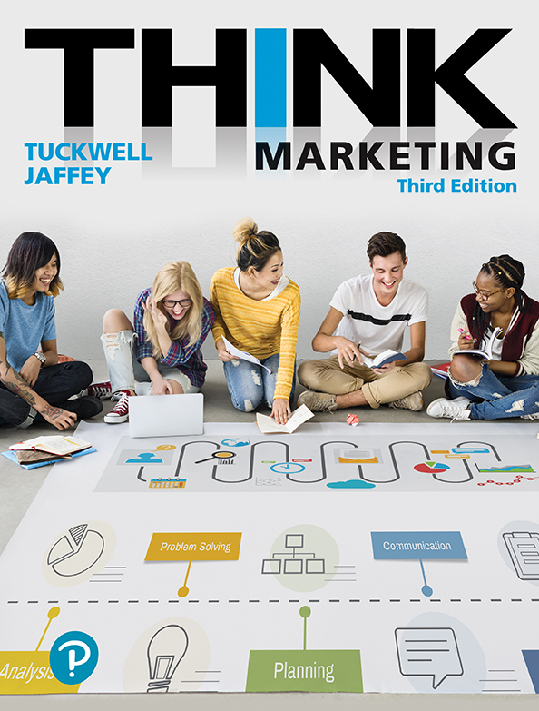
Chapter 11
Pricing Decisions: Objectives, Strategies, and Tactics
Copyright © 2019 Pearson Canada Inc.
Notes:
If this PowerPoint presentation contains mathematical equations, you may need to check that your computer has the following installed:
1) MathType Plugin
2) Math Player (free versions available)
3) NVDA Reader (free versions available)

Slide 2
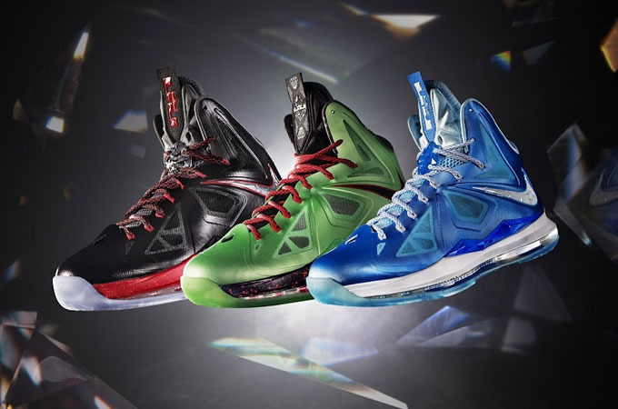
Price
“The exchange value of a good or service in the marketplace.”
Value is based on:
tangible and intangible benefits
Brand perception
Raw materials quality
Leading edge technology
LeBron endorsement
Impress peers
Nike

Slide 3
Influences on Price Decisions
Production and Marketing Costs
Channel Member Profit Expectations
Consumer Demand – Price Elasticity
Pricing Objectives

Slide 4
Production and Marketing Costs
Figure 11.3 Cost Components of a Packaged-Goods Product
 | Cost Items | Actual Cost
 | Ingredients | $15.75
 | Packaging (inner/outer) | 1.79
 | Shipping case | 0.68
 | Labour | 1.48
 | Manufacturing | 0.20
 | Warehousing | 0.34
 | Total Plant Cost | 20.24
Add: | Freight cost | 1.36
 | Total Product Cost | 21.60
Add: | Gross profit margin (40%) | 8.64
 | List Price | 30.24
Add: | Retail profit margin (25%) | 7.56
 | Retail price (per case of 24) | 37.80
 | Selling Price at Retail | 1.57
24 units
margins
Notes:
This example assumes a desired profit margin of 40% for the manufacturer of the product and a 25% markup at retail. The manufactured item is a case good that contains 24 packages in a shipping case. After all costs and profit margins are considered for the manufacturer and distributor, the price at retail is $1.57.

Slide 5
Reducing Costs that Influence Price
To protect profit margins a manufacturer will consider programs to reduce costs.
Improve operational efficiency
Use less expensive parts and materials
Shrink the size of the product (packaged good)
Relocate manufacturing facilities (lower labour rates)

Slide 6
Channel Members Profit Expectations
Manufacturer
Wholesaler
Retailer
Consumer
Each level (member) of channel must make adequate profit. Price of a product increases each time it changes hands.
Periodic price reductions (promotions) are offered by the manufacturer to encourage marketing support.

Slide 7
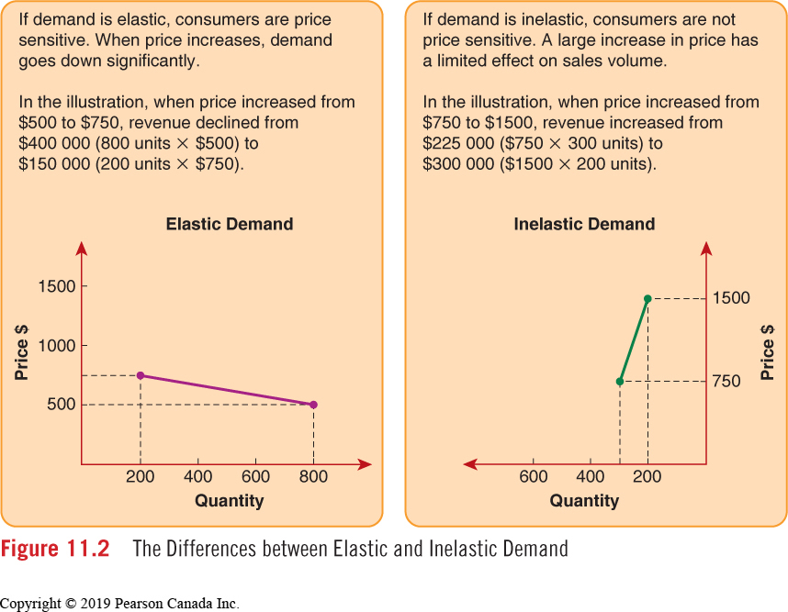
Consumer Demand: Elasticity
Notes:
Elastic – demand CHANGES based on pricing
Inelastic – demand CONSTANT (less elastic) based on pricing (less influence)
WHITEBOARD: Elastic and Inelastic – brainstorm products/services
Price Elasticity - two types of demand:
Elastic Demand – A situation where a small change in price results in a large change in volume.
Example: A price increase of 10% results in a volume decrease of 25%. In this case total revenues would go down.
Inelastic Demand – A situation in which a change in price does not have a significant impact on the quantity purchased.
Example: A price increase of 5% results in a volume decrease of only 2%. In this case total revenues would go up.

Slide 8
Pricing Objectives
Typically, there are three basic pricing objectives:
Maximizing Profit
Maximizing Sales Volume
Establishing a Competitive Position
Notes:
LO3
Pricing Objectives Influence Price Decisions
In a pure business environment, the primary goal of the organization is to produce the highest possible rate of return for the owner (shareholders, partners, sole proprietor, and so on). Pricing strategies are part of a marketing strategy that must be in line with this overall company strategy.
Profit maximization To achieve this, an organization sets some type of measurable and attainable profit objective on the basis of its situation in the market.
Sales volume maximization A firm strives for growth in sales that exceeds the growth in the size of the total market so that its market share increases.
Competitive pricing Placing prices above, equal to, or below those of competitors

Slide 9
Pricing Strategies
Price Skimming
Price Penetration
Competitive Pricing (Status Quo)
Notes:
LO3
Pricing Objectives Influence Price Decisions
In a pure business environment, the primary goal of the organization is to produce the highest possible rate of return for the owner (shareholders, partners, sole proprietor, and so on). Pricing strategies are part of a marketing strategy that must be in line with this overall company strategy.
Profit maximization To achieve this, an organization sets some type of measurable and attainable profit objective on the basis of its situation in the market.
Sales volume maximization A firm strives for growth in sales that exceeds the growth in the size of the total market so that its market share increases.
Competitive pricing Placing prices above, equal to, or below those of competitors

Slide 10
Strategy: Competitive Pricing
The price decision helps establish a desired competitive position in the market.
Above competition
Equal to competition
Below competition
Q-tips sets its prices well above its competitors.
Walmart sets its prices below all other department stores.

Slide 11
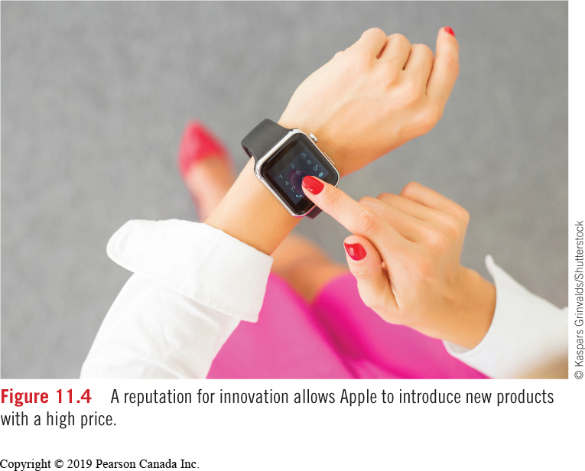
Price Skimming
Establishing a high entry price so that a company can maximize its revenue early.
Apple launched the iPod, iPhone and iPad with a skimming strategy.
Companies known for innovation have an advantage in terms of setting prices.
Setting high prices attracts competitors to a market.

Slide 12
Price Penetration
Establishing a low entry price to gain wide market acceptance quickly.

Slide 13
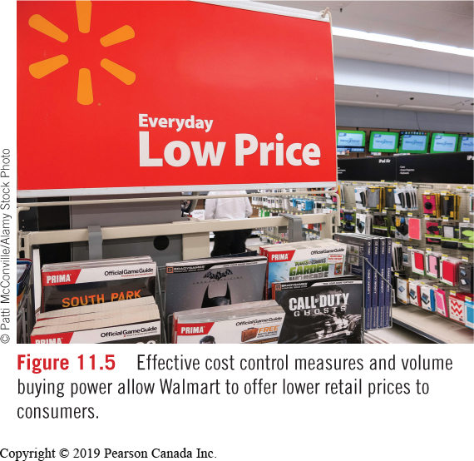
Competitive Pricing (Status Quo Pricing)
Placing prices above, equal to, or below those of competitors.

Slide 14
Price Tactics
Source Pricing and Offering Discounts
Quantity discounts
Cash Discounts
Trade or Functional Discounts
Slotting Allowances
Off-Invoice Trade Allowances
Performance (Promotional) Allowances
Seasonal Discounts
Rebates
Trade-In Allowances
Promotional Pricing
Flexible Pricing
Geographic Pricing
F.O.B. Origin (Plant)
F.O.B. Destination (Freight Absorption)
Uniform Delivered Pricing
Zone Pricing
Other
Psychological
Add-On

Slide 15
Pricing and the Law
Ignorance of the law is no excuse for a marketing manager.
Ordinary Price Claims
Double Ticketing and Bar Code Violations
Bait and Switch
Predatory Pricing
Price Fixing

Slide 16
Learning Outcomes (1 of 2)
Explain the importance of price in the development of marketing strategy.
Describe the various factors that influence price decisions.
Explain the difference among profit, return on investment, and sales pricing objectives.

Slide 17
Learning Outcomes (2 of 2)
Describe the various pricing strategies an organization considers to achieve price objectives.
Explain the various pricing tactics an organization employs to motivate purchase.
Describe how legal issues can affect pricing strategy.

Slide 18
Trade or Functional Discounts (1 of 3)
Slotting Allowance
Off-Invoice Allowance
Performance Allowance
To secure retail shelf space.
To encourage volume buying.
To secure merchandising activity.
A package of incentives offered together encourages stronger action among distributors.

Slide 19
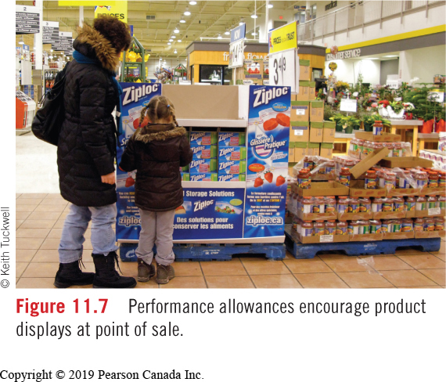
Trade or Functional Discounts (2 of 3)
A performance allowance is a price discount given by a manufacturer to a distributor that performs a promotional function on the manufacturer’s behalf.

Slide 20
Trade or Functional Discounts (3 of 3)
Figure 11.8 List Price and Discount Calculations
Information: Cost of product Trade discount Quantity discount Performance allowance Cash discount Customer purchases | $40.00 per case $4.00 per case 2% for each 100 cases 5% 2/10, n30 500 cases
Calculation of Price to Customer: List price Less: Trade discount (10%) Less: Quantity discount (2% X 5) Less: Performance allowance (5%) Less: Cash discount (2%) Net price Total discount Total percentage discount ($9.84/40) | $40.00 4.00 32.00 3.60 32.40 1.62 30.78 .62 30.16 9.84 = 24.6%

Slide 21
Flexible Pricing
A policy that allows for price negotiation. Different customers may pay different prices for the same product or service.
Airlines
Hotels
Houses
Cars
When flying don’t ask your seat neighbours how much they paid. It might ruin your trip!

Slide 22
Geographic Pricing
Answers the question: who pays the freight? The location of the customer has an impact on the way prices are quoted.
Figure 11.10 Who Pays the Freight?
Who Pays the Freight?
F.O.B. Origin, or Plant | Buyer | The buyer takes title when the product is on a common carrier (e.g., a truck).
F.O.B. Destination, or Freight Absorption | Seller | The seller pays all freight necessary to reach a stated destination.
Uniform Delivered-Price | Buyer | The buyer's price includes an average freight cost that all customers pay regardless of location.
Zone-Pricing | Buyer | All customers within a designated geographic area pay the same freight cost.

Slide 23
Psychological Pricing (1 of 2)
“Establishing prices that appeal to tendencies in consumer behaviour.”
There are many options:
Prestige Pricing
Odd-Even Pricing
Customary Pricing
Price Lining
Unit Pricing

Slide 24
Psychological Pricing (2 of 2)
Figure 11.13 Psychological pricing tactics get people to spend more.
How the price of a product is presented to consumers can have a significant influence on their reaction, and reaction will vary. It's all about psychology. Here are a few techniques that can influence buying decisions. Eliminate the Dollar Sign A restaurant menu shows a price of 25 instead of $25. Research by Cornell University showed people pay more when they only see a whole number and no dollar sign. Reduce the Font Size Research by the University of Connecticut revealed that the size of the price on a tag is linked in our brains with its magnitude. Price tags in smaller font sizes were more likely to be purchased than price tags in bigger fonts. An Anchor Helps The best way to sell a $600 handbag is to place a $1500 handbag beside it. People rarely know things are really worth so the more expensive bag is an anchor from which a person can make a decision.

