Slide 1
MID TERM FEEDBACK
Did More of:
Did Less of:
Group Work in class
Exam Review / Sheet; practice questions; how to study; where to focus
Homework practice
Practical hand-on exercises
Chapter review in class; lecture
Explain every topic
Student engagement in class
SA Questions in Exams
MC Questions in Exams
Exams
Group Work / Activities
Do the pre-class quizzes after the class
Reading
MC in exams
PowerPoint Slides; Chapter review, theory
Videos and Class exercises
Notes:
To do more in-class discussion, more exam review, - STUDENTS MUST BE PREPARED.
Case / Applied concept INSTEAD OF CHAPTER REVIEW – STUDENTS MUST BE PREPARED

Slide 2

Think Marketing
Third Edition
Chapter 10
Services and Not-for-Profit Marketing
Copyright © 2019 Pearson Canada Inc.

Slide 3
Learning Objectives
Outline the characteristics and behaviours that distinguish services marketing from product marketing.
Describe the elements of the services marketing mix.
Explain the nature, scope, and characteristics of not-for-profit marketing.
Describe the types of not-for-profit marketing.
Discuss the role and importance of marketing strategy in not-for-profit organizations.

Slide 4

THE SERVICE ECONOMY
What is the Service Industry?
Why is the Service Industry growing?
Notes:
What is the Service Industry? Why is it Growing?
Poll how many students in the class work in the service sector.
https://www.edc.ca/en/weekly-commentary/growing-trade-in-services-sector.html

Slide 5
LO 1: Outline the characteristics and behaviours that distinguish services marketing from product marketing.
Service Sector:
75% of Canadians work in service industry
Primary Categories:
Leisure and personal services
Food and beverage services
Accommodation
Business services
selection for class discussion
Notes:
legal, health, information technology, oil and gas, education, and recreation. SELECT ONE FOR DISCUSSION.
75% of Canadians work in the service industry, and it is likely they will have career opportunities in this sector. Clearly indicate why the service industry is growing (e.g., mention the external trends).
professional sports

Slide 6
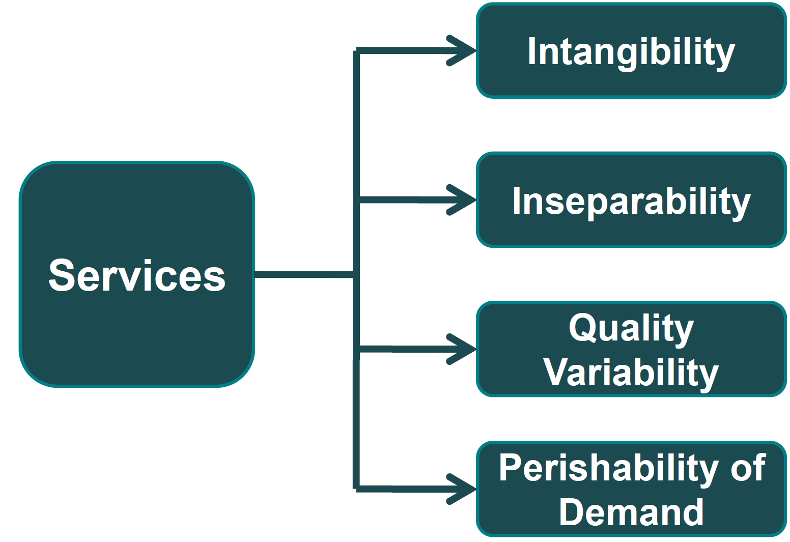
Characteristics of Services
example service?
Notes:
Describe each Characteristic for chosen Example.
Intangibility: not perceived by the senses – EXAMPLE?
Inseparability: difficult to separate service from provider- EXAMPLE?
Variability: variations in consistency – often tied to WHO is providing service – EXAMPLE?
Perishability: demand varies over given period – EXAMPLE?

Slide 7
Buying Behaviour in Services
Attitudes
A good impression is a strong influencer – of service and supplier.
Needs and
Motives
Convenience, expertise and personal attention help sell a service.
Purchase
Behaviour
People pay more attention when ready to buy; they also value the opinion of others.
example service?
Notes:
Differences in CONSUMER BEHAVIOUR toward Services (from Goods)
HOW BEHAVIOUR IS EVIDENCED IN EXAMPLE CONSUMER?

Slide 8
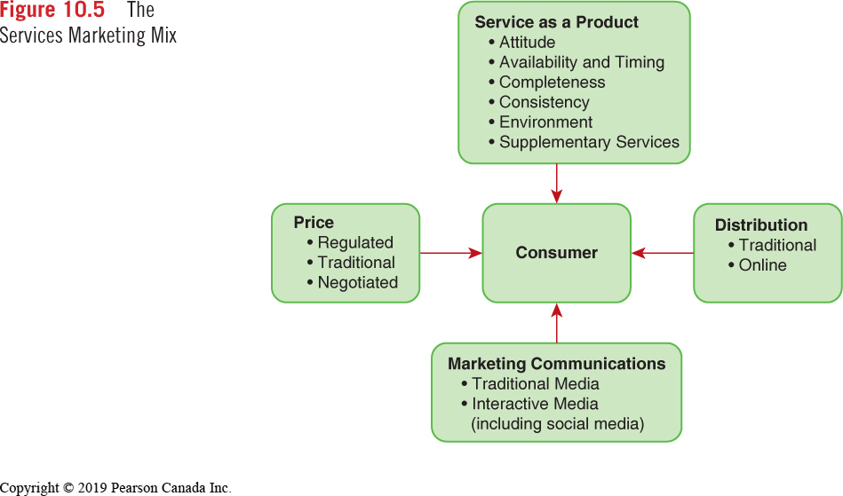
LO 2: Services Marketing Mix Elements
Notes:
pg 223 to 225
EXERCISE OR CLASS EXAMPLE?? THEN DISCUSS/SHARE
Customer is less interested in ownership and physical qualities and more interested in conveniences, timing, availability and consistency. INTANGIBLE QUALITIES OF SERVICE INCLUDES: (Product)

Slide 9


LO 3: Not-for-Profit and Cause Marketing
People, Causes, Ideas
Targets: fundraising goals vs. ROI, Volunteer time
Donor and Client considered
Persuading public to accept a given idea, cause or way of thinking
Notes:
NFP Emphasis is on people, causes, and ideas rather than goods and services.
There are many forms of exchange other than money, and targets are expressed in terms of fundraising goals instead of returns on investment and profits. Finally, two different targets are considered (the donor and the client) in developing marketing strategy.
One major goal of not-for-profit marketing is to raise funds or other resources such as volunteer time. These goals may be subordinate to changing attitudes, finding cures, and so on.
Cause Marketing: Cause marketing involves persuading the public to accept a given idea, cause, or way of thinking. An example is an anti-drinking and driving campaign, a seatbelt campaign, or a campaign to promote healthy lifestyles.

Slide 10

LO 3: Not-for-Profit Marketing
Not-for-profit marketing refers to the marketing efforts and activities of not-for-profit organizations.
Philosophy
People, causes, ideas, organizations
Exchange
Psychological satisfaction of supporting cause
Objectives
Not always quantifiable, measurable
Benefits Derived
Material benefits not shared by all
Notes:
NFP Characteristics:

Slide 11
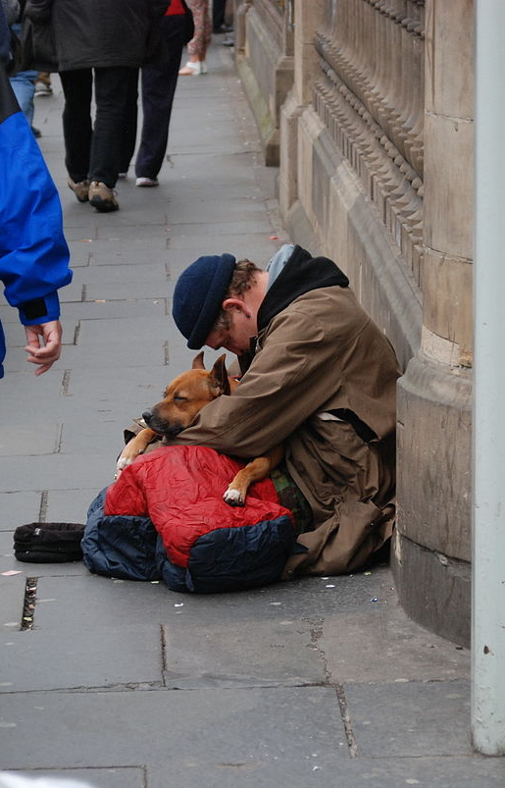
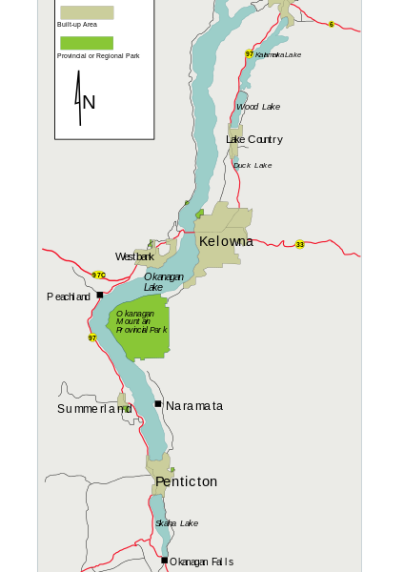
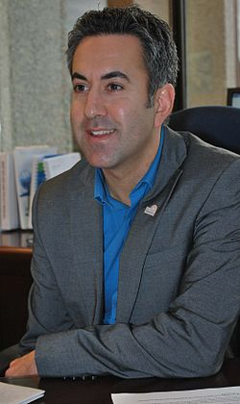

LO 4: Types of NFP Marketing
There are four categories of not-for-profit marketing:
Organization marketing
People marketing
Place marketing
Idea marketing
Notes:
WHICH IS WHICH? One Example for EACH:
OC – OC Foundation – building new health building
Colin Basran – Mayor
Okanagan Region Tourism
Journey Home – homelessness

Slide 12
LO 5: Marketing Strategy for Non-Profit
Product
Organizations believe they provide what the public needs. The public simply needs to be made aware of a certain viewpoint.
Price
Money may change hands (donation) but time and expertise are volunteered.
Distribution
Channels are direct (organization to donor).
Marketing
Communications
Media advertising plays a big role - creating awareness and communicating important details call for a well-rounded media mix.
Notes:
NFP as a Brand Product is OPPOSITE of profit-oriented firm; what does PUBLIC NEED?

Slide 13
TUESDAY EXAM: CHAPTERS 10 AND 12
How to Study:
Review Chapter Summaries
Online Textbook Quizzes

