Slide 1
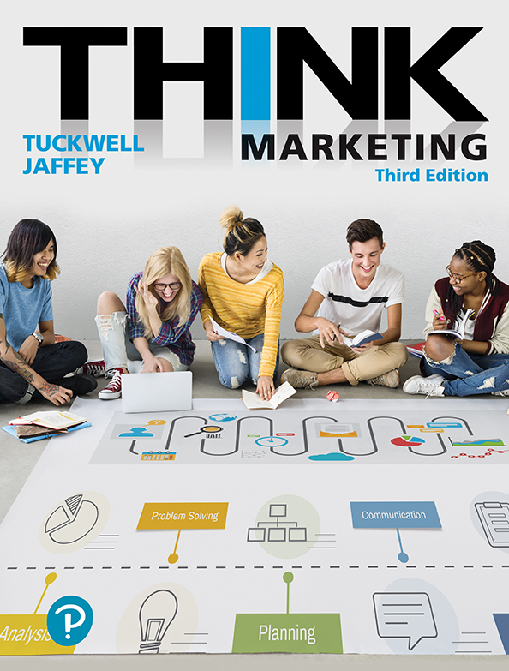
Think Marketing
Third Edition
Chapter 12
Distribution and Supply Chain Management
Copyright © 2019 Pearson Canada Inc.
Notes:
If this PowerPoint presentation contains mathematical equations, you may need to check that your computer has the following installed:
1) MathType Plugin
2) Math Player (free versions available)
3) NVDA Reader (free versions available)

Slide 2
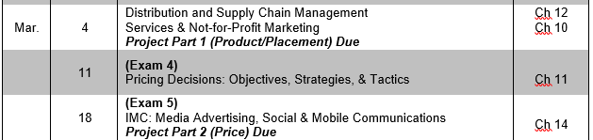
TODAY
Project Part 1 due Thursday @ 23:55
Thursday – Chapter 10
NEXT EXAM (3): Tuesday March 12th (one week!)

Slide 3
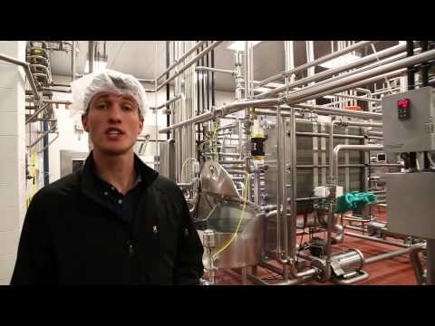
BYU Ice Cream’s Supply Chain Management
Notes:
https://www.youtube.com/watch?v=Twh6KrAEwR0&t=224s
Alternate: Lemonade Stand
https://www.youtube.com/watch?v=gBRrG0-SA1I

Slide 4
LO 1: Define distribution planning and describe the role of intermediaries in the distribution channel.
A systematic decision-making process regarding the physical movement and transfer of ownership of goods and services from producers to consumers.
POSSESS
STORE
RESELL
INTERMEDIARIES
WHOLESALERS
RETAILERS
Notes:
Intermediaries play a key role in the distribution of goods and services and may take possession of goods, store goods, and resell goods to the target market.
Includes Wholesalers and Retailers

Slide 5
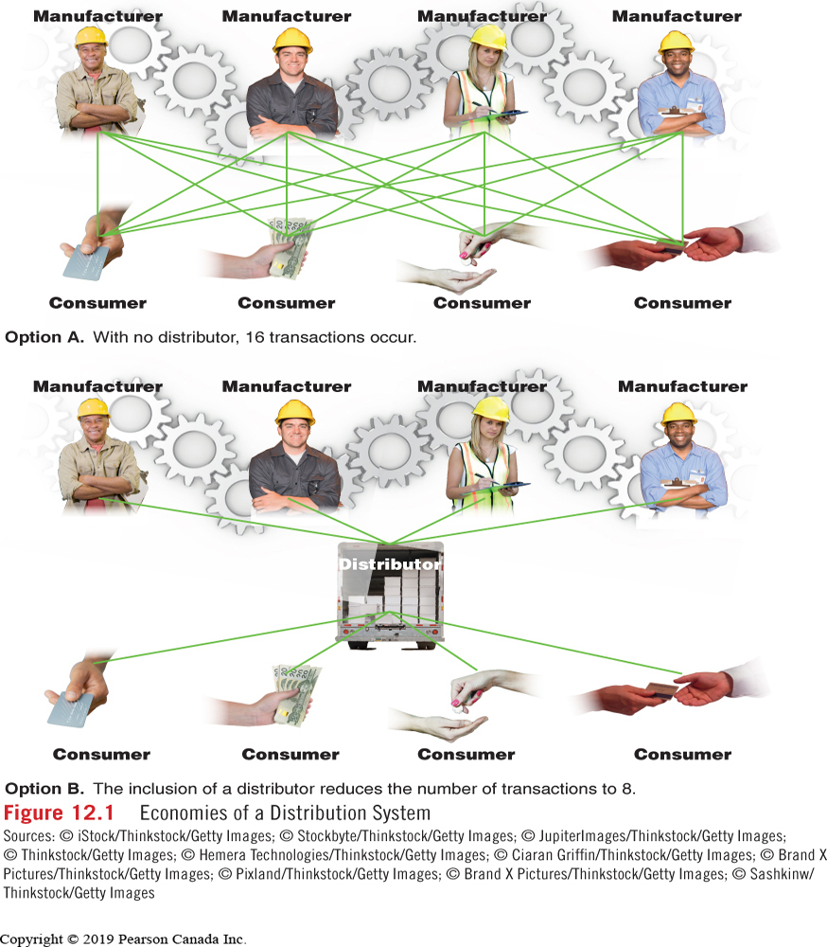
Economies of a Distribution System

Slide 6
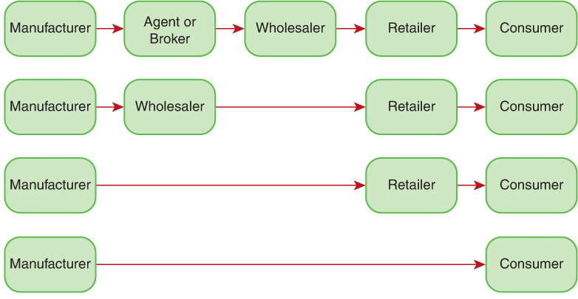
LO 2: Describe the structure of different types of distribution channels.
CHANNEL LENGTH
CHANNEL
WIDTH
Provide Market Coverage
Hold Inventory
Process Orders
Perform Market Intelligence
Provide Customer Service
Provide Merchandise Assortment
Break Bulk
Retailer
Retailer
Retailer
Notes:
Indirect = longer
Direct = shorter
NIKE SHOES – 3rd party retailer vs. own store
NAME SOME ITEMS IN EACH CHANNEL? iPhone, bread, produce, handmade soap, Honey, oranges, jeans, shoes, textbook
WHOLESALER FUNCTIONS MAY INCLUDE…

Slide 7
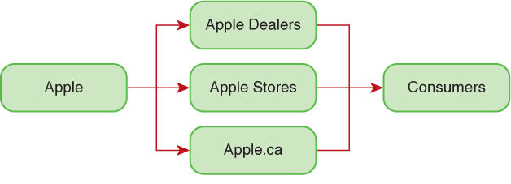
LO 3: Evaluate new channel strategies as a means of gaining competitive advantage.
A company uses different types of intermediaries at the same level in the channel to reach various customer groups.
Notes:
Channel Strategies include: Electronic Marketing (Internet), multi-channeling (different types of intermediaries at each level of channel to reach various customer groups – ie Apple) and contract marketing – partnerships for distribution, could be exclusive, often time-bound.

Slide 8
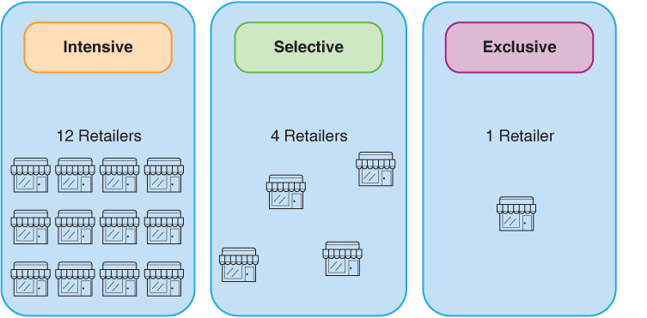
LO 4: Describe the influences that are considered when selecting a distribution channel.
Should the channel be a direct or indirect channel?
Product and Service Characteristics
Competition
Financial Resources Available
Desired Intensity of Distribution

Slide 9
LO 5:Describe the nature of relationships between members of a channel of distribution.
Horizontal conflict between similar organizations at the same level in the channel of distribution.
Vertical conflict occurs when a channel member feels that another member at a different level is engaging in inappropriate conduct.

Slide 10




Channel Control
Manufacturer Control
Distributor (Wholesaler) Control
Retailer Control
Economic clout often determines who controls the channel.
Notes:
A channel captain is a leader who integrates and coordinates the objectives and policies of other members in the channel.
Control can be at any level;

Slide 11
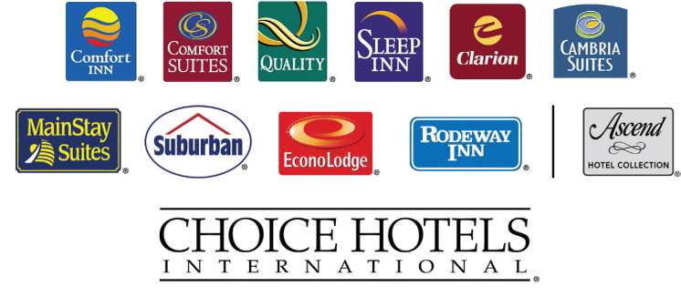
LO 6: Explain the concept of integrated marketing systems.
VERTICAL SYSTEM
HORIZONTAL SYSTEM
Linked at different levels:
Administered VMS
Contractual VMS
Corporate VMS
many channel members at one level have the same owner, operated under different banner (brand):
Backward integration
Notes:
To GAIN CONTROL of a channel or foster cooperation, a firm develops a planned integrated marketing system.
VERTICAL: adminsterd – org with most economic influence has control: LOBLAWS, COSTCO, WALMART
Contractual – governed by legal agreement: cooperatives, voluntary chain, franchise agreements
Corporate – SINGLE CORP owns and operates each level; George Weston LTD: OWNS Loblaws, NoFrills, Real Canadian Superstore…. Many others.
Backward Integration: when a manufacturer purchases some or all of its suppliers.

Slide 12
LO 7: Explain how supply chain management systems are improving operational efficiency in the channel of distribution.
Objective of SCM is to reduce costs while maintaining the most efficient and productive distribution system possible.
Collaboration and cooperation among members to optimize efficiencies
Technology plays key role
Notes:
It involves much collaboration and cooperation among members of the channel to optimize the efficiencies of the system. Effective supply chain management is crucial and in that regard technology plays a key role. Supply chain management has embraced technologies such as EDI (electronic data interchange), in which information is exchanged electronically between channel members, and RFID (radio frequency identification), which allows members to track the location of goods anywhere in the channel. The objective of supply chain management is to reduce costs while maintaining the most efficient and productive distribution system possible.

Slide 13
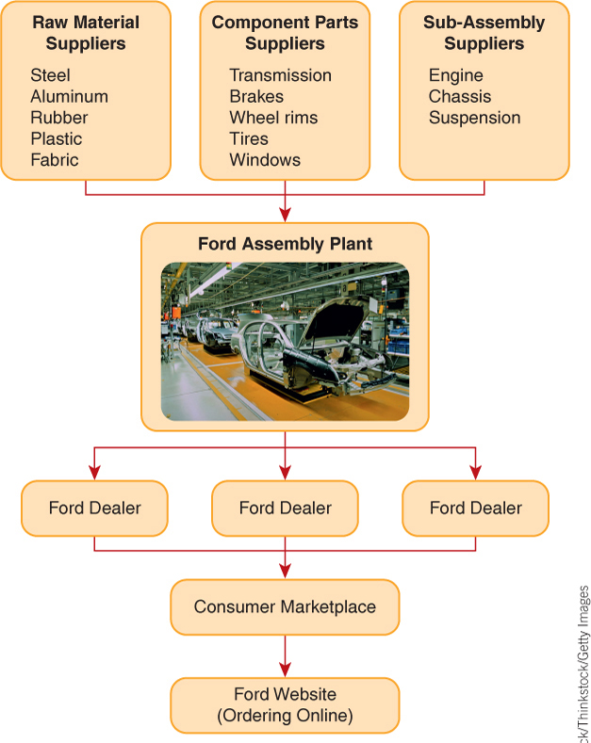
A Seamless Supply Chain
Supply Chain –perform activities related to the creation and delivery of goods.
Supply Chain Management
integration of information
facilitates efficient production and distribution of goods
Notes:
Technology is playing a key role in improving distribution systems. Supply chain management programs involve all members of the channel.
EDI – computerized transfer of information among members
additional technology = RFID and BAR CODES

Slide 14
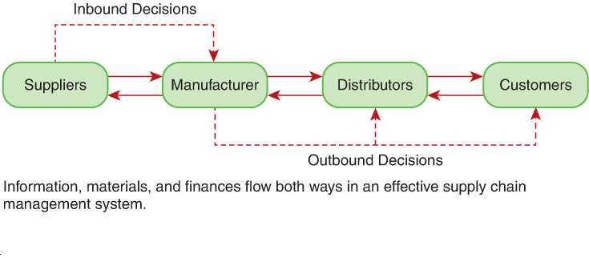
Supply Chain Management System
Movement of goods from suppliers to point of manufacture
Movement of goods from point of manufacture to customers

Slide 15
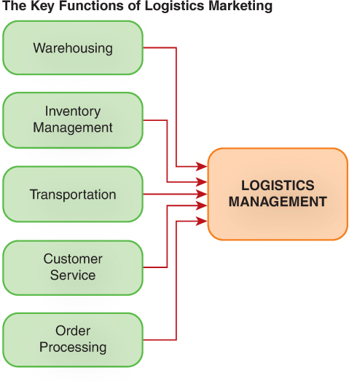
LO 8: Describe the key logistics marketing functions in a supply chain.
      Order Processing
      Warehousing
        Storage Warehouse
        Distribution Warehouse
      Inventory Management
        Just-in-time
      Transportation
        Roads, Rail, Air, Water
        Internet
Notes:
Logistics involves the Planning the physical flow of materials, finished goods and information.
Transportation – most expensive / cost component
The Internet acts as an invisible distribution system for products such as software, music, media, and financial services.

