Slide 1
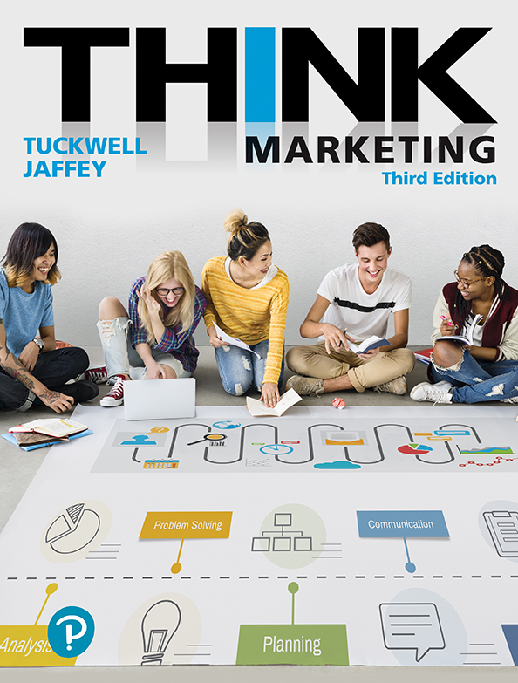
Product Strategy
Product Management
Exam 3 – Thursday
March 7 – Part 1 Due
Review assignment instructions
Communication Reminder !
Notes:
I do not respond to emails asking me simple questions that are answered on Moodle!!

Slide 2
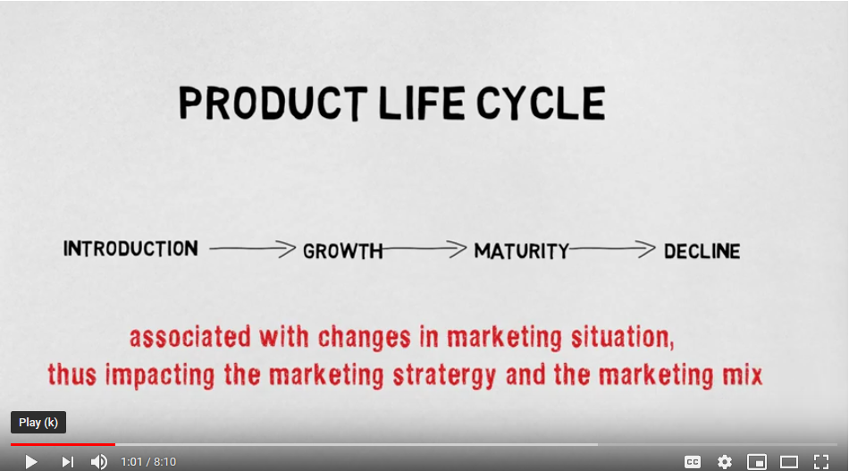
Notes:
Life cycle using Blackberry (8:03)
https://www.youtube.com/watch?v=jYbc4HfhPuQ

Slide 3
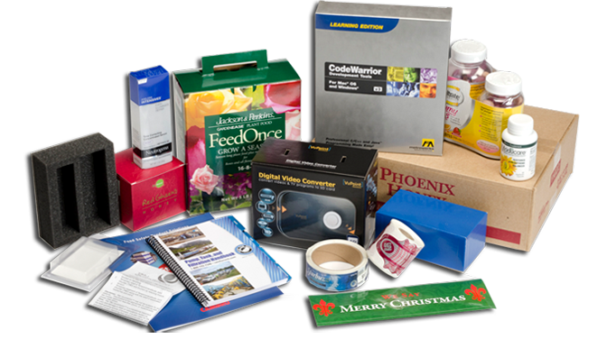
Total Product Concept
A product is a bundle of tangible and intangible benefits a buyer receives in exchange for money and other considerations.
Package of Benefits
Physical product
Brand name
Package
Service guarantee
Brand image
Warranty, etc.
This Photo by Unknown Author is licensed under CC BY-SA

Slide 4
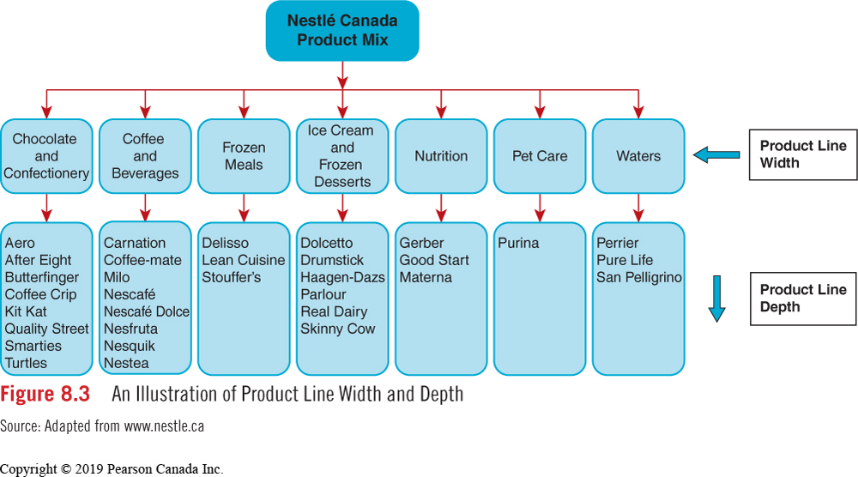
Product Item
The Product Mix
The total range of products offered for sale by a company.
A unique product offered for sale; it has a “unique selling point” or “USP.”
Notes:
Product Line width = # of items in product LINE
Product Line depth = # of LINES in the MIX

Slide 5
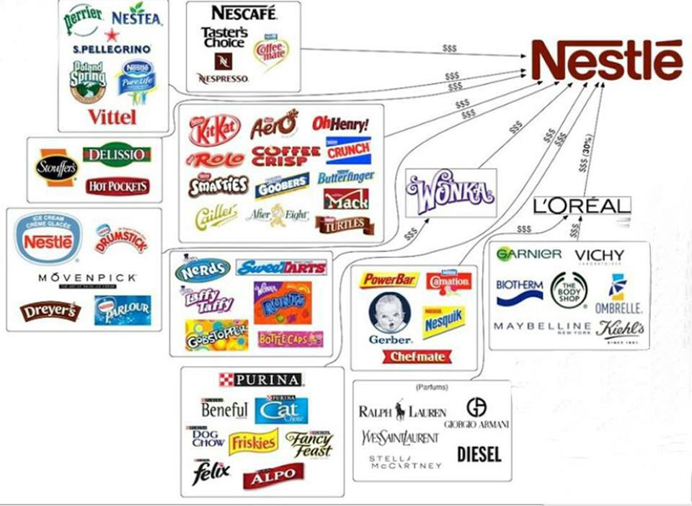
Notes:
product mix – all product items
Product line depth – MANY PRODUCT LINES: BABY FOOD, COSMETICS, PERFUM, PET FOOD, CHOCOLATE BARS/Candy Bars
PRODUCT LINE WIDTH …. 13 items in Chocolate Bar Line

Slide 6
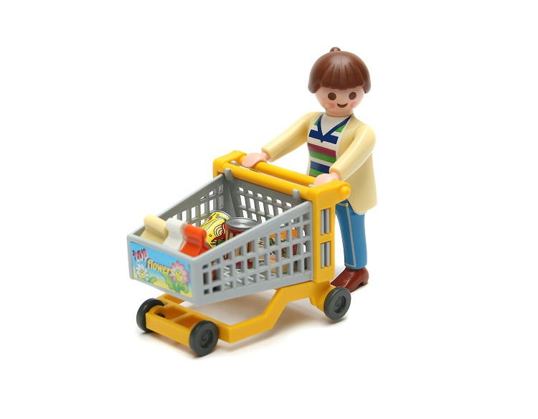
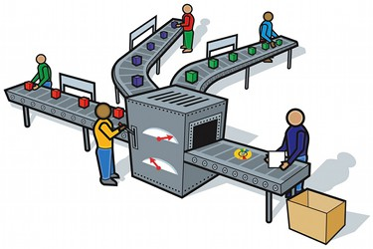
Product Classifications
Consumer Goods: Products and services ultimately purchased for personal use.
Industrial (business) Goods: Products and services purchased to be used directly or indirectly in the production of other goods for resale.
This Photo by Unknown Author is licensed under CC BY-SA-NC

Slide 7

Categories of Consumer Goods
Basis of Comparison | Convenience | Shopping | Specialty
Examples | Bread Cookies Shampoo Deodorant | Automobiles Clothing Home furnishings Cleaning services | Coach handbags BMW automobiles Rolex watches
Product | Attractive package Proven performance Brand name | Quality Style Reliability | Brand name Brand image Reputation Superior quality
Price | Relatively inexpensive | Fairly expensive | Usually very expensive
Distribution | Widely available in many outlets | Available in a large number of selective outlets | Only available at a few resellers
Marketing communications | Focus on price and availability | Personal selling at point-of-sale | Focus on brand status and quality
Consumer buying behaviour | Purchase often Little time spent in researching purchase | Purchase infrequently Some time and effort made to compare alternatives | Purchase infrequently A lot of time and effort is put into purchase decision process
Figure 8.4 Marketing Considerations for Consumer Goods

Slide 8
Industrial (Business) Goods
Category | Type | Examples
Capital Items | Installations Accessory equipment | Buildings Production line equipment Computer systems Computers Photocopiers Office furnishings
Parts and Materials | Raw materials Processed materials Component parts | Crude oil Lumber Farm goods (wheat, milk, fruit) DuPont Nylon Glass windows Tires Steel frames
Supplies and Services | Office supplies Consulting Other services | Paper and stationery Tax or legal counsel Office cleaning services
Figure 8.6 Categories of Industrial (Business) Goods and Services

Slide 9
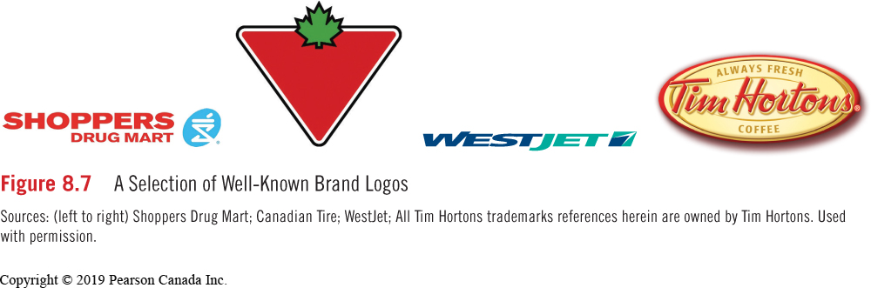
Brand and Branding Strategies
A name, term, symbol, or design, or some combination of these, that identifies a good or service.
Three key areas to develop a brand strategy:
brand name and designing the brand logo
packaging and determining what information goes on the label
the actual product design (if a durable good)

Slide 10
Components of a Brand
Brand Name – The part of a brand that can be vocalized.
Brandmark or Logo – The part of a brand identified by a symbol or design.
Trademark – The part of a brand granted legal protection so that only the owner can use it.
Patent - A provision that gives a manufacturer the sole right to develop and market a new product, process, or material.

Slide 11
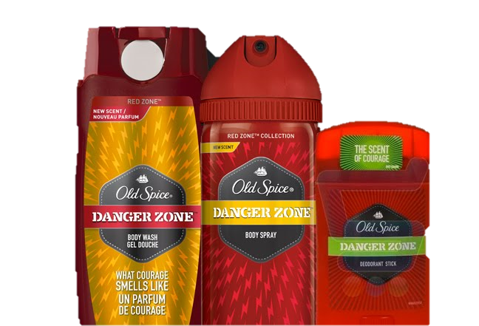
Family Brands
The use of the same brand name for a group of related products.
Procter & Gamble uses a family brand strategy Old Spice for personal care product line.
Old Spice Body Wash
Old Spice Body Spray
Old Spice Hair Care and Styling
Old Spice Trimmers and Shavers
This Photo by Unknown Author is licensed under CC BY-NC-ND
Notes:
Prior to 2010, Old Spice was seen as a brand for older generations, a somewhat uninteresting and stagnant brand that wasn’t especially bad or especially good. Then, in a massive rebranding stunt, they came out with a new advertisement (and a series to follow) featuring athlete Isaiah Mustafa in a strange, funny, “random” video implying the deodorant to be something sexy, surprising, fun, and youthful. The rebranding effort was a success, in part, because it helped a new demographic access a traditional product. It capitalized on new trends, like non-sequitur-based humor and online videos, and ended up being a massive boon for the brand.
https://www.youtube.com/watch?v=owGykVbfgUE

Slide 12
Co-Branding
Using the equity of one brand name to market another: two brand names on the product.
Private-Label Brands
Brands produced to the specifications of the distributor, usually by national brand manufacturers that make similar products under their own brand names
Company
Canadian Tire
Costco
Loblaws
Sobeys
Walmart
Brand Name
Mastercraft, Motomaster
Kirkland Signature
President’s Choice, Joe Fresh
Compliments
George, Great Value
Generic Brands
A product without a brand name or identifying features.

Slide 13
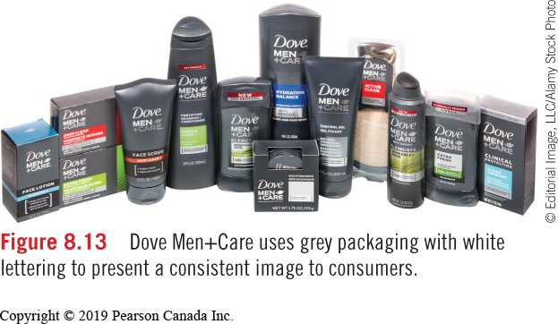
Packaging in Action
Primary Package, Secondary Package, Labels, Shipping Carton
A good package:
Protects the product
Markets the product
Provides convenience
Meets social concerns
Notes:
Unilever launched Dove Men+Care with a medium grey colour that was unique to the product category. The shape also considered “grip” when in the hands of a male.
Primary Package - contains the actual product (e.g., the jar that contains the jam).
Secondary Package - outer wrapper that protects the product, often discarded when the product is used the first time.
Labels - printed sheets of information affixed to a package container.
Shipping Carton - packaging that can be marked with product codes to facilitate storage and transportation of merchandise

Slide 14
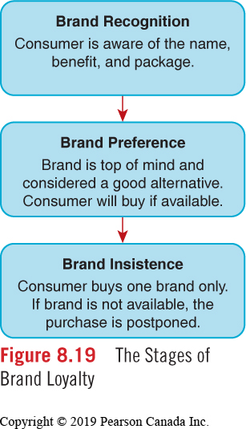
Stages of Brand Loyalty
Brand Equity Measurements
Name awareness
Loyal customer base
Perceived quality
Brand attributes
Notes:
REBRANDING - https://blog.advids.co/20-brilliant-product-rebranding-video-examples/
SAVANNA paint
BOOKER product = growth + product lines – colour

Slide 15
Learning Objectives
Explain the total product concept and product mix.
Describe how consumer and business goods are classified.
Explain the role and importance of branding strategies.
Discuss the role of packaging and labelling in the development of product strategies.
Explain the benefits of branding.
Describe the various stages of brand loyalty and how brand equity is created.

Slide 16
Product Management
Product management concerns three key areas:
The internal organization structure for managing current products.
The allocation of resources for developing new products.
Dealing with changing market conditions as products progress through their life cycles.

Slide 17
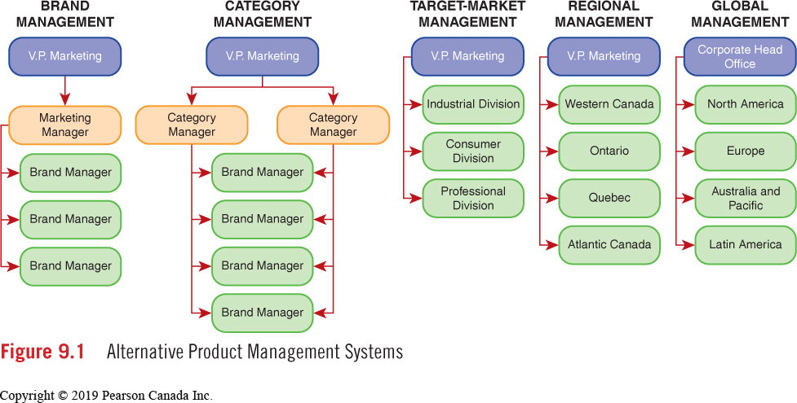
Organizational Structures for Managing Brands
Notes:
A brand manager responsible for the development and implementation of marketing programs for a specific product or group of products.
Category Management – A category manager is assigned responsibility for developing and implementing marketing activity for a group of products or product lines.
Target Market Management – Marketing activity is managed based on the requirements of different customer groups.
Regional Management – Marketing activities are managed based on the needs of customers in different geographical locations.

Slide 18
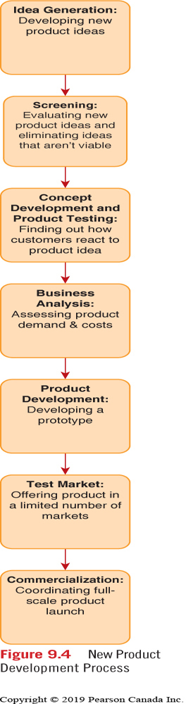
New Product Decisions
All aspects of the marketing mix are managed to maximize profit.
Key product decisions embrace:
Product Modifications
Product Mix Expansion (Stretching)
Brand Design and Packaging
Maintenance or Withdrawal (Planned Obsolescence)
Notes:
KNOW THIS – and steps within

Slide 19
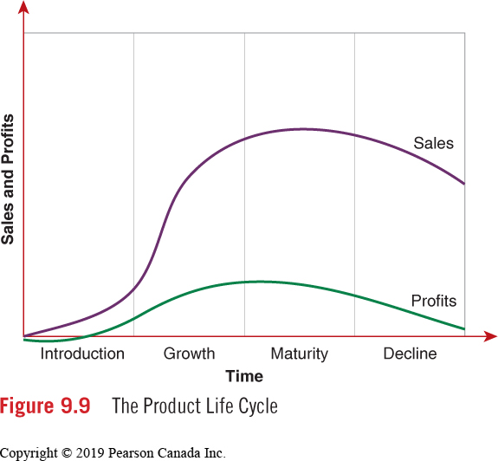
The Product Life Cycle
time, sales and profits determinants of a product’s stage in the life cycle.
Notes:
be able to draw this and label!

Slide 20
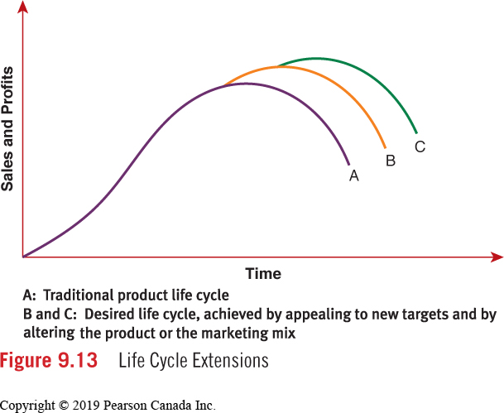
Extending the Product Life Cycle
Rejuvenation strategies:
Attract New Markets
Alter Product (Improvements)
Introduce New Product Lines (Line Extensions)
Change Other Marketing Mix Elements
Many brand managers attempt to rejuvenate brands and extend their life cycles for as long as possible.
Notes:
Factors at various stages in life cycle ACTIVITY

Slide 21
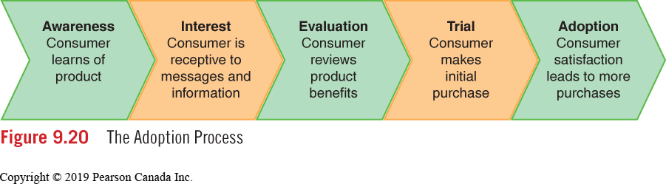
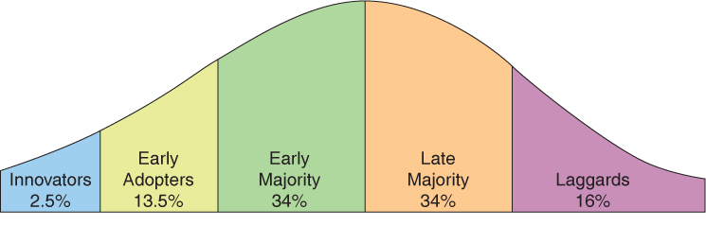
The Adoption Process
Series of stages a consumer passes through on the way to purchasing a product on a regular basis.
Notes:
Innovators: risk takers and trendsetters; eager to try
Early Adopters: opinion leaders; affected by status and prestige
Early majority: like to buy proven commodity; mid-range social & economic status
late majority: buy established products; lower in social and economic status
Laggards: do not like change; last group to buy the product

