Slide 1

Registering for MyLab™

Slide 2
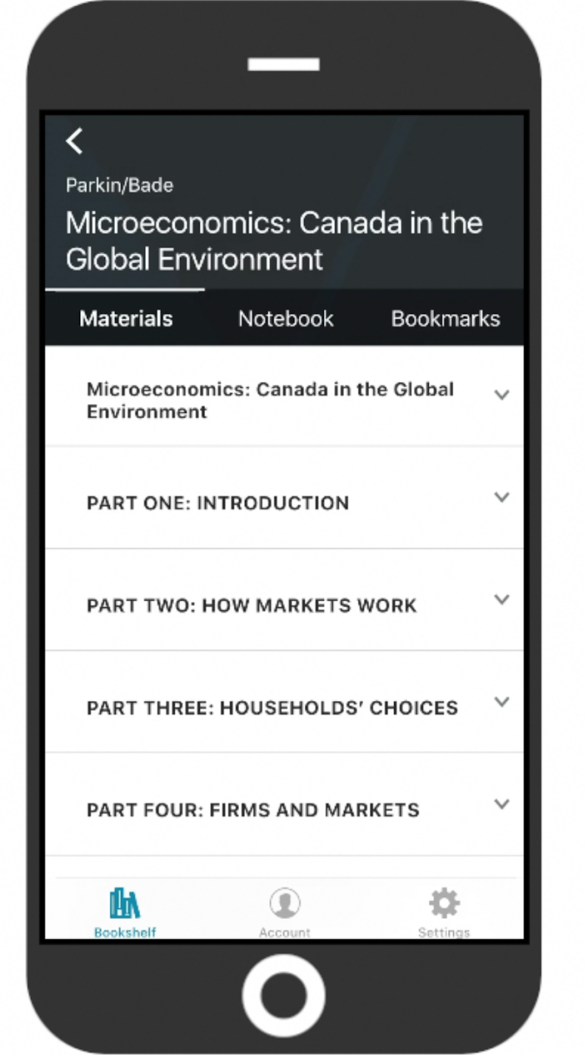


Pearson eText App
Study anytime, anywhere!
Read your text anywhere you go
Offline access
Store bookmarks and notes
Highlight key passages
Access all your Pearson eTexts in one place, including your MyLab and Mastering courses!
Download eText for FREE
iPhone and iPad
Presentation Title Arial Bold 7 pt
2

Slide 3


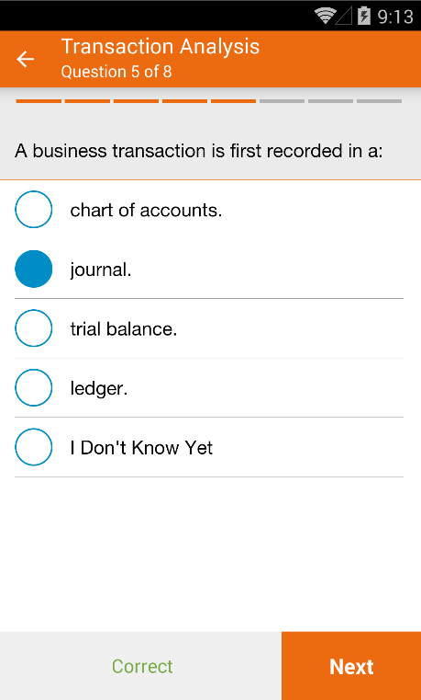
MyLab/Mastering Study Modules App
Study anytime, anywhere!
Questions delivered in groups of 6-8
Indicate how confident you are
Learn faster by asking and answering questions
Highlights areas for review
Learn at your own pace with personalized learning
Download for FREE
iPhone and iPad
Notes:
Dynamic Study Modules present study questions, delivered in groups of 6-8 questions for short bursts of learning to keep reduce fatigue Even though you might not have studied the material yet, recent scientific findings demonstrate that the process of asking and answering questions first actually triggers the brain to learn faster.

Slide 4

Step 1: Go to www.pearsonmylabandmastering.com
(We recommend you use Chrome or Firefox)
Select Register-Student

Slide 5
Step 2: Confirm you have...
Email Address
Course ID
Access Code
Make sure it’s one you check often —your school email will probably be the best bet.
Your instructor will provide this.
Your Course ID is: jaffey61604
Either enter the code you purchased from the bookstore (packaged or alone), or have your credit card or PayPal account ready.

Slide 6
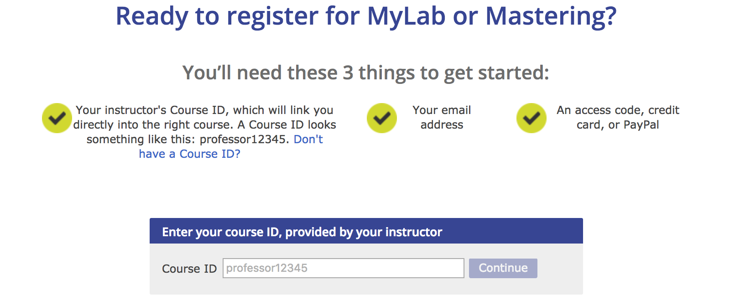
Step 3: Enter your Course ID
Your Course ID is: jaffey61604

Slide 7
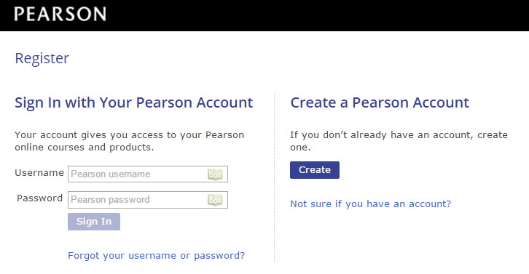
Step 4: Sign in or create an account
On the next page, you will be asked to create a Pearson account or sign into an existing Pearson account.
If you already have a Pearson Account (if you have used a Pearson product in one of your other courses), sign in with your Pearson account.
If this is your first time registering for a Pearson product, click Create and fill out the necessary information.

Slide 8
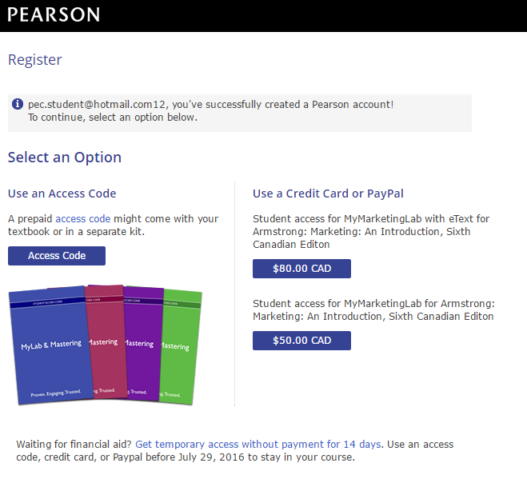
Step 5: Select your access option
Option One:
“Use an Access Code”
Choose this option if you purchased your access code at the book store, either on its own or packaged up with a print textbook or loose leaf text.

Slide 9
Step 5: Select your access option
Option Two:
“Use a Credit Card or PayPal”
Choose this option if you have not yet purchased your access code. This will give you immediate access to the product.
Your options may include:
MyLab + eText **BEST VALUE!**
MyLab + loose leaf print
MyLab alone
*Note: if you purchase MyLab alone, you can later “upgrade” your package to include the eText or loose leaf.

Slide 10
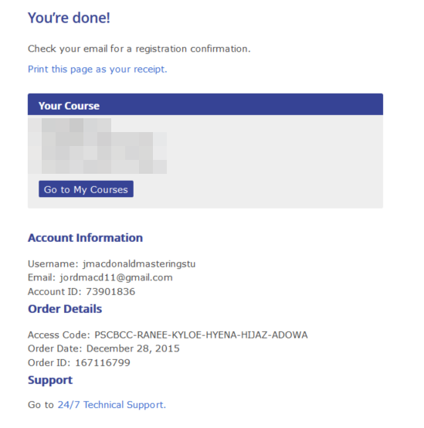
Step 6: You’re done!
When you see the “You’re done!” screen, you have successfully completed registration. Print the confirmation screen for your records (you will also receive an email).
Click Go to My Courses and select your course to begin.

Slide 11
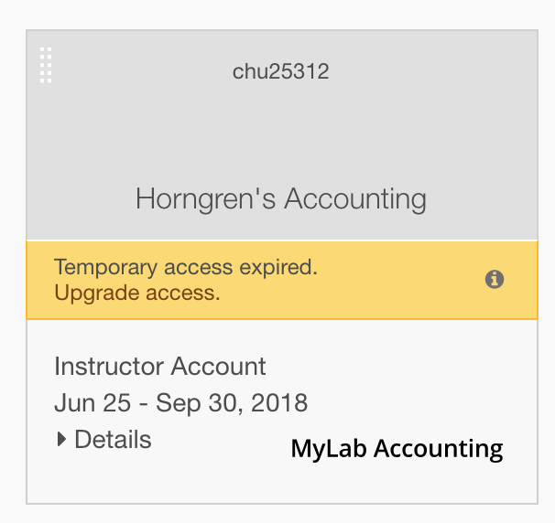
Upgrading from Temporary Access: Step 1
Your course will be greyed out and you will be prompted to “Upgrade Access”. Click to begin.

Slide 12
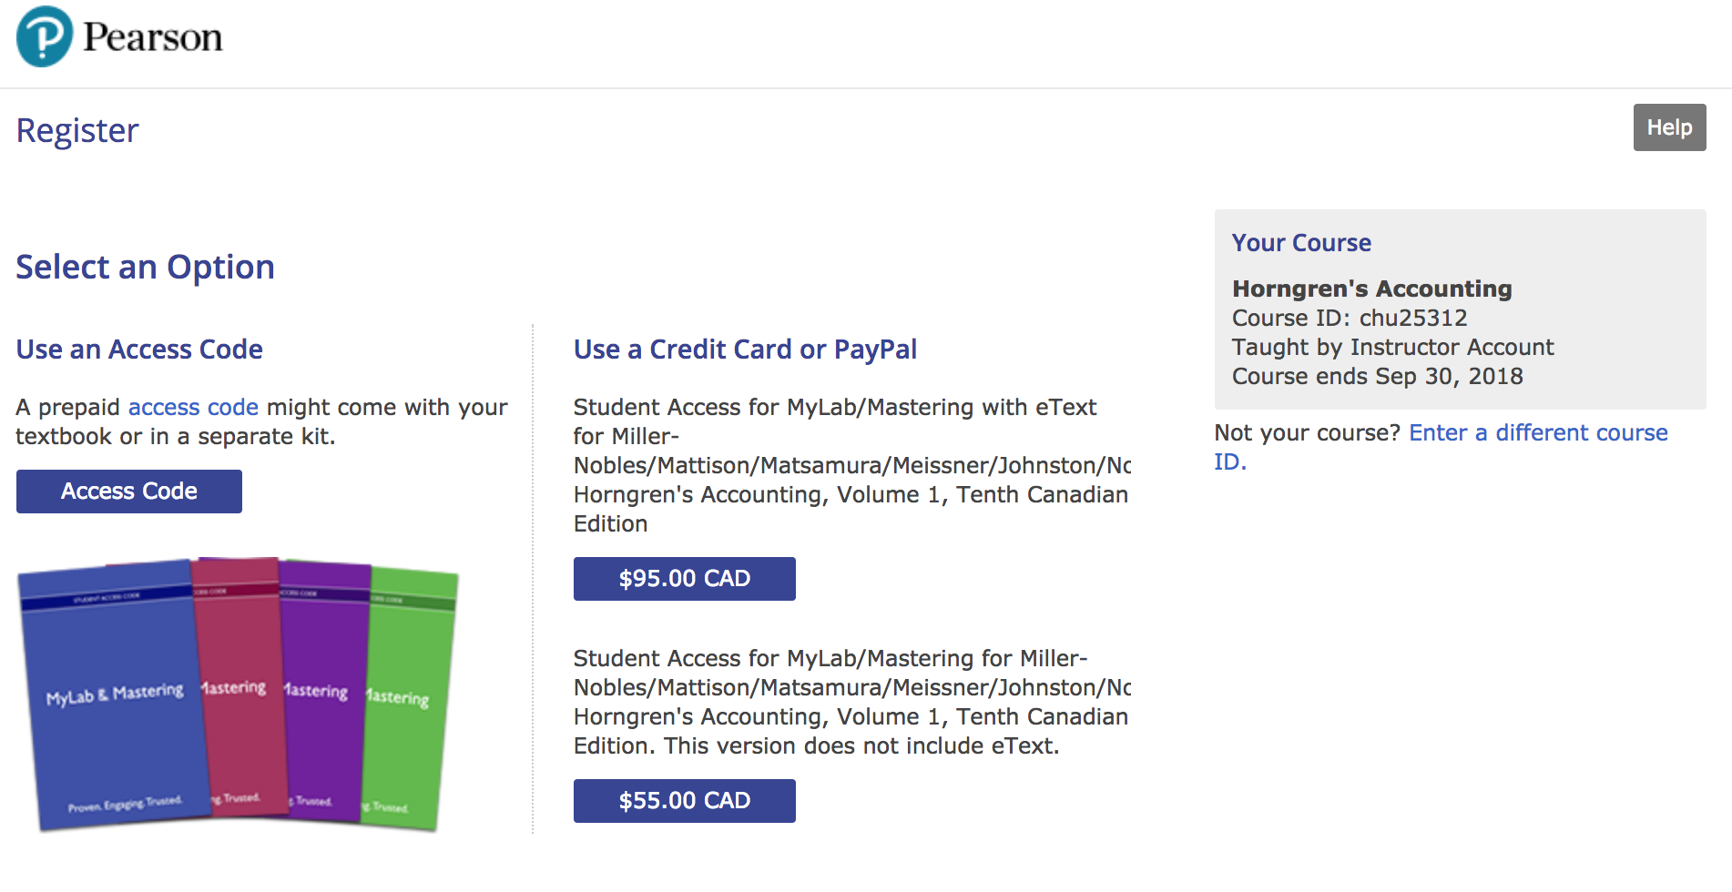
Upgrading from Temporary Access: Step 2
Your same purchasing options are available. You can:
Use an Access Code or;
Use a Credit Card or PayPal

Slide 13
Upgrading from Temporary Access: Step 3
When you see the “You’re done!” screen, you have successfully completed your Upgrade. Print the confirmation screen for your records (you will also receive an email).
Click Go to My Courses and select your course to begin.

Slide 14
Watch this video for a registration walk-through
Check out the PearsonStudents YouTube channel for tips on how MyLab and Mastering can help you
Check out the Get Started website for lots more information!
Get information about your specific MyLab platform

Slide 15



Need Help?
Contact Pearson 24/7 Support:
https://support.pearson.com/getsupport
@PearsonCanada @PearsonCanadaEdu

Slide 16

For more information, purchasing options, and registration info, visit:
www.pearsoncanada.ca/getstarted
@PearsonCanada @PearsonCanadaEdu

Slide 17
Get Started!

