Slide 1

Welcome to Marketing BUAD 116-008
AGENDA
Introductions
Course Syllabus
Assignments and Evaluation
Moodle and MyLab
Schedule and structure
Class Expectations
Next Class

Slide 2
What Does Marketing Mean to You?
Notes:
Brainstorm all terms… what does marketing mean to you?

Slide 3

Notes:
https://www.youtube.com/watch?v=WYP9AGtLvRg (6:31 minutes)
Find Your Greatness commercial – what was the message? Who is the market? What are they selling?

Slide 4
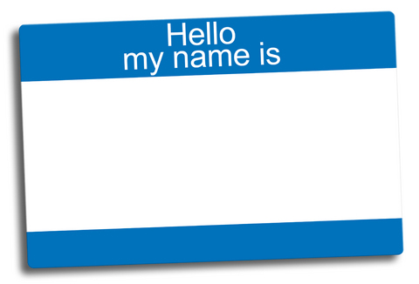
Getting to know each other
Teams of 4 – at least 3 people you don’t know yet.
Find 3 things in common with ALL others.
Notes:
Spending the next 13 weeks together…
5 minutes

Slide 5
What did you learn?
Notes:
(3:00) students share group similarities
Pam – records on whiteboard

Slide 6





About Pamela Carey Nelson, MBA
Ask me something you don’t know?
Cominco Ltd. (Engineering)
Numerous Law Firms – corporate/commercial paralegal (BC / AB)
Bridges.com – pure dot com
Consultant – FMS Flight Motion Simulators, technology start-ups, purchase/sale of small businesses
Women’s Enterprise Centre
Entrepreneur, Right-Seat Aviator
Nana!

Slide 7
AGENDA
Introductions
Course Outcomes
Assignments and Evaluation
Moodle and MyLab
Schedule and structure
Class Expectations
Next Class

Slide 8
Course Syllabus
Learning Outcomes
Assignments and Evaluation
Textbook and Moodle
Code of Conduct
Notes:
Syllabus contains very important information; you can find it on Moodle

Slide 9
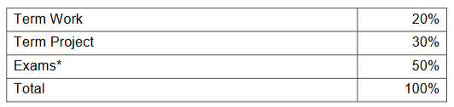
Assignments and Evaluation
Term Work:
Pre-class Quizzes (10%)
In-class exercises, homework, participation (readiness) (10%)
Term Project:
Written Portion (20%)
Presentation (10%)
Exams:
6 Exams in-class (50%)
30-40 marks each; top 4 scores out of 5 plus Pricing
Must achieve 50% pass on exams to pass course.
Notes:
Readiness = pre-read chapter, use MyLab resources to test learning, complete Moodle quizzes
Term Project – Individual marks, work in pairs – Jan 24 – Project Preparation and Pairings class (mandatory!)
Exams – 6 in-class; Pricing exam mark plus top 4 of remaining 5

Slide 10
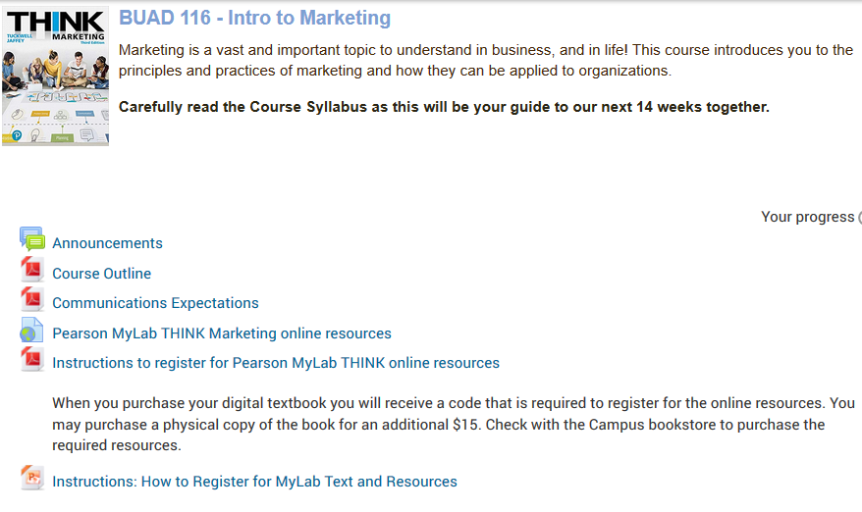
Moodle and MyLab
Notes:
Textbook
Course Syllabus
Link to Pearson MyLab – eText and online resources
Communication Expectations
Student Assistance

Slide 11
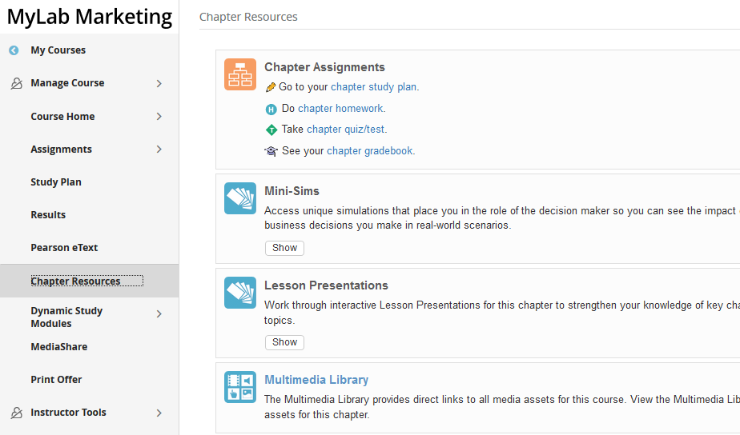
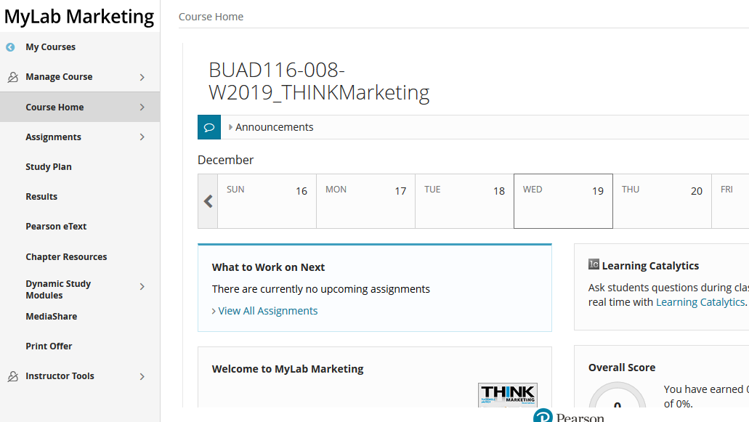
Moodle and MyLab
Notes:
Log into MyLab to show course resources
E-Textbook
Chapter Resources

Slide 12



Pearson eText App
Study anytime, anywhere!
Read your text anywhere you go
Offline access
Store bookmarks and notes
Highlight key passages
Access all your Pearson eTexts in one place, including your MyLab and Mastering courses!
Download eText for FREE
iPhone and iPad
Presentation Title Arial Bold 7 pt
12

Slide 13


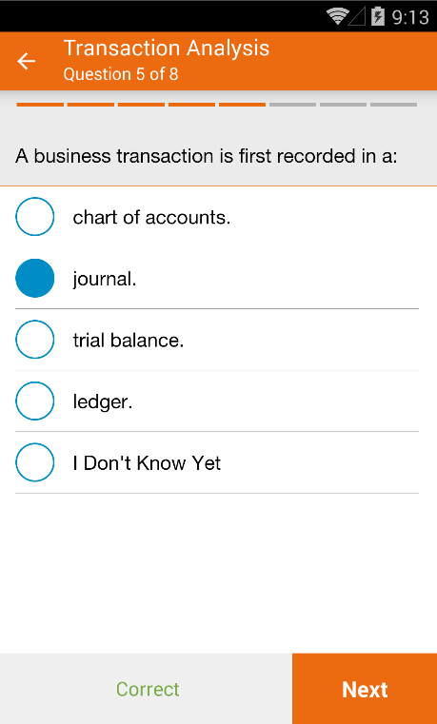
MyLab/Mastering Study Modules App
Study anytime, anywhere!
Questions delivered in groups of 6-8
Indicate how confident you are
Learn faster by asking and answering questions
Highlights areas for review
Learn at your own pace with personalized learning
Download for FREE
iPhone and iPad
Notes:
Dynamic Study Modules present study questions, delivered in groups of 6-8 questions for short bursts of learning to keep reduce fatigue Even though you might not have studied the material yet, recent scientific findings demonstrate that the process of asking and answering questions first actually triggers the brain to learn faster.

Slide 14
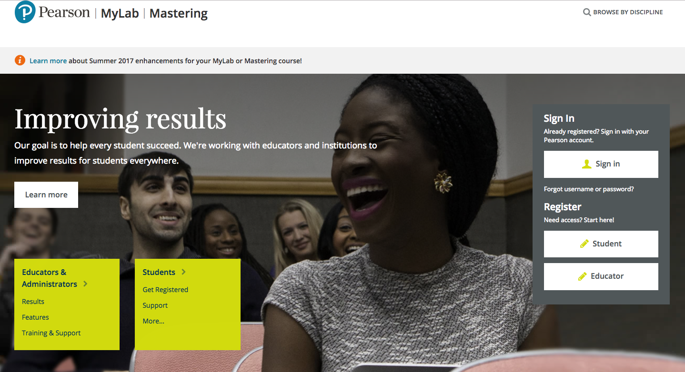
Step 1: Go to www.pearsonmylabandmastering.com
(We recommend you use Chrome or Firefox)
Select Register-Student

Slide 15
Step 2: Confirm you have...
Email Address
Course ID
Access Code
Make sure it’s one you check often —your school email will probably be the best bet.
Your instructor will provide this.
Your Course ID is: jaffey61604
Either enter the code you purchased from the bookstore (packaged or alone), or have your credit card or PayPal account ready.

Slide 16
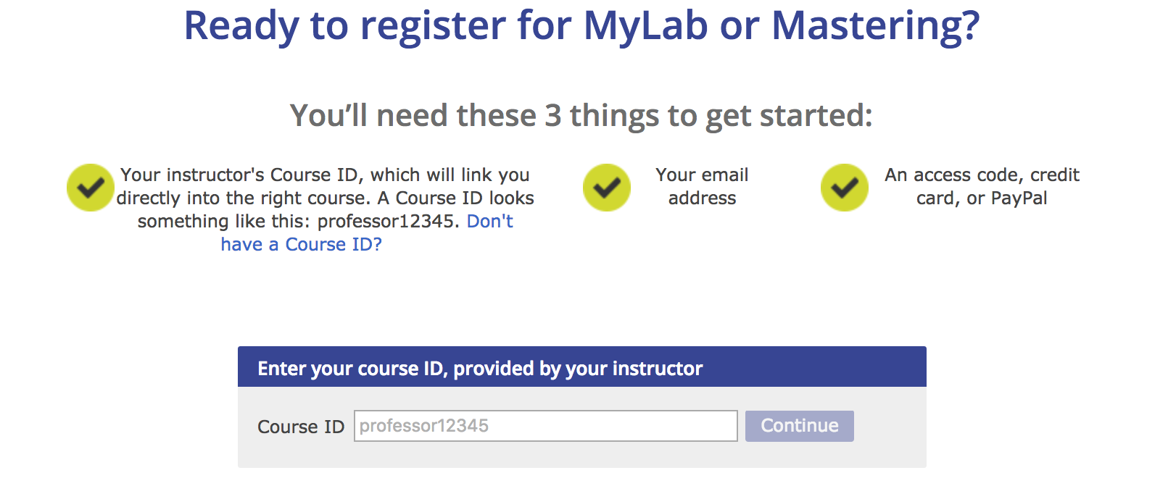
Step 3: Enter your Course ID
Your Course ID is: jaffey61604

Slide 17
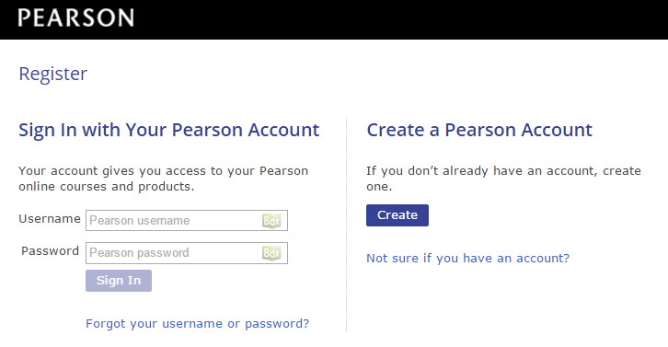
Step 4: Sign in or create an account
On the next page, you will be asked to create a Pearson account or sign into an existing Pearson account.
If you already have a Pearson Account (if you have used a Pearson product in one of your other courses), sign in with your Pearson account.
If this is your first time registering for a Pearson product, click Create and fill out the necessary information.

Slide 18
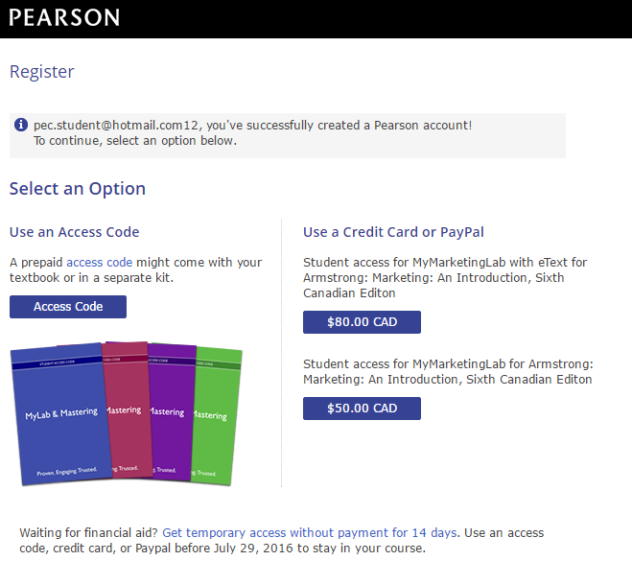
Step 5: Select your access option
Option One:
“Use an Access Code”
Choose this option if you purchased your access code at the book store, either on its own or packaged up with a print textbook or loose leaf text.

Slide 19
Step 5: Select your access option
Option Two:
“Use a Credit Card or PayPal”
Choose this option if you have not yet purchased your access code. This will give you immediate access to the product.
Your options may include:
MyLab + eText **BEST VALUE!**
MyLab + loose leaf print
MyLab alone
*Note: if you purchase MyLab alone, you can later “upgrade” your package to include the eText or loose leaf.

Slide 20
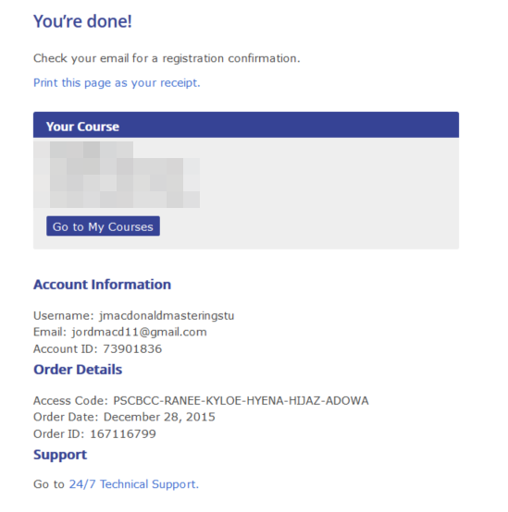

Step 6: You’re done!
When you see the “You’re done!” screen, you have successfully completed registration. Print the confirmation screen for your records (you will also receive an email).
Click Go to My Courses and select your course to begin.

Slide 21
How to be successful in 116
You are expected to complete the MyLab Chapter study aids PRIOR to class.
BEFORE the class
Pre-Read your Textbook
Use MyLab resources
Do the quizzes
IN CLASS
Participate: exercises, discussion, presentations
Bring your devices (go online)
Work with your peers (in and out of class)
The in-class work builds off the MyLab study.
Notes:
If you do not do the pre-work, you will not be prepared for class, you will not be contributing to your groups and you will be letting yourself, your classmates and your professor down.

Slide 22
Class Schedule and Structure
Tuesdays and Thursdays, 12:30 – 1:50
Classroom H115
Office Hours or by appointment
Tu/Th ~2:00 p.m. to 5:00 p.m. in C274
Wed ~12:30 p.m. to 3:00 p.m. in C274
Subject to change – published on Moodle
Notes:
Hand-outs – 40-45 copies of course syllabus

Slide 23
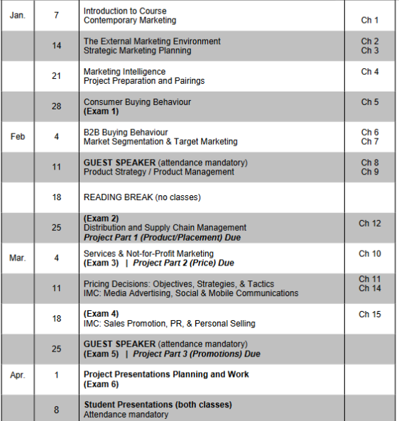
Course Schedule

Slide 24
AGENDA
Introductions
Course Outcomes
Assignments and Evaluation
Moodle
Schedule and structure
Class Expectations
Chapter 1

Slide 25
Expectations | Instructor
What you can expect from me
In class on time and prepared
Regular office hours and by appointment
Available by email, phone/text*
Respectful & supportive attitude and classroom
Open to suggestions and willing to adapt
Other?
Notes:
*email preferred; text if URGENT
Other expectations not listed?

Slide 26
Expectations | Students
My expectations of you
In class on time (START @ 12:30)
Prepared to participate
Assignments submitted on time
Respectful attitude to me and each other
Check your email
Communicate any issues or concerns immediately. If you don’t tell me I can’t help you
Notes:
Moodle – Writing a Report for Me
Academic Writing Errors (AWE)
Expectations re. spelling, grammar, professional communications
HELP: Moodle – Student Assistance; Library Tutors;

Slide 27
Expectations | Classmates
What do you expect of your classmates?
Notes:
10 minutes: groups of THREE brainstorm a list
Be on-time
A class room free of distractions – cell phones, conversations, computers, etc.
Respectful and supportive attitude
Willing to communicate issues
Other?

Slide 28
Next Class:
Contemporary Marketing
Preparation:
Chapter 1 – read/skim
MyLab preparation resources
Moodle Quiz

